Slide 1
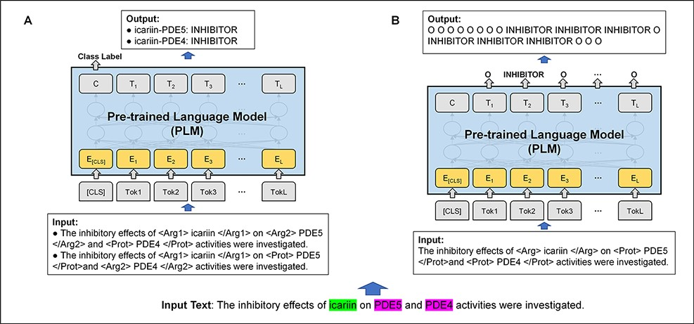
Figure 2. Example of relation extraction in text classification and sequence labeling frameworks. (A) Text ...
Notes:
Figure 2. Example of relation extraction in text classification and sequence labeling frameworks. (A) Text classification framework. (B) Sequence labeling framework. In the example, the drug of ‘icariin’ has INHIBITOR relations with the proteins of ‘PDE5’ and ‘PDE4’.
Unless provided in the caption above, the following copyright applies to the content of this slide: Published by Oxford University Press 2022. This work is written by (a) US Government employee(s) and is in the public domain in the US.This work is written by (a) US Government employee(s) and is in the public domain in the US.

Slide 2
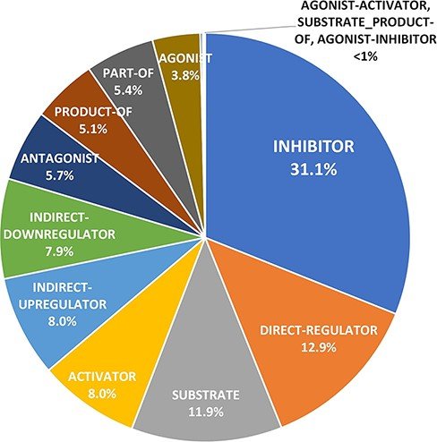
Figure 1. The distribution of the relation categories in the DrugProt in the training and development merged set.
Notes:
Figure 1. The distribution of the relation categories in the DrugProt in the training and development merged set.
Unless provided in the caption above, the following copyright applies to the content of this slide: Published by Oxford University Press 2022. This work is written by (a) US Government employee(s) and is in the public domain in the US.This work is written by (a) US Government employee(s) and is in the public domain in the US.

Slide 3
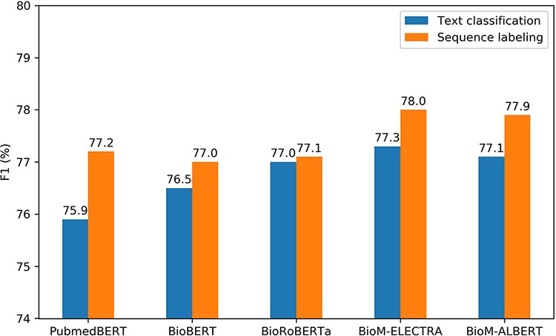
Figure 3. Performance comparison of the text classification and sequence labeling frameworks.
Notes:
Figure 3. Performance comparison of the text classification and sequence labeling frameworks.
Unless provided in the caption above, the following copyright applies to the content of this slide: Published by Oxford University Press 2022. This work is written by (a) US Government employee(s) and is in the public domain in the US.This work is written by (a) US Government employee(s) and is in the public domain in the US.

