Slide 1
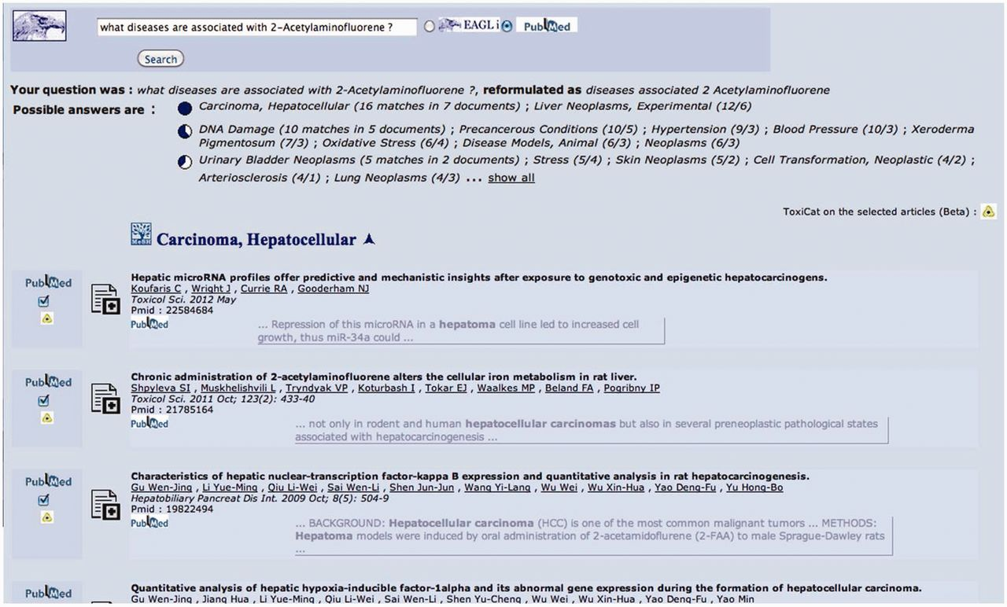
Figure 2 This is the starting point and also—if the user decides to click on the final questions generated by the ...
Notes:
Figure 2 This is the starting point and also—if the user decides to click on the final questions generated by the system, see Figure 5—the end point of the search and annotation process. Here, the user can select some PMIDs, which will be then sent to ToxiCat (Figure 3) to be prioritized (Figure 4) and finally processed to generate an annotation (Figures 4 and 5).
Unless provided in the caption above, the following copyright applies to the content of this slide: © The Author(s) 2012. Published by Oxford University Press.This is an Open Access article distributed under the terms of the Creative Commons Attribution License (http://creativecommons.org/licenses/by-nc/3.0/), which permits non-commercial reuse, distribution, and reproduction in any medium, provided the original work is properly cited. For commercial re-use, please contact journals.permissions@oup.com.

