Slide 1
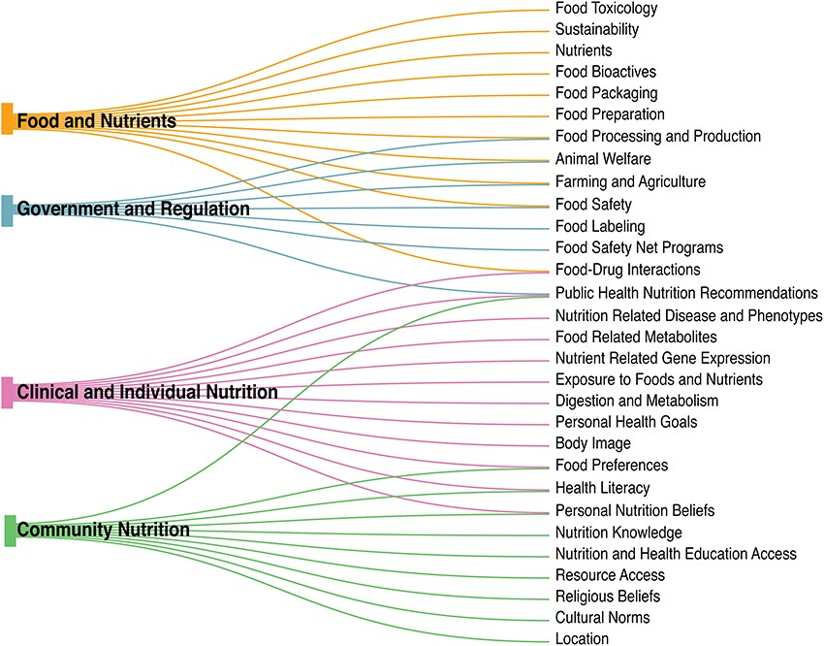
Figure 1. The nutri-informatics landscape. Nutrition is complex and heterogeneous in nature, ranging from larger ...
Notes:
Figure 1. The nutri-informatics landscape. Nutrition is complex and heterogeneous in nature, ranging from larger categories of ‘Food and Nutrients’ to ‘Government and Regulation’, yet within each broad category, many subcategories are shared.
Unless provided in the caption above, the following copyright applies to the content of this slide: © The Author(s) 2021. Published by Oxford University Press.This is an Open Access article distributed under the terms of the Creative Commons Attribution License (http://creativecommons.org/licenses/by/4.0/), which permits unrestricted reuse, distribution, and reproduction in any medium, provided the original work is properly cited.

