Slide 1
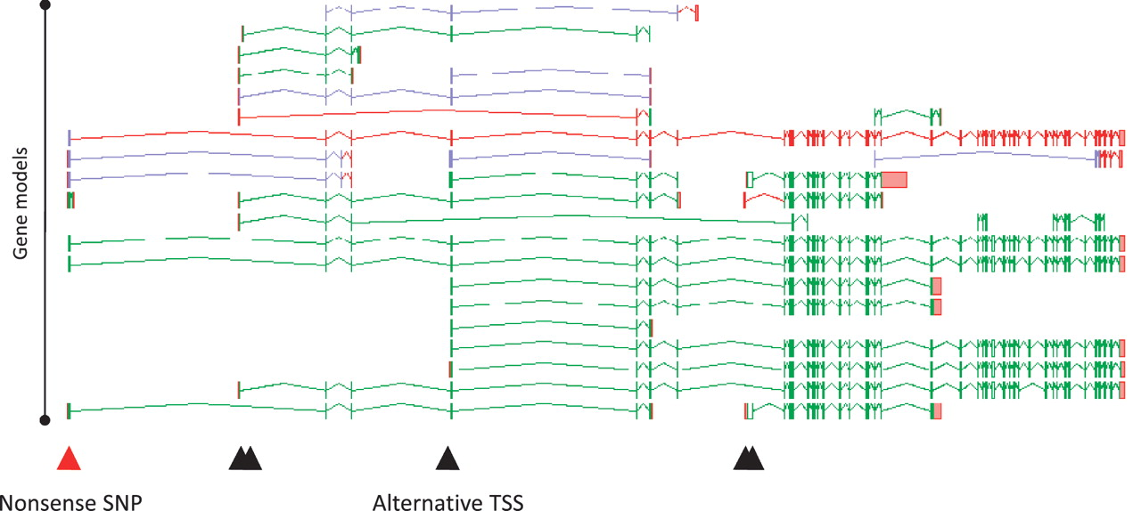
Figure 6 Zmap screenshot of all transcripts at the human PDE4DIP locus encoding phosphodiesterase 4D interacting ...
Notes:
Figure 6 Zmap screenshot of all transcripts at the human PDE4DIP locus encoding phosphodiesterase 4D interacting protein. The red arrowhead indicates the position of a disabling nonsense SNP, black arrowheads indicate the positions of alternative TSSs.
Unless provided in the caption above, the following copyright applies to the content of this slide: © The Author(s) 2012. Published by Oxford University Press.This is an Open Access article distributed under the terms of the Creative Commons Attribution Non-Commercial License (http://creativecommons.org/licenses/by-nc/3.0), which permits unrestricted non-commercial use, distribution, and reproduction in any medium, provided the original work is properly cited.

