Slide 1
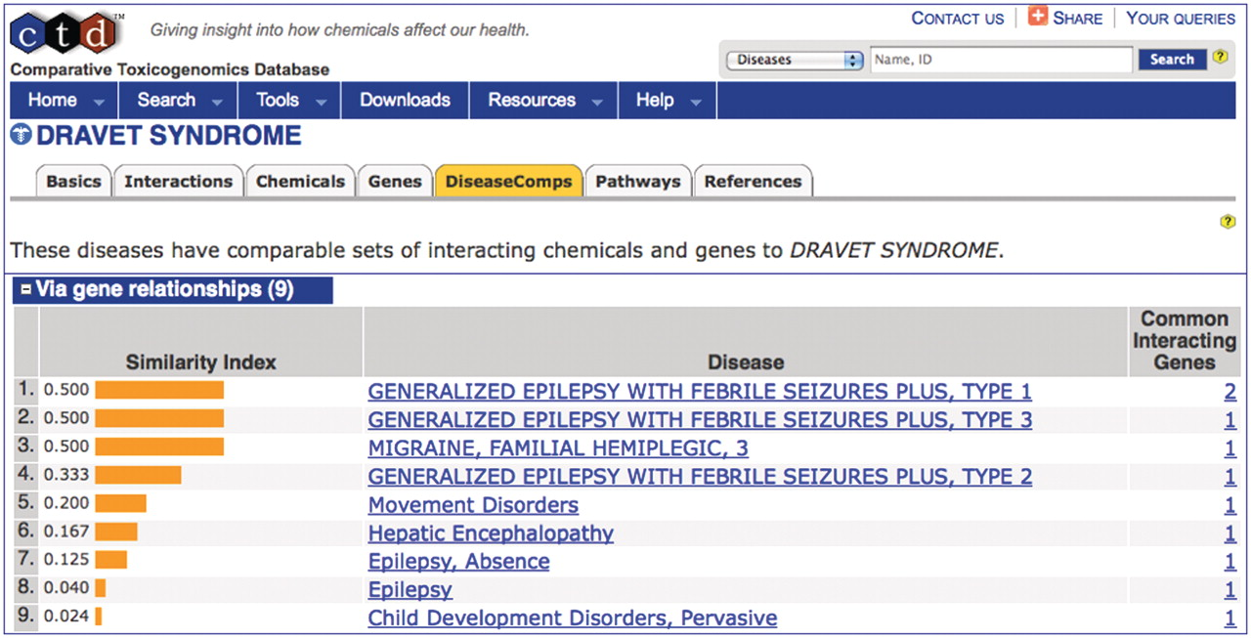
Figure 6. DiseaseComps use MEDIC. The DiseaseComps tab (orange) ranks diseases similar to ‘DRAVET SYNDROME’ based upon ...
Notes:
Figure 6. DiseaseComps use MEDIC. The DiseaseComps tab (orange) ranks diseases similar to ‘DRAVET SYNDROME’ based upon shared genes. DiseaseComps, which employs MEDIC as its disease vocabulary, ranks a mixture of both MeSH and OMIM terms (recognizable by its capitalization) based upon their similarity index. ‘DRAVET SYNDROME’ is discovered to share genes with epilepsy, migraines and hepatic encephalopathy.
Unless provided in the caption above, the following copyright applies to the content of this slide: © The Author(s) 2012. Published by Oxford University Press.This is an Open Access article distributed under the terms of the Creative Commons Attribution Non-Commercial License (http://creativecommons.org/licenses/by-nc/3.0), which permits unrestricted non-commercial use, distribution, and reproduction in any medium, provided the original work is properly cited.

