Slide 1
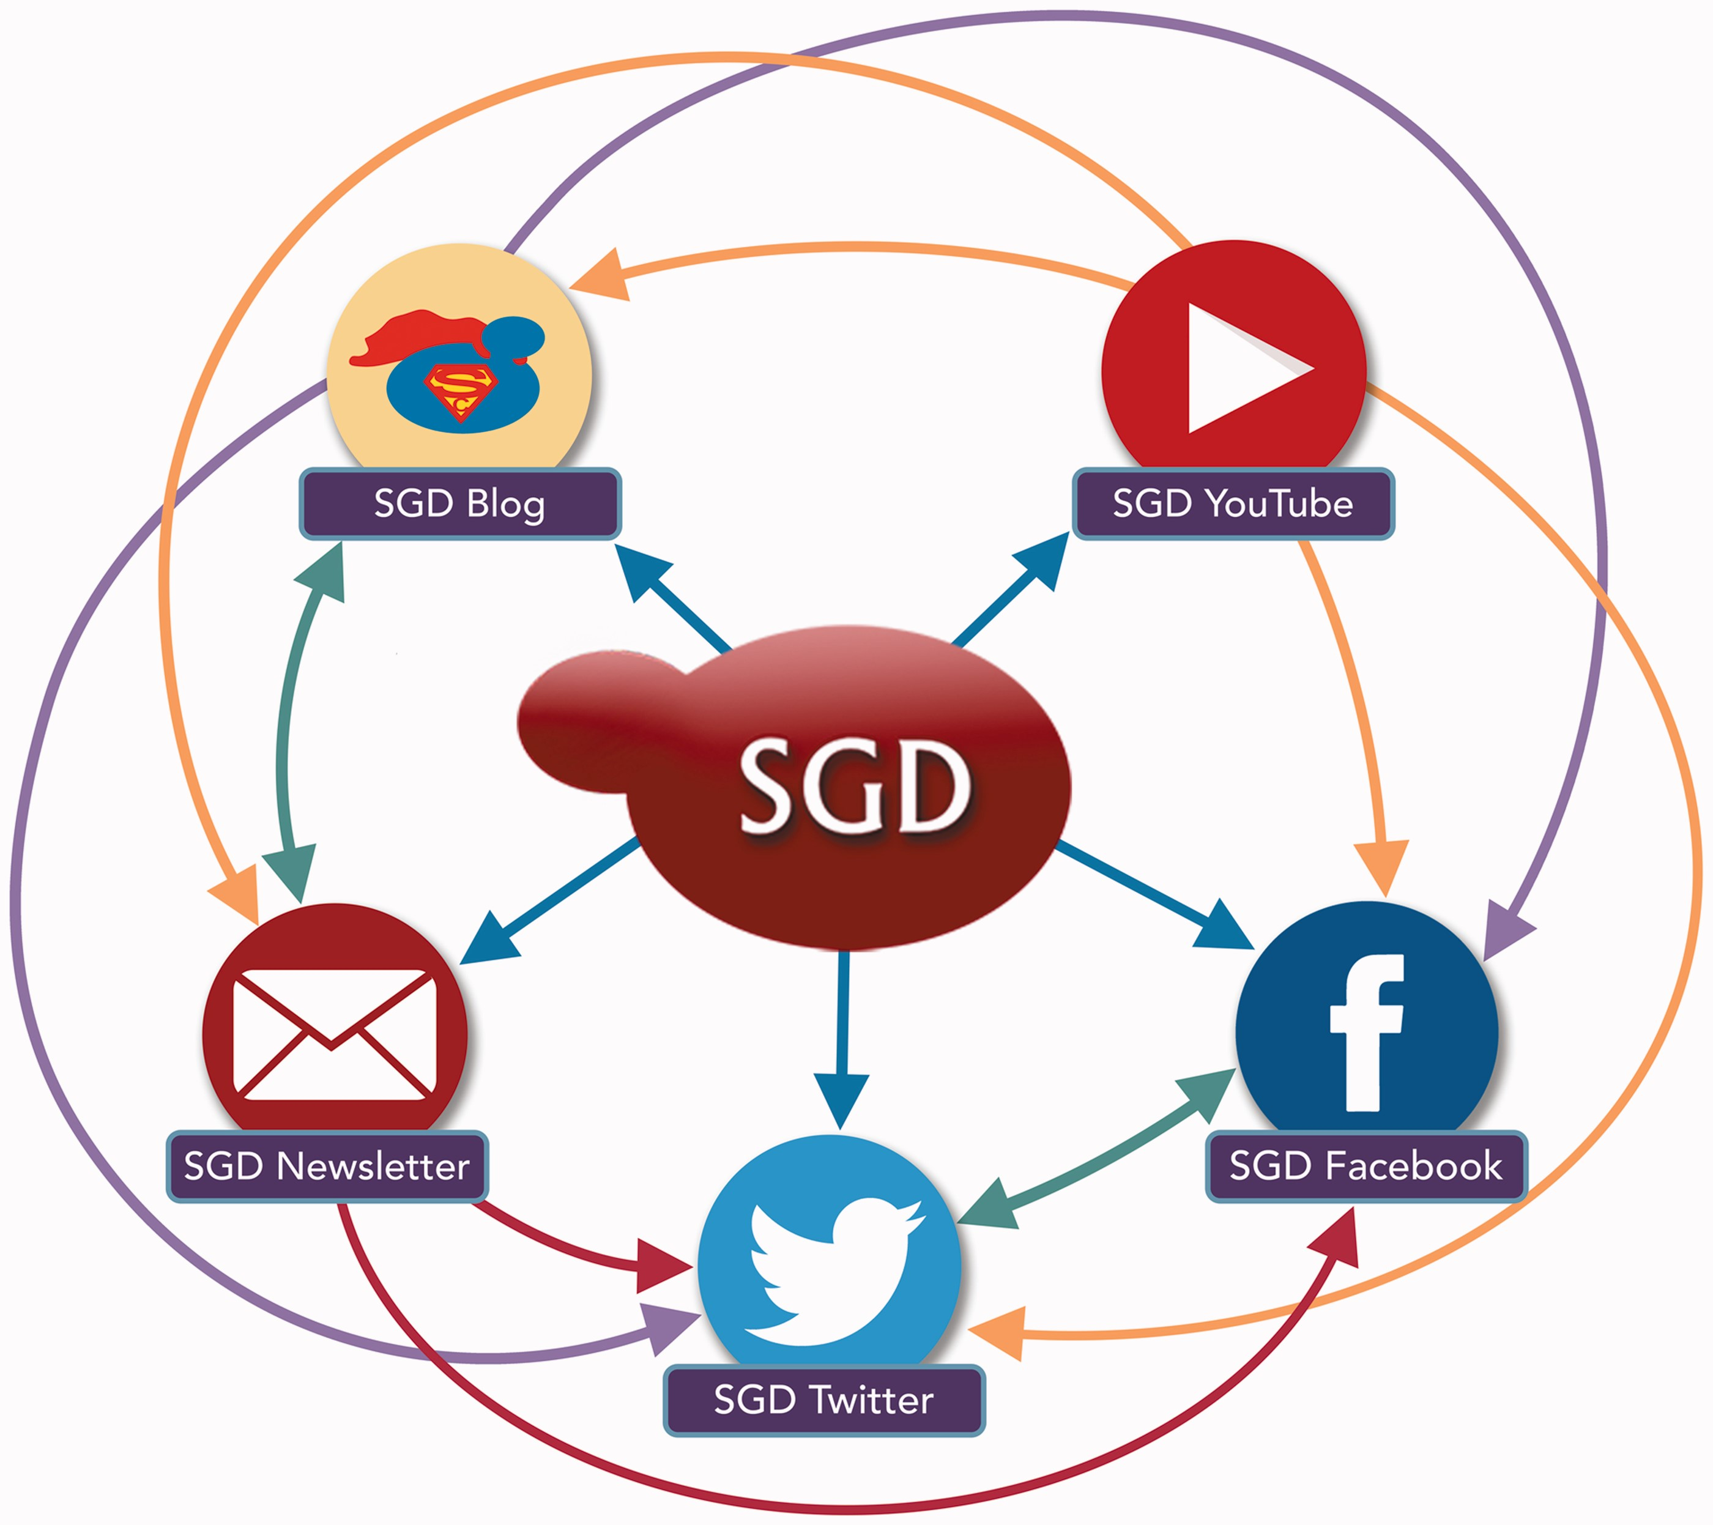
Figure 1 The SGD uses a variety of outreach and social media platforms to disseminate news and information to our user ...
Notes:
Figure 1 The SGD uses a variety of outreach and social media platforms to disseminate news and information to our user community. To increase readership and reach the broadest possible audience, content posted on one outreach platform is often publicized, announced or re-posted on other outreach platforms. Colored arrows indicate the directions in which content is pushed from one platform to another.
Unless provided in the caption above, the following copyright applies to the content of this slide: © The Author(s) 2017. Published by Oxford University Press.This is an Open Access article distributed under the terms of the Creative Commons Attribution License (http://creativecommons.org/licenses/by/4.0/), which permits unrestricted reuse, distribution, and reproduction in any medium, provided the original work is properly cited.

Slide 2
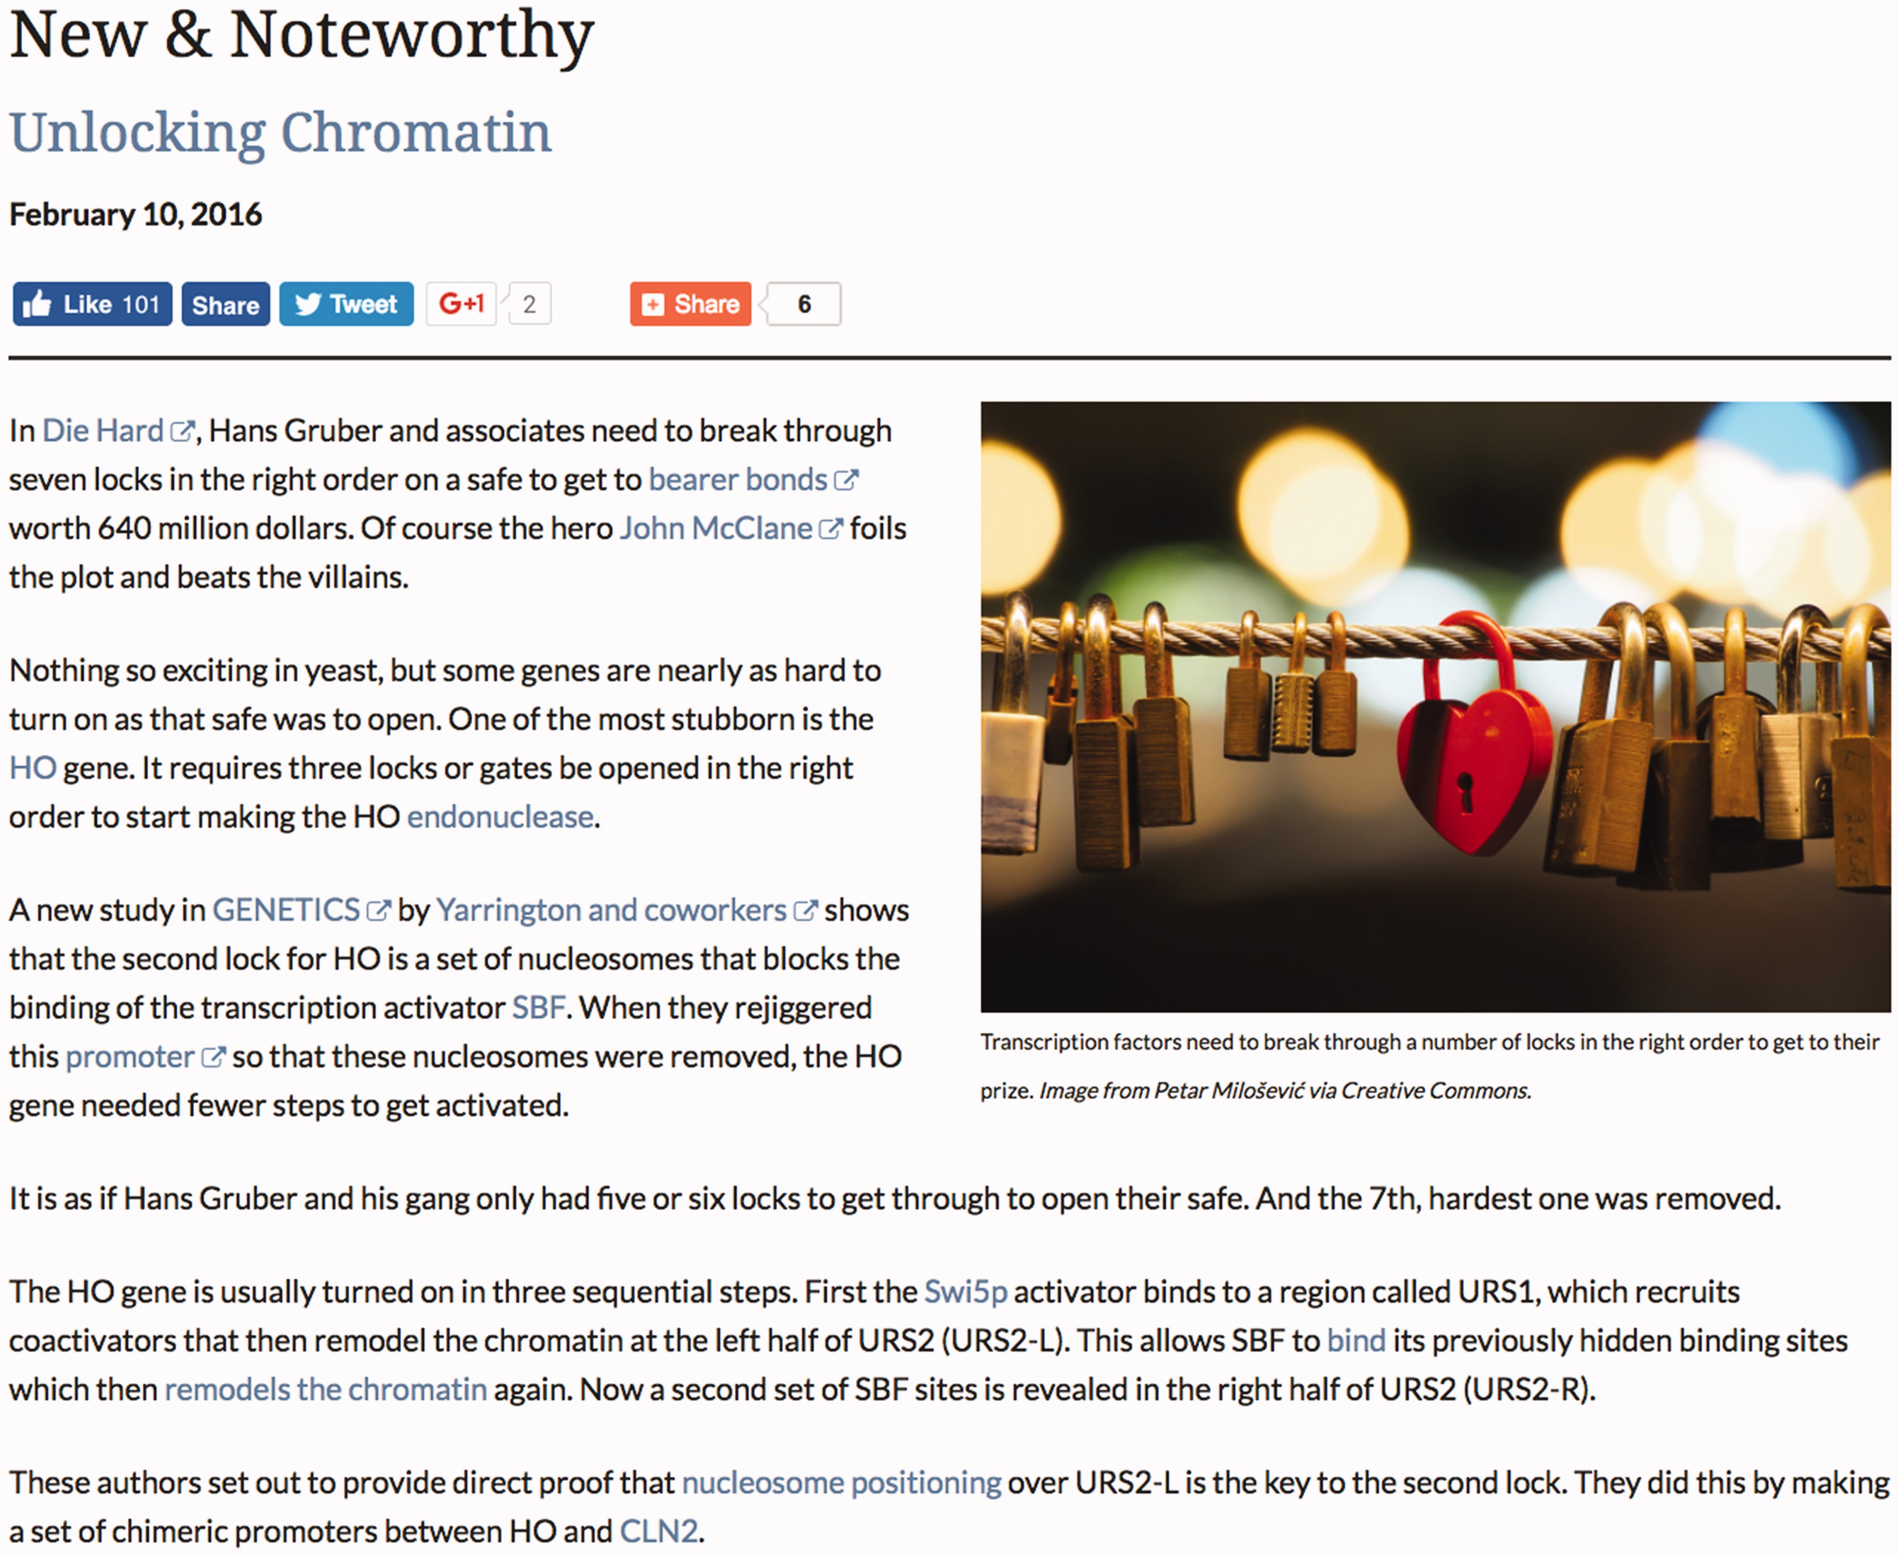
Figure 2 A key feature of the SGD blog is the Research Spotlight, which use real-world analogies to highlight recent ...
Notes:
Figure 2 A key feature of the SGD blog is the Research Spotlight, which use real-world analogies to highlight recent yeast research articles in an informal and engaging manner.
Unless provided in the caption above, the following copyright applies to the content of this slide: © The Author(s) 2017. Published by Oxford University Press.This is an Open Access article distributed under the terms of the Creative Commons Attribution License (http://creativecommons.org/licenses/by/4.0/), which permits unrestricted reuse, distribution, and reproduction in any medium, provided the original work is properly cited.

Slide 3
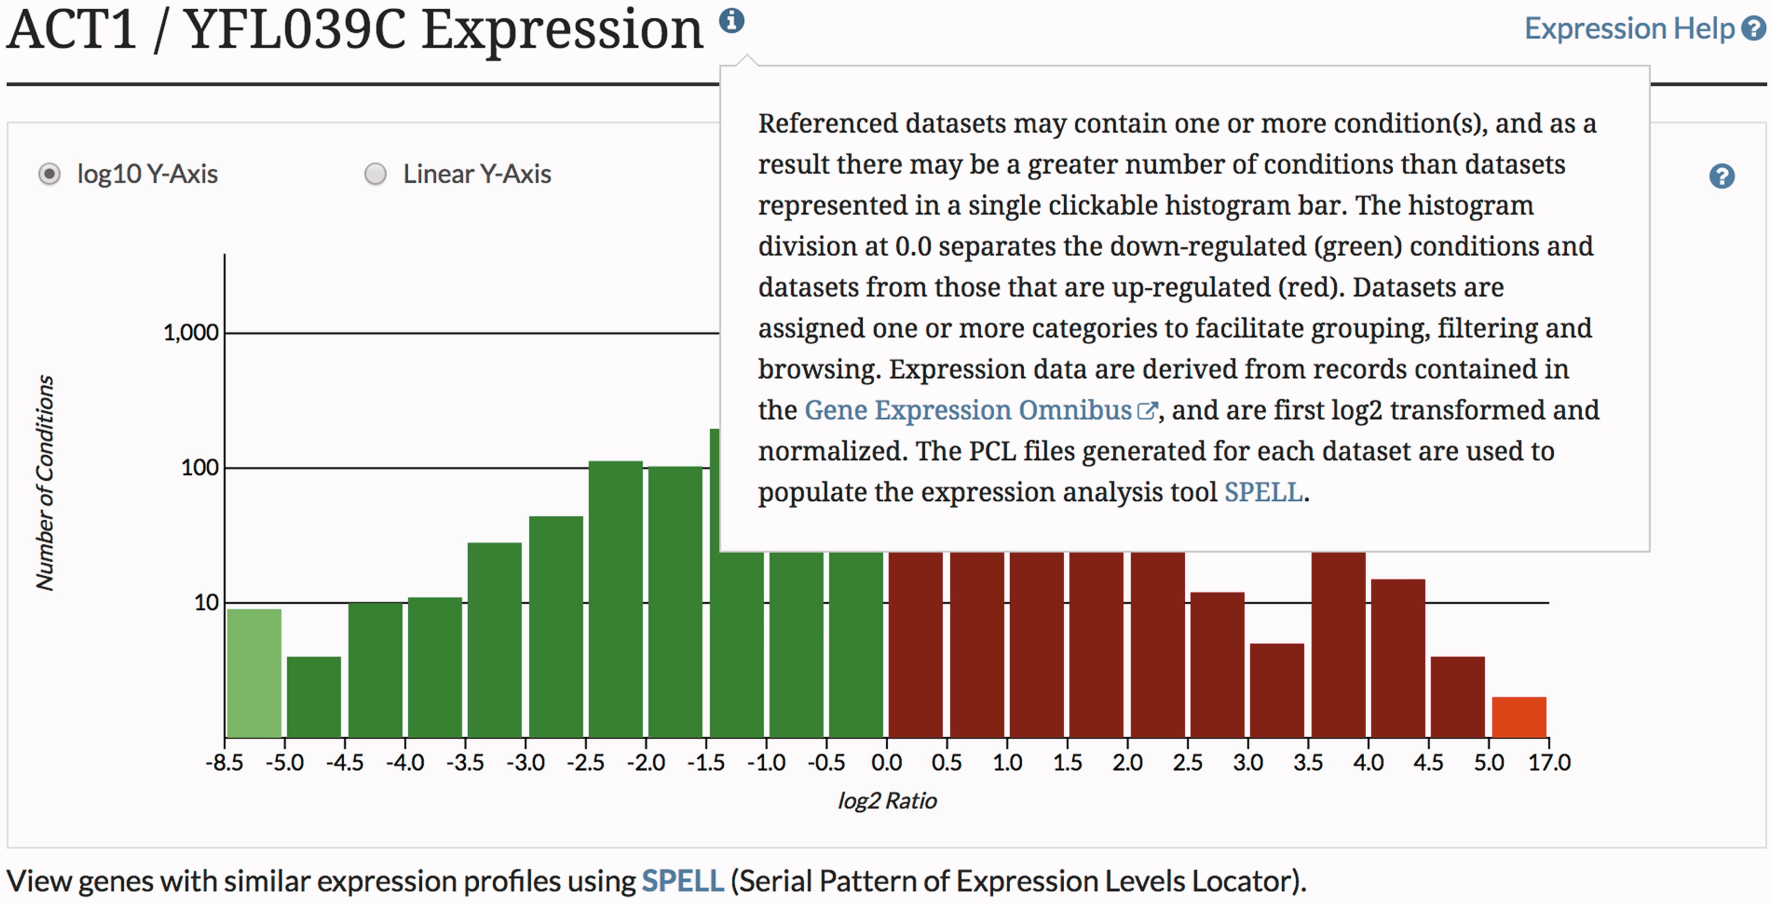
Figure 3 The SGD provides context-specific help throughout the SGD website, enabling quick in situ access to ...
Notes:
Figure 3 The SGD provides context-specific help throughout the SGD website, enabling quick in situ access to explanations of various tools and features.
Unless provided in the caption above, the following copyright applies to the content of this slide: © The Author(s) 2017. Published by Oxford University Press.This is an Open Access article distributed under the terms of the Creative Commons Attribution License (http://creativecommons.org/licenses/by/4.0/), which permits unrestricted reuse, distribution, and reproduction in any medium, provided the original work is properly cited.

Slide 4
Figure 4 The SGD distributes video tutorials via the SGD YouTube channel (youtube.com/SaccharomycesGenomeDatabase).
Notes:
Figure 4 The SGD distributes video tutorials via the SGD YouTube channel (youtube.com/SaccharomycesGenomeDatabase).
Unless provided in the caption above, the following copyright applies to the content of this slide: © The Author(s) 2017. Published by Oxford University Press.This is an Open Access article distributed under the terms of the Creative Commons Attribution License (http://creativecommons.org/licenses/by/4.0/), which permits unrestricted reuse, distribution, and reproduction in any medium, provided the original work is properly cited.

Slide 5
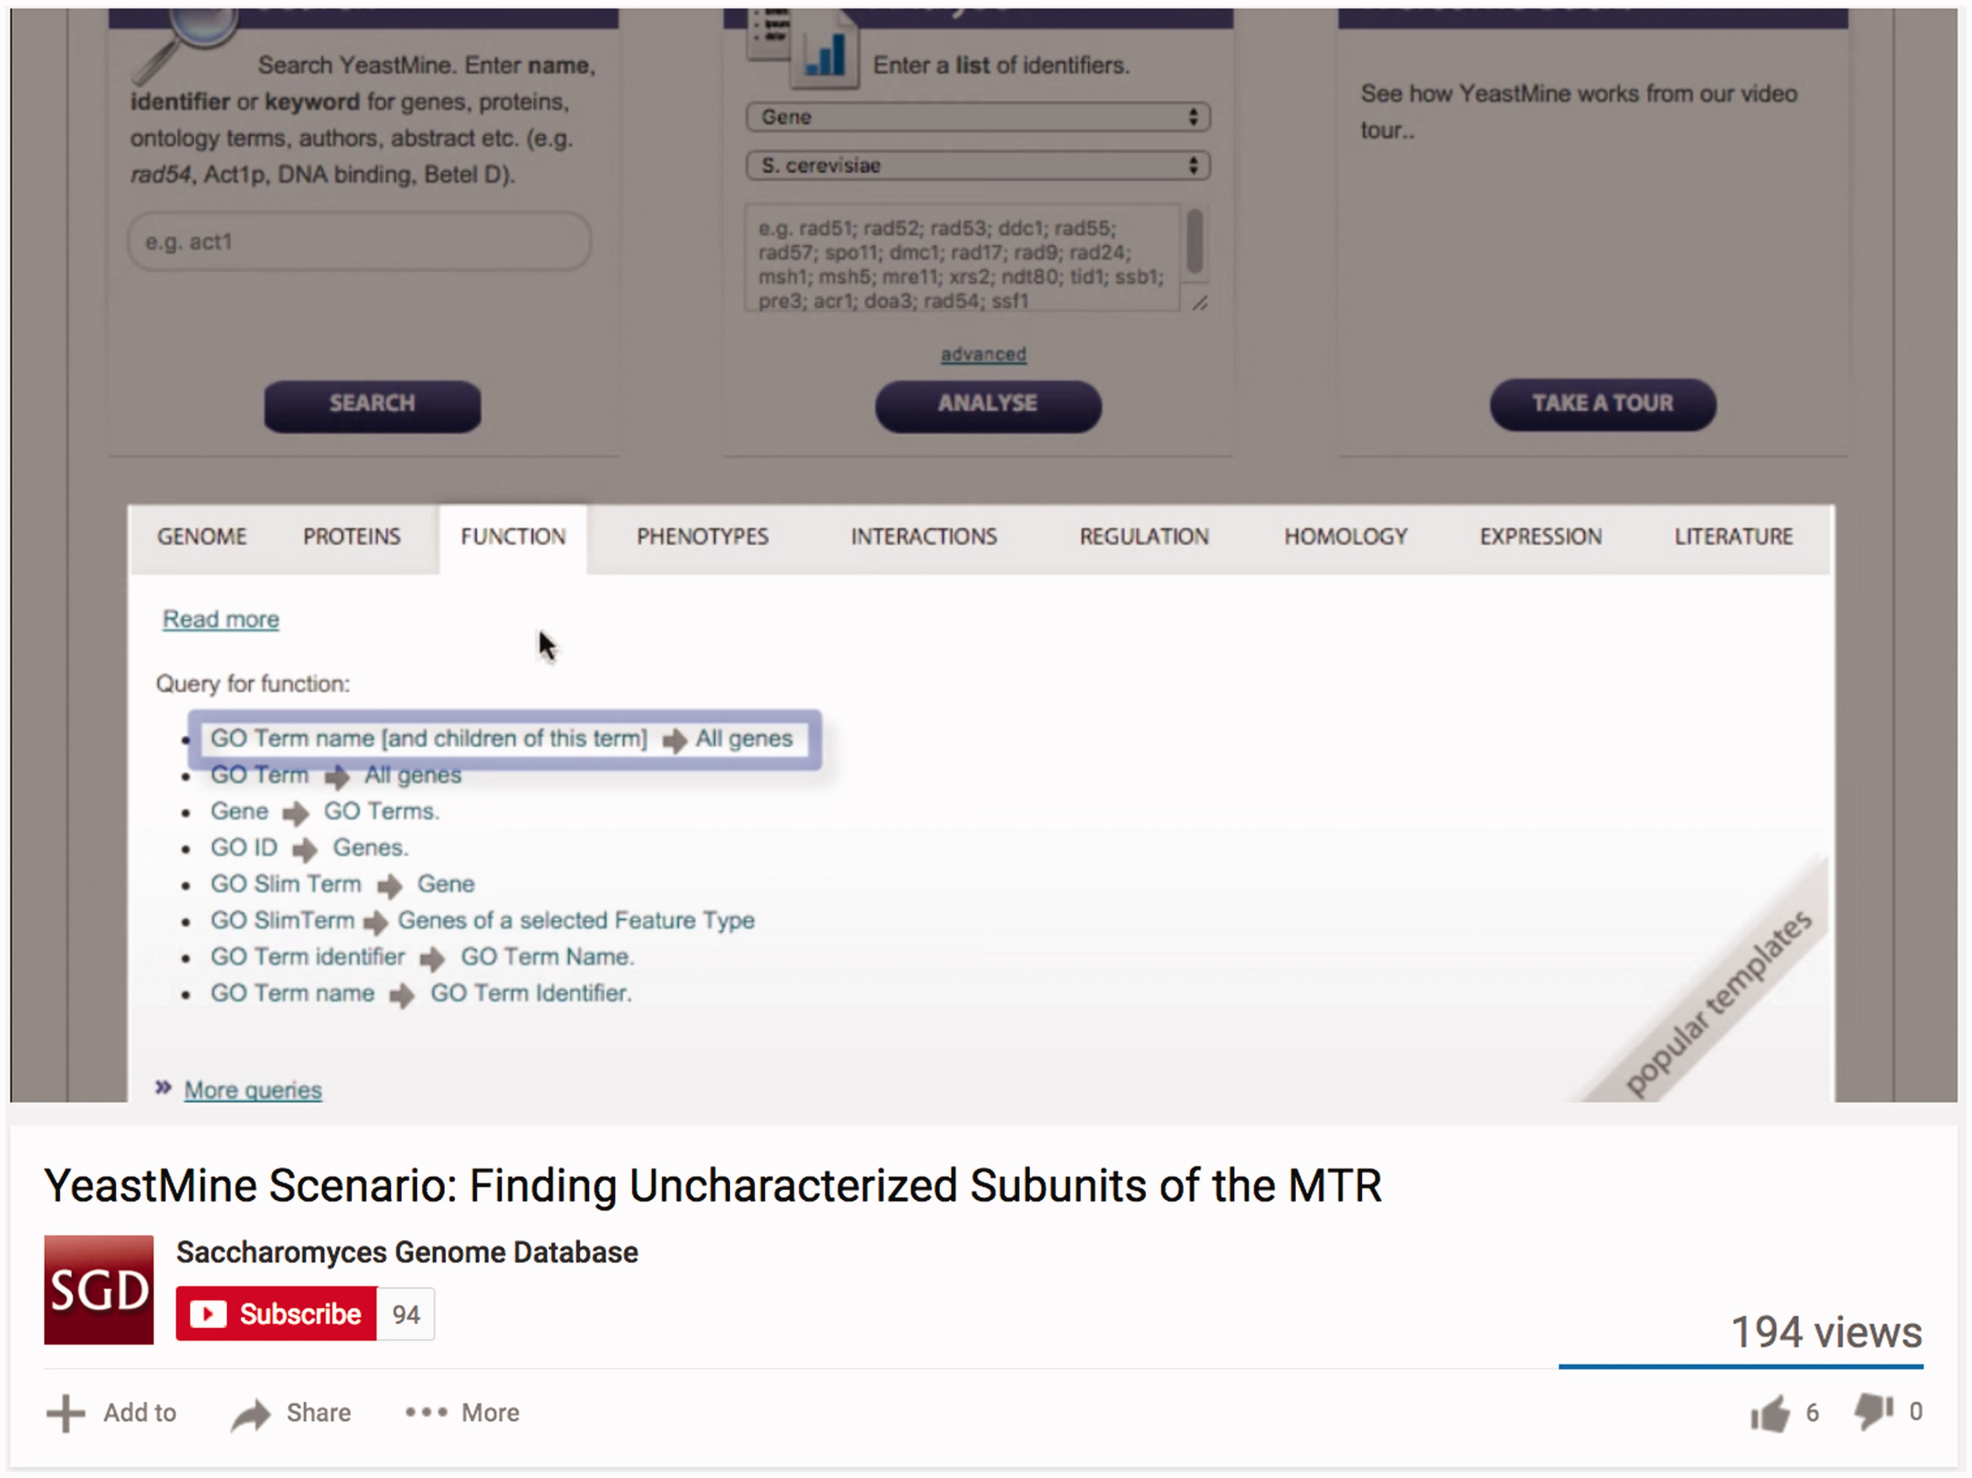
Figure 5 Camtasia software (www.techsmith.com/camtasia.html) has been used by the SGD to add simple effects and ...
Notes:
Figure 5 Camtasia software (www.techsmith.com/camtasia.html) has been used by the SGD to add simple effects and annotations to video tutorials in order to enhance clarity of the presented material.
Unless provided in the caption above, the following copyright applies to the content of this slide: © The Author(s) 2017. Published by Oxford University Press.This is an Open Access article distributed under the terms of the Creative Commons Attribution License (http://creativecommons.org/licenses/by/4.0/), which permits unrestricted reuse, distribution, and reproduction in any medium, provided the original work is properly cited.

