Slide 1
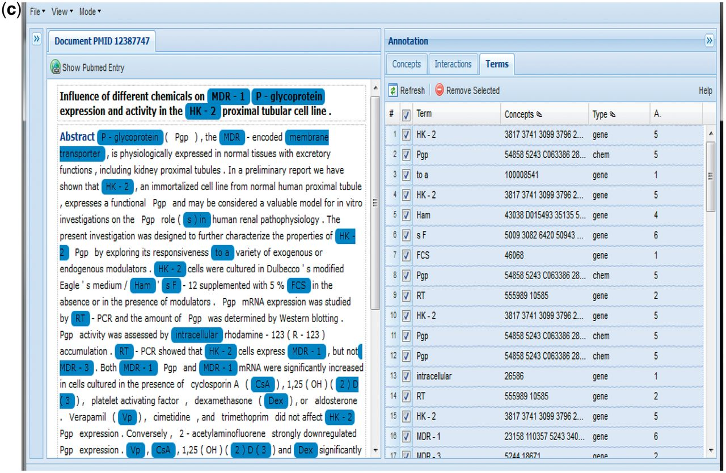
Figure 8 (a) Group 116 web interface. A screenshot of Group 116’s Concepts tab in their web interface. (b) A ...
Notes:
Figure 8 (a) Group 116 web interface. A screenshot of Group 116’s Concepts tab in their web interface. (b) A screenshot of Group 116’s Interactions tab in their web interface. (c) A screenshot of Group 116’s Terms tab in their web interface.
Unless provided in the caption above, the following copyright applies to the content of this slide: © The Author(s) 2012. Published by Oxford University Press.This is an Open Access article distributed under the terms of the Creative Commons Attribution License (http://creativecommons.org/licenses/by-nc/3.0/), which permits non-commercial reuse, distribution, and reproduction in any medium, provided the original work is properly cited. For commercial re-use, please contact journals.permissions@oup.com.

