Slide 1
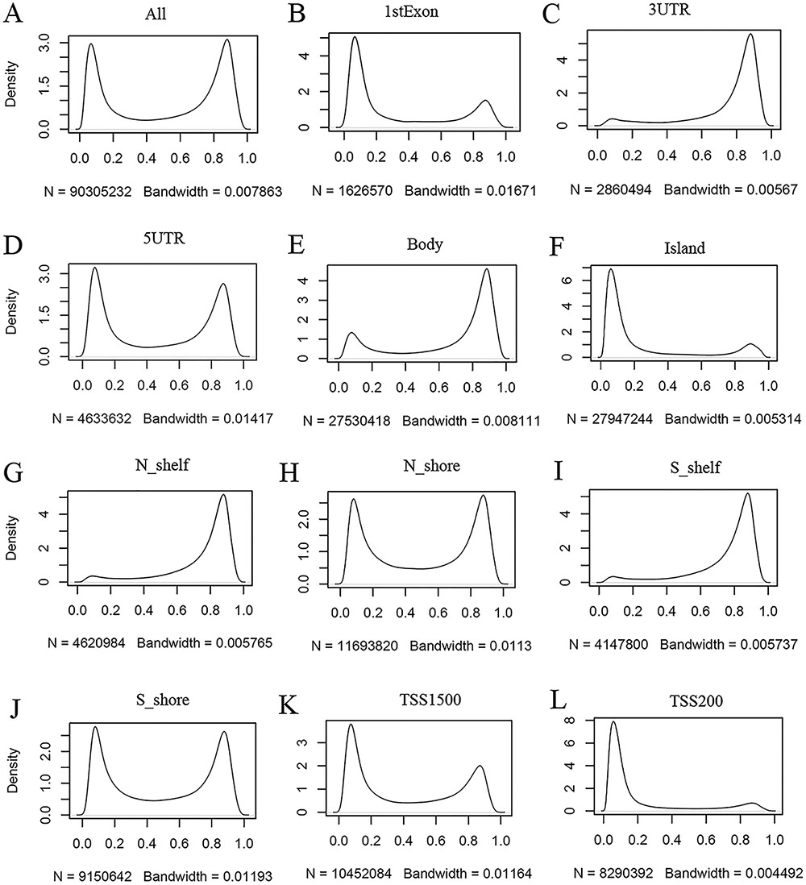
Figure 3. Kernel density estimation to show frequency distributions of beta values in different gene regions. The study ...
Notes:
Figure 3. Kernel density estimation to show frequency distributions of beta values in different gene regions. The study dataset PB_CD4T_normal (normal peripheral blood CD4+ T cells) from the 450k platform is shown as an example. Kernel density estimation was analyzed using the R function “density” with default settings. “N” indicates the total number of methylation sites analyzed in each panel while “Bandwidth” represents a measure of how closely the kernel density matches the real distribution. Lower bandwidth is generally better. A total of 186 samples in the study dataset were uniformly processed, with each sample containing 485 512 cytosine sites. Therefore, a total of 90 305 232 sites in all samples were analyzed (A). These sites can be assigned to different gene regions based on their genomic loci (from panels B to L) in the associated genes, and then, the kernel density was estimated to show the beta value distribution of the cytosine sites in each gene region, as labeled in each panel. Gene regions explain as follows: 1stExon = the first exon; 3ʹUTR = Between the stop codon and poly A signal; 5ʹUTR = Within the 5ʹ UTR, between the TSS and the translational start site; Body = Between the translational start and stop codons, irrespective of the presence of introns, exons, TSS or promoters; Island = CGI; N shelf = 2–4 kb upstream (5ʹ) of CGI; N shore = 0–2 kb upstream (5ʹ) of CGI; S shelf = 2–4 kb downstream (3ʹ) of CGI; S shore = 0–2 kb downstream (3ʹ) of CGI; TSS1500 = 200–1500 bases upstream of the TSS; TSS200 = 0–200 bases upstream of the TSS.
Unless provided in the caption above, the following copyright applies to the content of this slide: © The Author(s) 2022. Published by Oxford University Press.This is an Open Access article distributed under the terms of the Creative Commons Attribution License (https://creativecommons.org/licenses/by/4.0/), which permits unrestricted reuse, distribution, and reproduction in any medium, provided the original work is properly cited.

