Slide 1
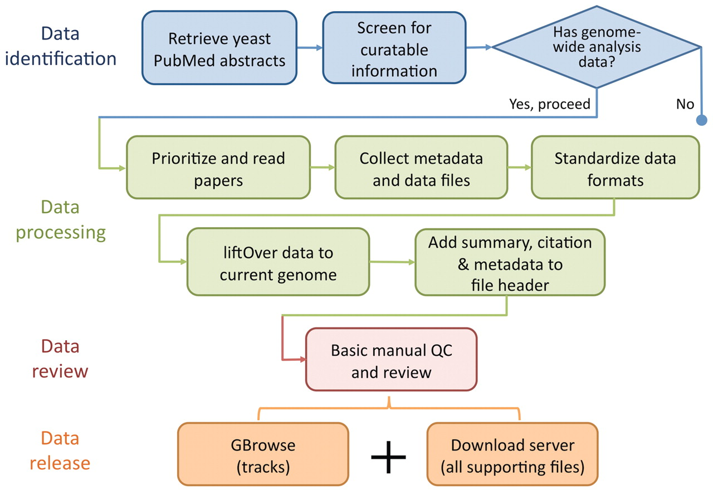
Figure 1. Flowchart showing the basic data identification, processing, review and release procedure performed by SGD ...
Notes:
Figure 1. Flowchart showing the basic data identification, processing, review and release procedure performed by SGD biocurators (blue) and bioanalysts (some blue and all other colours). SGD biocurators perform the first 3 steps in blue as part of their regular literature triage, whereas SGD bioanalysts perform steps 2 and 3 in blue following the biocurators, with an eye for collectible data to integrate (all other colours).
Unless provided in the caption above, the following copyright applies to the content of this slide: © The Author(s) 2012. Published by Oxford University Press.This is an Open Access article distributed under the terms of the Creative Commons Attribution Non-Commercial License (http://creativecommons.org/licenses/by-nc/3.0), which permits unrestricted non-commercial use, distribution, and reproduction in any medium, provided the original work is properly cited.

