Slide 1
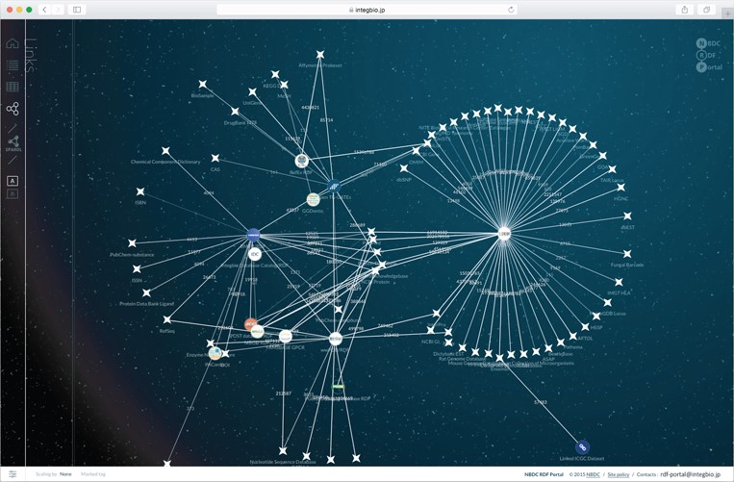
Figure 4 Network view of the NBDC RDF portal. This network view dynamically shows how the datasets are connected. The ...
Notes:
Figure 4 Network view of the NBDC RDF portal. This network view dynamically shows how the datasets are connected. The circles represent datasets registered with the RDF portal, while the stars represent external datasets. When two datasets are linked, they are connected by a straight line, and the number on the line represents the number of links.
Unless provided in the caption above, the following copyright applies to the content of this slide: © The Author(s) 2018. Published by Oxford University Press. All rights reserved. For Permissions, please email: journals.permissions@oup.comThis article is published and distributed under the terms of the Oxford University Press, Standard Journals Publication Model (https://academic.oup.com/journals/pages/open_access/funder_policies/chorus/standard_publication_model)

