Slide 1
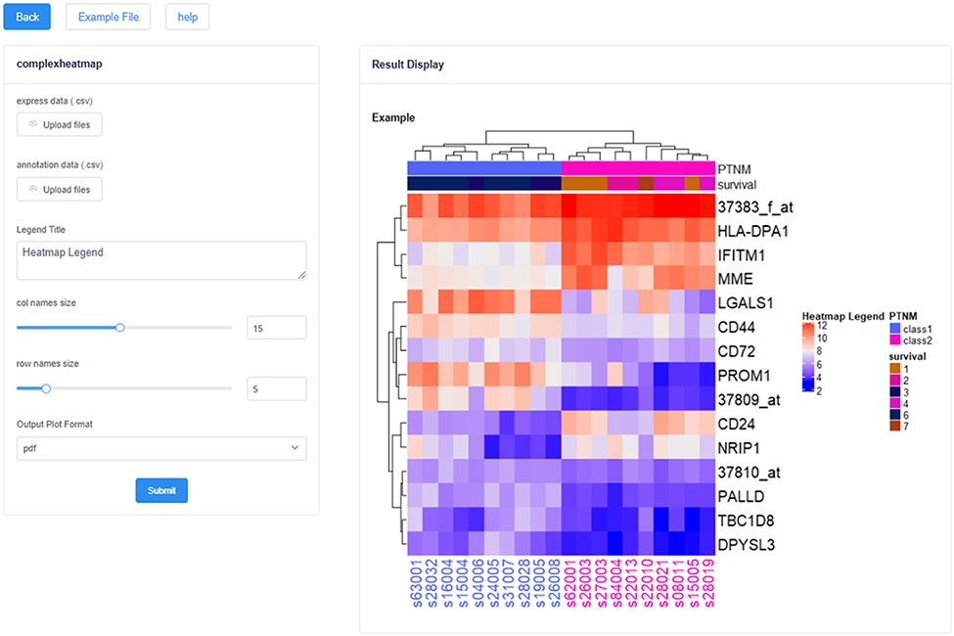
Figure 4. The heatmap visualization tool in HFIP. The left side is the data upload and parameter adjustment panel, and ...
Notes:
Figure 4. The heatmap visualization tool in HFIP. The left side is the data upload and parameter adjustment panel, and the right side is the result display and export panel.
Unless provided in the caption above, the following copyright applies to the content of this slide: © The Author(s) 2021. Published by Oxford University Press.This is an Open Access article distributed under the terms of the Creative Commons Attribution License (https://creativecommons.org/licenses/by/4.0/), which permits unrestricted reuse, distribution, and reproduction in any medium, provided the original work is properly cited.

