Slide 1
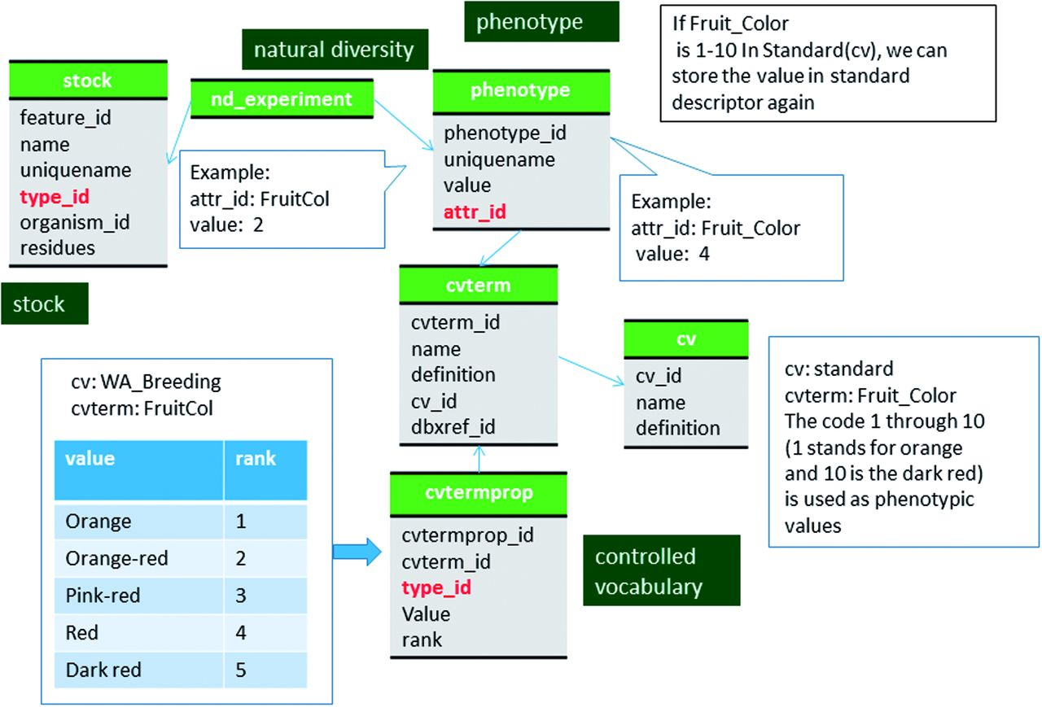
Figure 5 Schematic diagram of how coded phenotypic values are stored in Chado. The same data can be stored in two ...
Notes:
Figure 5 Schematic diagram of how coded phenotypic values are stored in Chado. The same data can be stored in two different code system to enable comparison among datasets. The bold red fields represent foreign keys to the cvterm table which houses vocabulary terms. Boxes in dark green represents the modules of Chado represented in this diagram.
Unless provided in the caption above, the following copyright applies to the content of this slide: © The Author(s) 2016. Published by Oxford University Press.This is an Open Access article distributed under the terms of the Creative Commons Attribution License (http://creativecommons.org/licenses/by/4.0/), which permits unrestricted reuse, distribution, and reproduction in any medium, provided the original work is properly cited.

