Slide 1
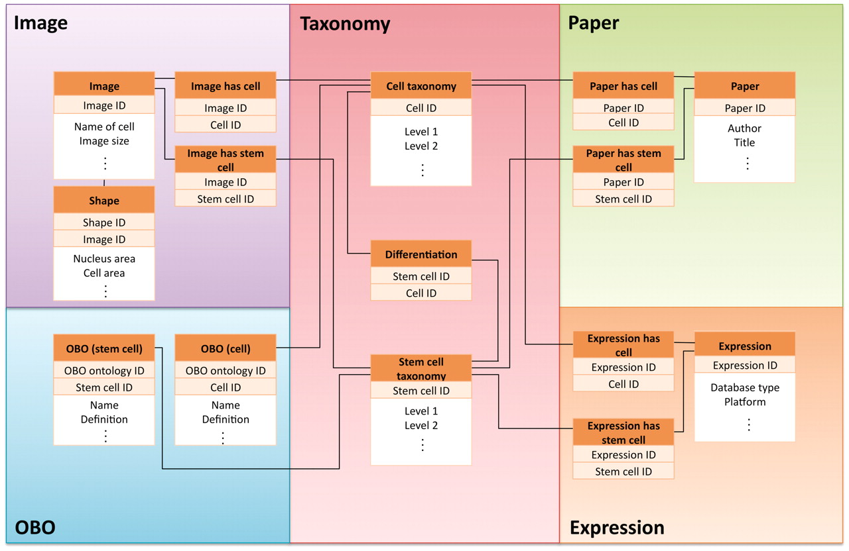
Figure 2. Simplified view of database schema used in CELLPEDIA. The database schema is designed so that as many as 15 ...
Notes:
Figure 2. Simplified view of database schema used in CELLPEDIA. The database schema is designed so that as many as 15 tables in the database can be interconnected by the backbone of the cell taxonomy keys (differentiated cell ID or stem cell ID) and other branch group keys.
Unless provided in the caption above, the following copyright applies to the content of this slide: © The Author(s) 2011. Published by Oxford University Press.This is Open Access article distributed under the terms of the Creative Commons Attribution Non-Commercial License (http://creativecommons.org/licenses/by-nc/2.5), which permits unrestricted non-commercial use, distribution, and reproduction in any medium, provided the original work is properly cited.

