Slide 1
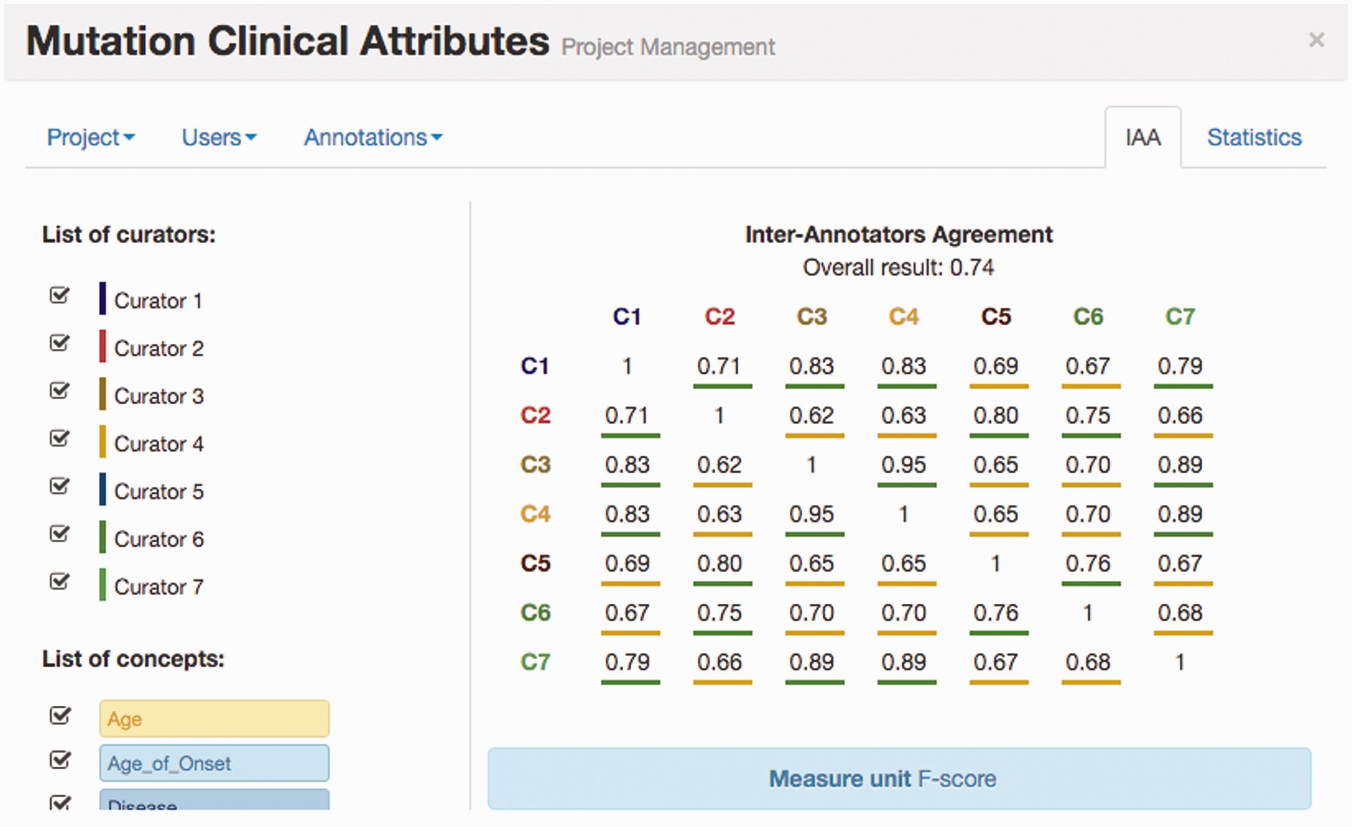
Figure 4. IAA panel in Egas. The IAA is calculated as the F -score between each pair of curators, and the average of ...
Notes:
Figure 4. IAA panel in Egas. The IAA is calculated as the F -score between each pair of curators, and the average of these values is taken as the overall result. Annotations for each concept type and each curator can be included or removed from the calculation by using the checkboxes on the left.
Unless provided in the caption above, the following copyright applies to the content of this slide: © The Author(s) 2016. Published by Oxford University Press. This is an Open Access article distributed under the terms of the Creative Commons Attribution License ( http://creativecommons.org/licenses/by/4.0/ ), which permits unrestricted reuse, distribution, and reproduction in any medium, provided the original work is properly cited.

