Slide 1
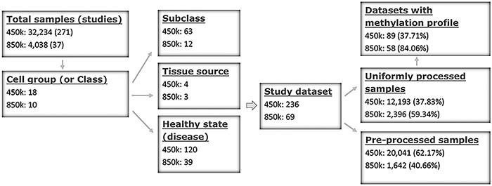
Figure 1. Sample stratification and statistics. (A) Sample or dataset counts are shown beside the platforms: for 450k, ...
Notes:
Figure 1. Sample stratification and statistics. (A) Sample or dataset counts are shown beside the platforms: for 450k, ∼37.83% (12 193/32 234) of all samples are uniformly processed, whereas, for 850k, ∼59.34% (2396/4038) of all samples are uniformly processed. In addition, ∼37.71% (89/236) and ∼84.06% (58/69) of all study datasets had methylation profiles. In total, ∼62.29% (147/236) and ∼15.94% (11/69) of all study datasets for the 450k and 850k platforms, respectively, were not uniformly processed, and for these study datasets, only the preprocessed beta values but not methylation profiles could be analyzed. For more details, please see Supplementary Tables S1 and S2.
Unless provided in the caption above, the following copyright applies to the content of this slide: © The Author(s) 2022. Published by Oxford University Press.This is an Open Access article distributed under the terms of the Creative Commons Attribution License (https://creativecommons.org/licenses/by/4.0/), which permits unrestricted reuse, distribution, and reproduction in any medium, provided the original work is properly cited.

Slide 2
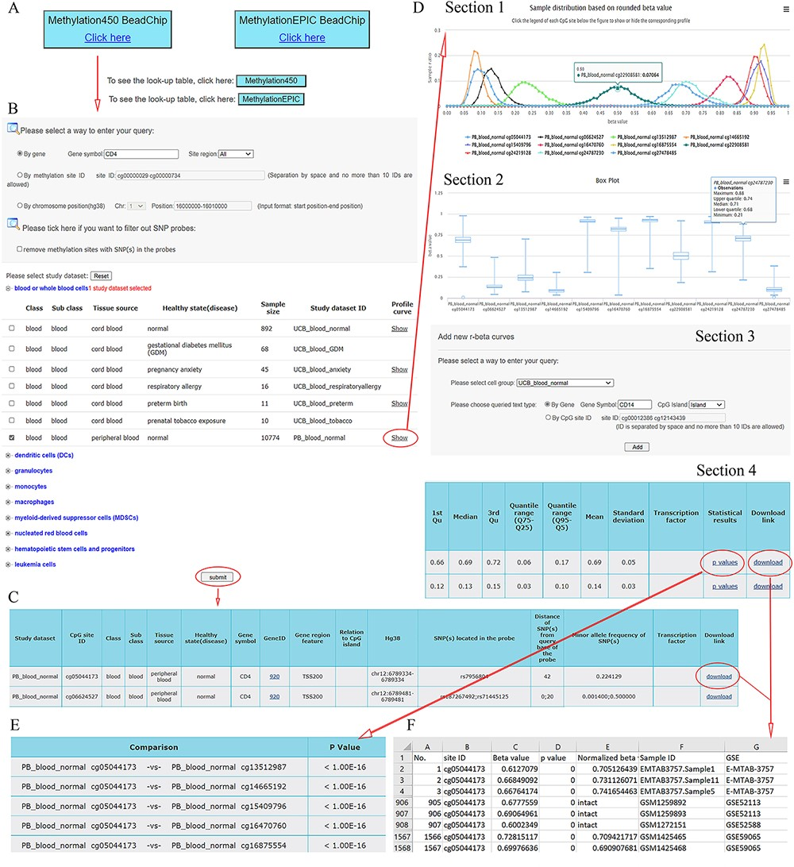
Figure 2. A workflow to navigate the database, using CD4 as an example. (A) The Methylation450 BeadChip platform is ...
Notes:
Figure 2. A workflow to navigate the database, using CD4 as an example. (A) The Methylation450 BeadChip platform is selected. B. The gene symbol “CD4” was used to search “All” possible methylation sites in the study dataset PB_blood_normal (normal human peripheral blood cells). The “Reset” button is used to deselect all study datasets. C. On the beta value result page, a basic description of all retrieved methylation sites is given. Beta values can be downloaded via the “download” button. D. On the methylation profile result page, four sections are included. Section 1 directly shows methylation profiles by the r-beta curve, which indicates the extent of MPL, the distributions of beta values and the overall methylation intensities. Section 2 uses box plots to show beta value distributions. Section 3 provides a curve addition function, facilitating the addition of new profiles for comparison. Section 4 shows the basic descriptions, such as quartiles, mean, standard deviation and quantile ranges of the beta values, for all retrieved sites. Beta values and results of statistical comparisons can be downloaded via the corresponding links. E. Statistical comparisons between the site in the indicated row and the sites in the other rows. A lower P-value indicates a greater statistical significance of the observed differential methylation levels. F. The beta value result. The meaning of the headings is shown as follows. The “p value” reflects statistical significance between the true hybridization signal and the background signal. The “intact” symbols, but not the numeric values (which represent recalculated values), in the column “Normalized beta value” indicate the beta values in the column “Beta value” represent preprocessed values that are directly from the data submitter. Sample IDs and data source study IDs are shown in the columns “Sample ID” and “GSE,” respectively. See the operation steps in the main text for more details. Web page figures are cropped to fit the page.
Unless provided in the caption above, the following copyright applies to the content of this slide: © The Author(s) 2022. Published by Oxford University Press.This is an Open Access article distributed under the terms of the Creative Commons Attribution License (https://creativecommons.org/licenses/by/4.0/), which permits unrestricted reuse, distribution, and reproduction in any medium, provided the original work is properly cited.

Slide 3
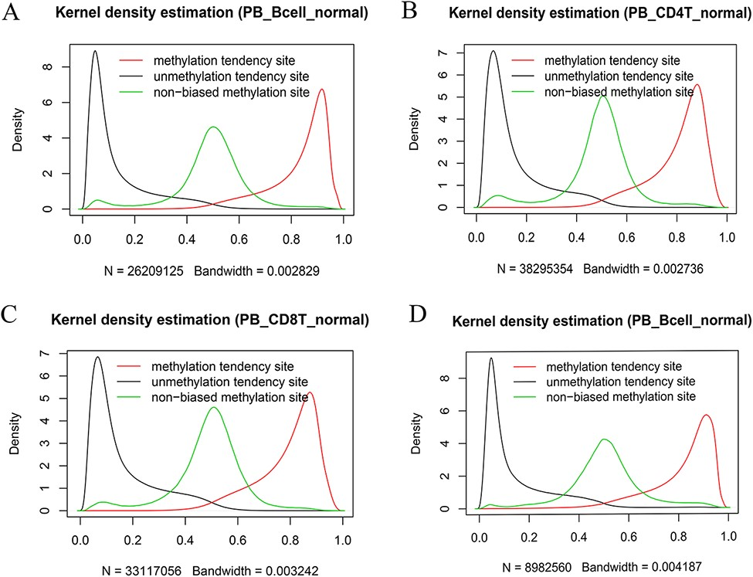
Figure 7. Kernel density estimation of beta values of the sites derived from the indicated categories. The figures show ...
Notes:
Figure 7. Kernel density estimation of beta values of the sites derived from the indicated categories. The figures show beta value distributions of the sites from MTSs, UTSs and nonbiased tendency sites in normal peripheral blood B cells (A, D), normal peripheral CD4+ T cells (B) and normal peripheral CD8+ T cells (C). Figures A, B and C are from the 450k platform, whereas D is from the 850k platform.
Unless provided in the caption above, the following copyright applies to the content of this slide: © The Author(s) 2022. Published by Oxford University Press.This is an Open Access article distributed under the terms of the Creative Commons Attribution License (https://creativecommons.org/licenses/by/4.0/), which permits unrestricted reuse, distribution, and reproduction in any medium, provided the original work is properly cited.

Slide 4
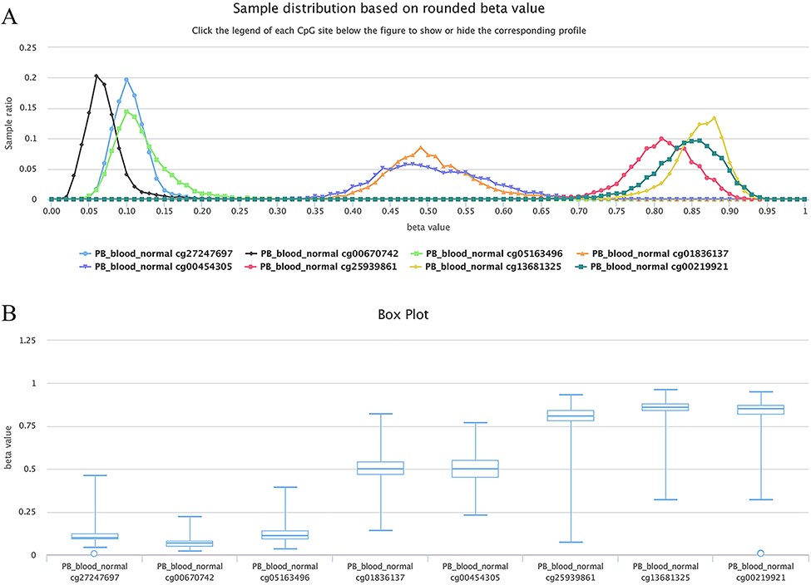
Figure 6. Examples showing methylation sites with differential methylation tendencies. (A) Methylation profiles showing ...
Notes:
Figure 6. Examples showing methylation sites with differential methylation tendencies. (A) Methylation profiles showing differential methylation tendencies. (B) Box plots showing differential methylation tendencies of the same sites in Figure A. Datasets are from the 450k platform.
Unless provided in the caption above, the following copyright applies to the content of this slide: © The Author(s) 2022. Published by Oxford University Press.This is an Open Access article distributed under the terms of the Creative Commons Attribution License (https://creativecommons.org/licenses/by/4.0/), which permits unrestricted reuse, distribution, and reproduction in any medium, provided the original work is properly cited.

Slide 5
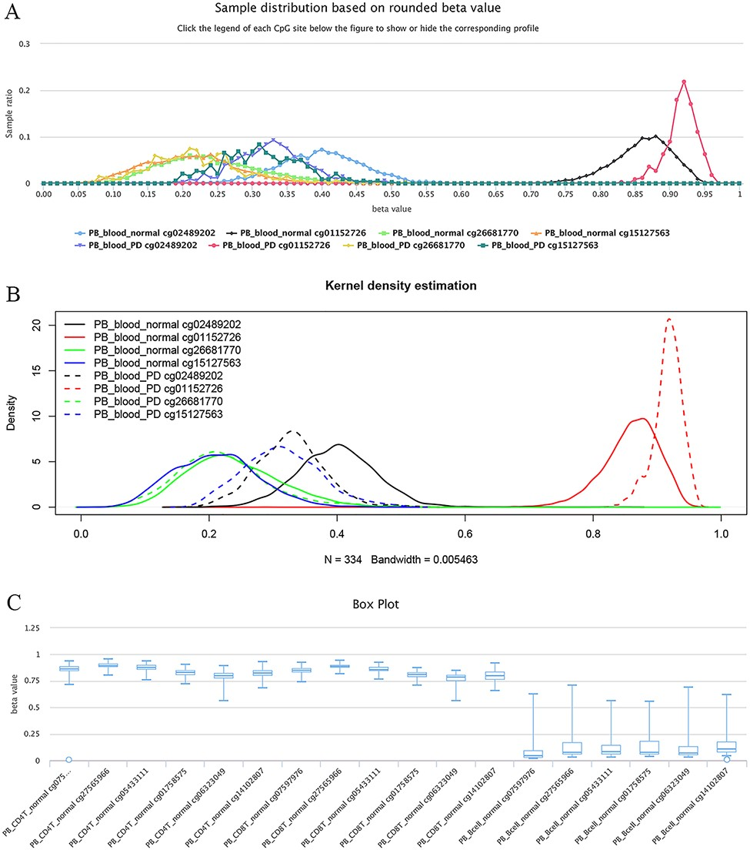
Figure 5. Examples of differential methylation sites. (A) Differentially methylated sites are illustrated by ...
Notes:
Figure 5. Examples of differential methylation sites. (A) Differentially methylated sites are illustrated by methylation profiles. In PD, site cg02489202 is hypomethylated, whereas cg01152726 is hypermethylated. However, there was no apparent differential methylation of cg26681770. Site cg15127563 shows an elevated methylation level in PD patients. The study datasets “PB_blood_normal” and “PB_blood_PD” indicate human peripheral blood samples from normal individuals (n = 5181) or individuals with PD (n = 334). The y-axis represents the sample ratio at an indicated beta value. For example, for cg01152726, there were 73 samples with a rounded beta value of 0.92, and the ratio was 73/334 ∼= 0.21856. Therefore, the accumulated square or ratio covered by each methylation profile curve is equal to 1. (B) Kernel density estimation to show frequency distributions of beta values of the sites in Figure A. Similar distributions of the same sites in Figures A and B can be observed, suggesting the feasibility and reliability of the r-beta curve to show the methylation profile. (C) Box plots showing differentially methylated sites in the CD19 gene in normal peripheral CD8+ T cells (PB_CD8T_normal, n = 161) and B cells (PB_Bcell_normal, n = 125). Datasets are from the 450k platform.
Unless provided in the caption above, the following copyright applies to the content of this slide: © The Author(s) 2022. Published by Oxford University Press.This is an Open Access article distributed under the terms of the Creative Commons Attribution License (https://creativecommons.org/licenses/by/4.0/), which permits unrestricted reuse, distribution, and reproduction in any medium, provided the original work is properly cited.

Slide 6
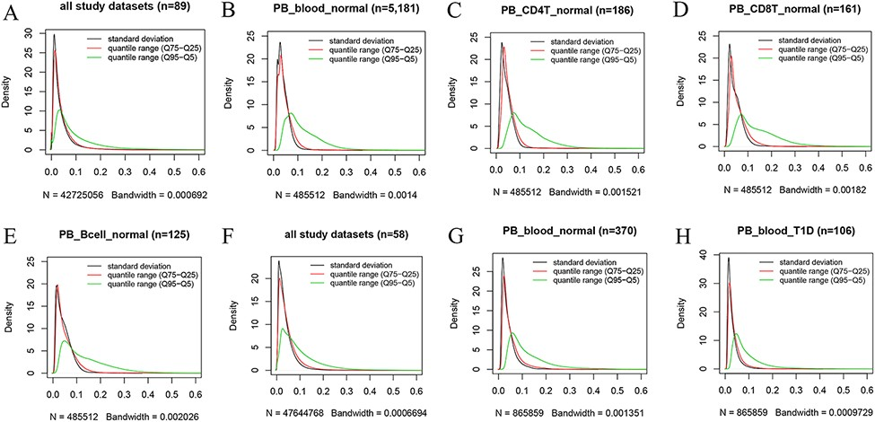
Figure 4. Kernel density estimation to show frequency distributions of standard deviation and quantile ranges. Figures ...
Notes:
Figure 4. Kernel density estimation to show frequency distributions of standard deviation and quantile ranges. Figures A to E are from the 450k platform and indicate all study datasets (A), normal peripheral blood samples (B), normal peripheral CD4+ T cells (C), normal peripheral CD8+ T cells (D) and normal peripheral B cells (E). Figures F, G and H are from the 850k platform and indicate all study datasets (F), normal peripheral blood samples (B) and peripheral blood samples from individuals with type-1 diabetes.
Unless provided in the caption above, the following copyright applies to the content of this slide: © The Author(s) 2022. Published by Oxford University Press.This is an Open Access article distributed under the terms of the Creative Commons Attribution License (https://creativecommons.org/licenses/by/4.0/), which permits unrestricted reuse, distribution, and reproduction in any medium, provided the original work is properly cited.

Slide 7
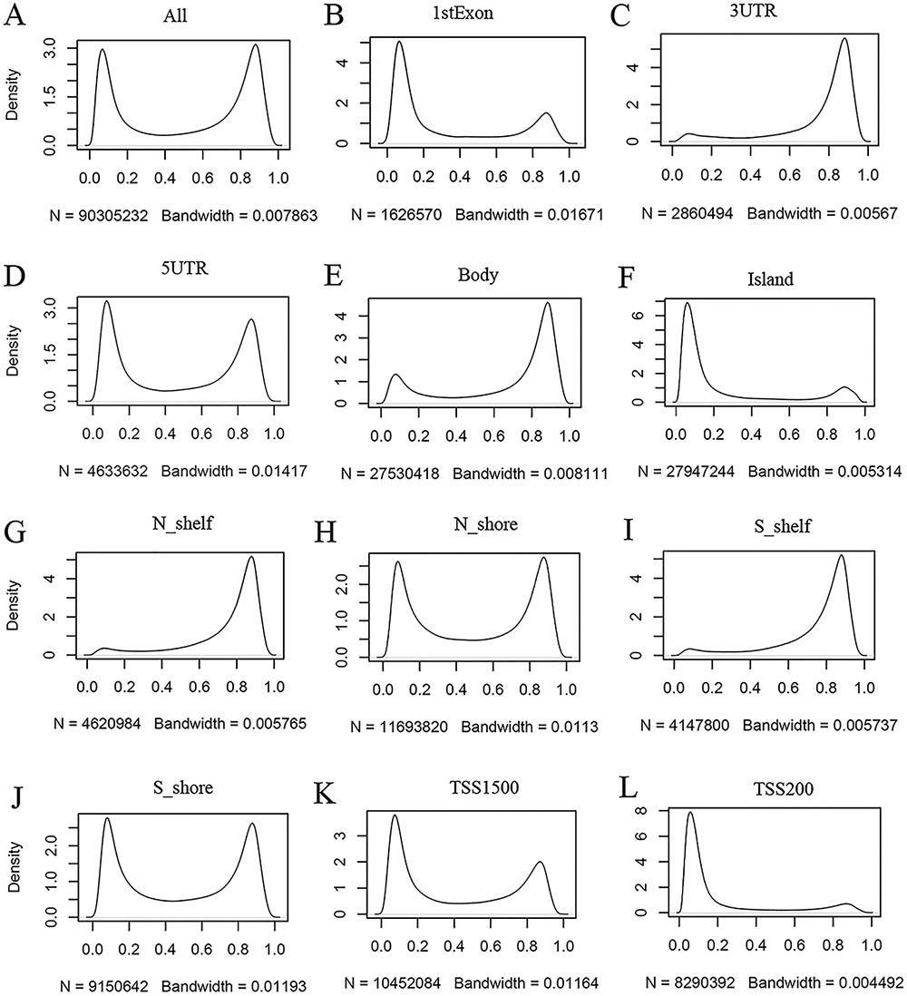
Figure 3. Kernel density estimation to show frequency distributions of beta values in different gene regions. The study ...
Notes:
Figure 3. Kernel density estimation to show frequency distributions of beta values in different gene regions. The study dataset PB_CD4T_normal (normal peripheral blood CD4+ T cells) from the 450k platform is shown as an example. Kernel density estimation was analyzed using the R function “density” with default settings. “N” indicates the total number of methylation sites analyzed in each panel while “Bandwidth” represents a measure of how closely the kernel density matches the real distribution. Lower bandwidth is generally better. A total of 186 samples in the study dataset were uniformly processed, with each sample containing 485 512 cytosine sites. Therefore, a total of 90 305 232 sites in all samples were analyzed (A). These sites can be assigned to different gene regions based on their genomic loci (from panels B to L) in the associated genes, and then, the kernel density was estimated to show the beta value distribution of the cytosine sites in each gene region, as labeled in each panel. Gene regions explain as follows: 1stExon = the first exon; 3ʹUTR = Between the stop codon and poly A signal; 5ʹUTR = Within the 5ʹ UTR, between the TSS and the translational start site; Body = Between the translational start and stop codons, irrespective of the presence of introns, exons, TSS or promoters; Island = CGI; N shelf = 2–4 kb upstream (5ʹ) of CGI; N shore = 0–2 kb upstream (5ʹ) of CGI; S shelf = 2–4 kb downstream (3ʹ) of CGI; S shore = 0–2 kb downstream (3ʹ) of CGI; TSS1500 = 200–1500 bases upstream of the TSS; TSS200 = 0–200 bases upstream of the TSS.
Unless provided in the caption above, the following copyright applies to the content of this slide: © The Author(s) 2022. Published by Oxford University Press.This is an Open Access article distributed under the terms of the Creative Commons Attribution License (https://creativecommons.org/licenses/by/4.0/), which permits unrestricted reuse, distribution, and reproduction in any medium, provided the original work is properly cited.

Slide 8
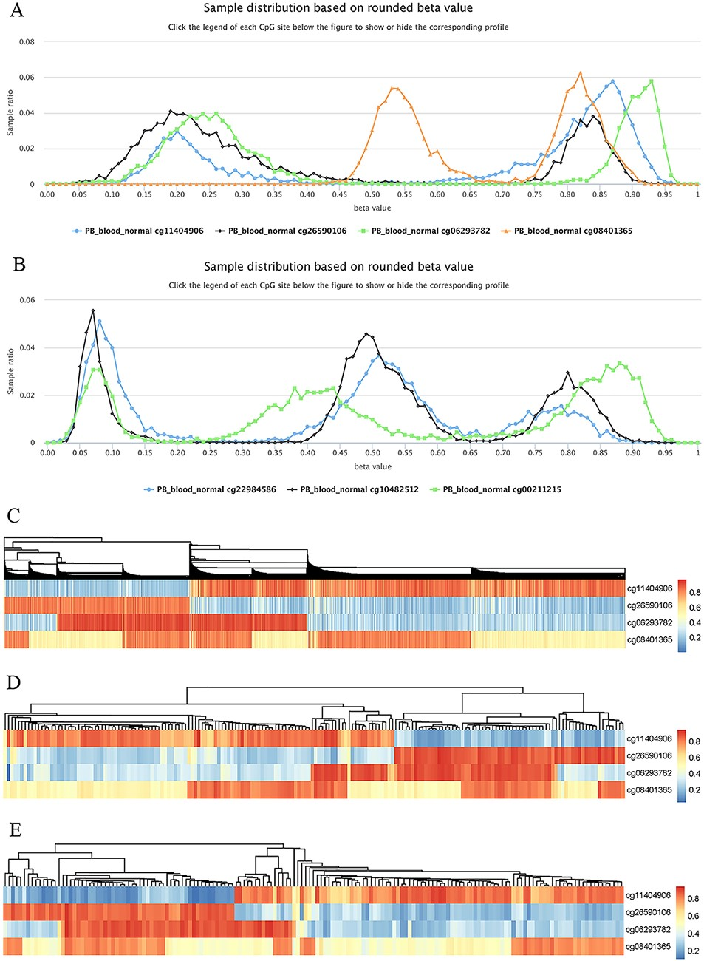
Figure 8. Examples to show split methylation sites. (A) Examples of split methylation sites with two main peaks in the ...
Notes:
Figure 8. Examples to show split methylation sites. (A) Examples of split methylation sites with two main peaks in the methylation profiles. B. Examples of split methylation sites with three main peaks in the methylation profiles. Methylation profiles in A and B are from normal human peripheral blood samples (PB_blood_normal from 450k, n = 5181). C, D and E represent heatmaps to show sample subdivisions of normal human peripheral blood samples (C), normal human peripheral CD4+ T cell samples (D) and normal human peripheral CD8+ T cell samples (E) based on the split methylation sites in A, respectively. Color bars in C, D and E indicate DNA methylation from low (blue) to high (red) beta values.
Unless provided in the caption above, the following copyright applies to the content of this slide: © The Author(s) 2022. Published by Oxford University Press.This is an Open Access article distributed under the terms of the Creative Commons Attribution License (https://creativecommons.org/licenses/by/4.0/), which permits unrestricted reuse, distribution, and reproduction in any medium, provided the original work is properly cited.

