Slide 1
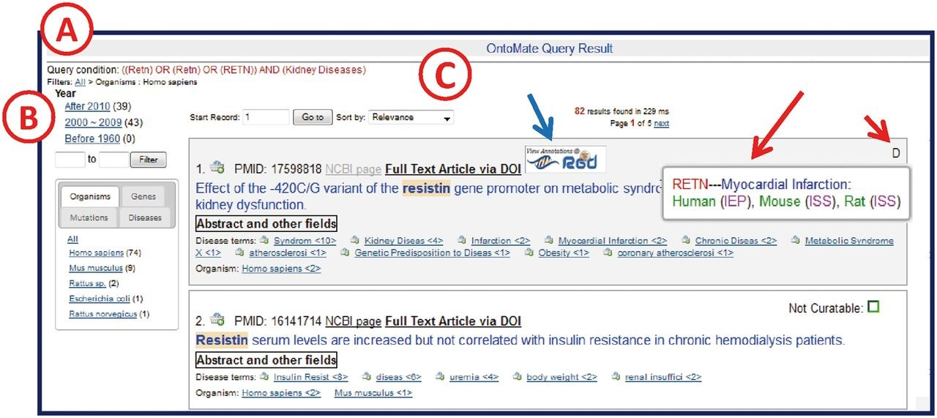
Figure 3. OntoMate query results page. ( A ) ‘Query Condition’ displays the string of objects and terms used in the ...
Notes:
Figure 3. OntoMate query results page. ( A ) ‘Query Condition’ displays the string of objects and terms used in the query. ( B ) The filter section allows users to adjust the results according to publication chronology or object/term refinements. The tabs display hyperlinked subsets of result categories. Any link may be selected to restrict or expand the selected results. A ‘filter path’ appears below the Query Condition to show the user what filters have been applied. ( C ) The search results are sorted by relevance by default, but can also be sorted by publication date or PMID. If the reference is in RGD already, an RGD logo appears (blue arrow) above the title. If there are any GO or disease vocabulary annotations from this reference, an aspect initial appears in the upper right corner of the reference entry (short red arrow, D = disease). By ‘mousing over’ the aspect letter, a pop-up appears to show what annotation(s) has been made (long red arrow).
Unless provided in the caption above, the following copyright applies to the content of this slide: © The Author(s) 2015. Published by Oxford University Press.This is an Open Access article distributed under the terms of the Creative Commons Attribution License (http://creativecommons.org/licenses/by/4.0/), which permits unrestricted reuse, distribution, and reproduction in any medium, provided the original work is properly cited.

