Slide 1
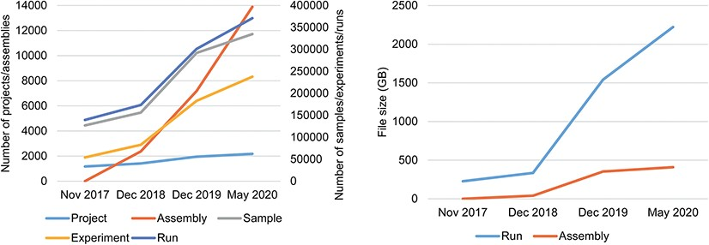
Figure 3 Data statistics of CNSA A. Numbers of Projects, Samples, Assemblies, Experiments and runs in CNSA. B. File ...
Notes:
Figure 3 Data statistics of CNSA A. Numbers of Projects, Samples, Assemblies, Experiments and runs in CNSA. B. File sizes of Runs and Assemblies in CNSA. All statistics are based on data submitted from November 2017 to May 2020.
Unless provided in the caption above, the following copyright applies to the content of this slide: © The Author(s) 2020. Published by Oxford University Press.This is an Open Access article distributed under the terms of the Creative Commons Attribution License (http://creativecommons.org/licenses/by/4.0/), which permits unrestricted reuse, distribution, and reproduction in any medium, provided the original work is properly cited.

