Slide 1
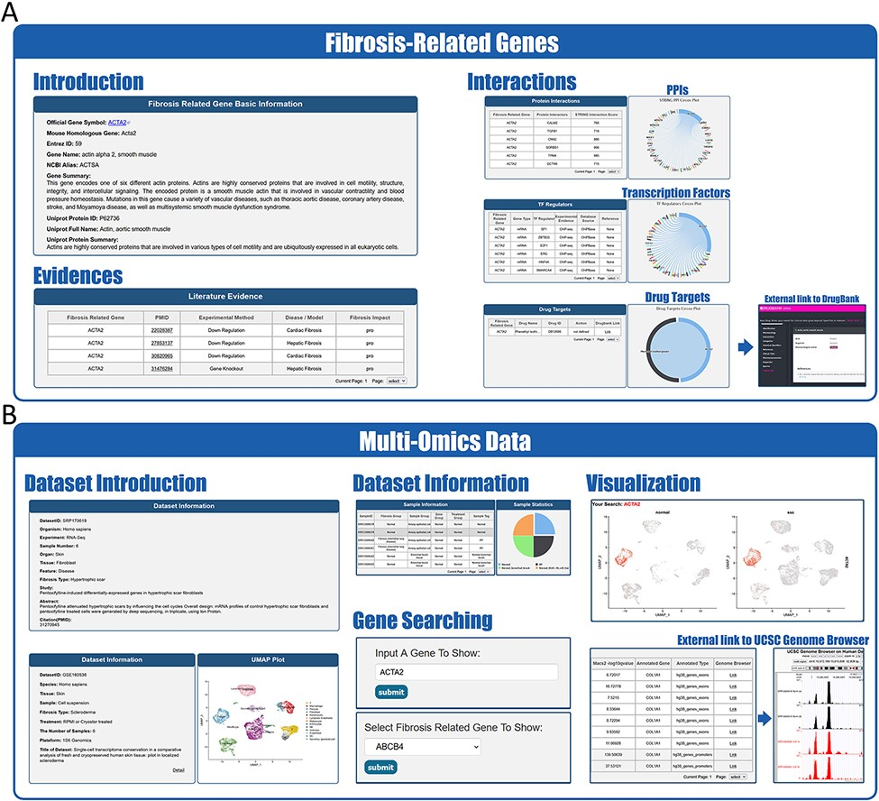
Figure 3. Website interface for FibROAD results and visualizations. (A) Result page for Fibrosis-Related Genes: gene ...
Notes:
Figure 3. Website interface for FibROAD results and visualizations. (A) Result page for Fibrosis-Related Genes: gene introduction collected from both NCBI-Gene and UniProt databases are displayed in the basic information column, followed by literature evidence for the gene (left). Protein-protein interactions (right upper), transcription factor regulators (right middle) and drug targets (right lower) with the FRG are collected from String, RNAinter and DrugBank databases, respectively. An external link to the DrugBank database record for each target drug is provided. (B) Result page for omic data: retrieved datasets of types (RNA-seq, miRNA-seq, scRNA-seq, ATAC-seq, ChIP-seq, Methyl-seq) are shown in a similar pattern, with dataset introduction at the top (left panel), followed by a detailed sample information table (middle upper panel). A search tool for a self-input gene or FRGs within the dataset is provided (middle lower panel) and, once an item is submitted, search results and visualizations will be displayed below (right panel). For ATAC-seq/ChIP-seq/Methyl-seq, an external link to the UCSC Genome Browser is provided for genome tracks observation.
Unless provided in the caption above, the following copyright applies to the content of this slide: © The Author(s) 2022. Published by Oxford University Press.This is an Open Access article distributed under the terms of the Creative Commons Attribution License (https://creativecommons.org/licenses/by/4.0/), which permits unrestricted reuse, distribution, and reproduction in any medium, provided the original work is properly cited.

