Slide 1
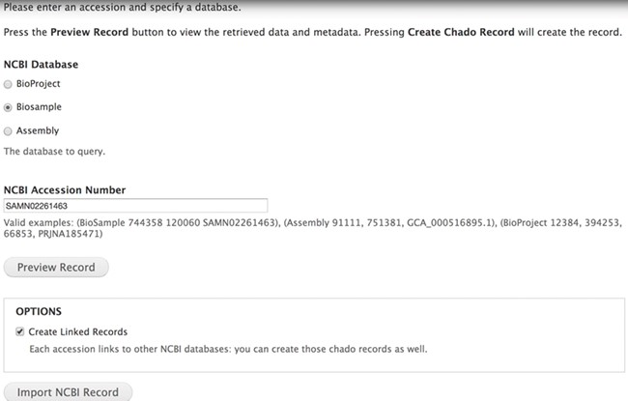
Figure 1 The Tripal EUtils accession importer. Administrators select a database and provide a numeric uid or mixed ...
Notes:
Figure 1 The Tripal EUtils accession importer. Administrators select a database and provide a numeric uid or mixed accession. Clicking the Preview button lists all the fields, properties and additional links found in the record. Each record links back to NCBI. Administrators can choose to only import the single record or to also insert records linked to that primary record. In this example, BioSample accession SAMN02261463 will be inserted into Chado.
Unless provided in the caption above, the following copyright applies to the content of this slide: Published by Oxford University Press 2020.This work is written by US Government employees and is in the public domain in the US.

Slide 2
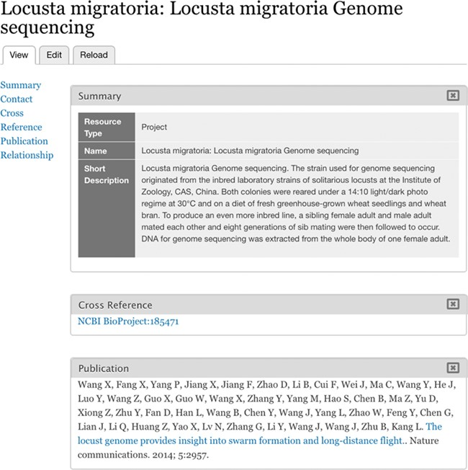
Figure 2 Imported BioProject. BioProject 185471 is stored as a Chado Project record.
Notes:
Figure 2 Imported BioProject. BioProject 185471 is stored as a Chado Project record.
Unless provided in the caption above, the following copyright applies to the content of this slide: Published by Oxford University Press 2020.This work is written by US Government employees and is in the public domain in the US.

Slide 3
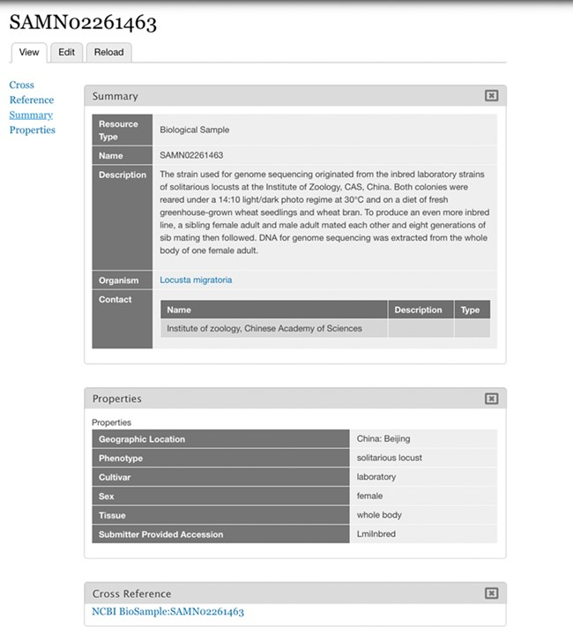
Figure 3 Imported BioSample. BioSample SAMN02261463 represented as a Chado Biomaterial/Tripal Sample bundle as ...
Notes:
Figure 3 Imported BioSample. BioSample SAMN02261463 represented as a Chado Biomaterial/Tripal Sample bundle as imported by the Tripal EUtils module. The properties imported are for geographic location, phenotype, cultivar, sex, tissue and submitter provided accession.
Unless provided in the caption above, the following copyright applies to the content of this slide: Published by Oxford University Press 2020.This work is written by US Government employees and is in the public domain in the US.

Slide 4
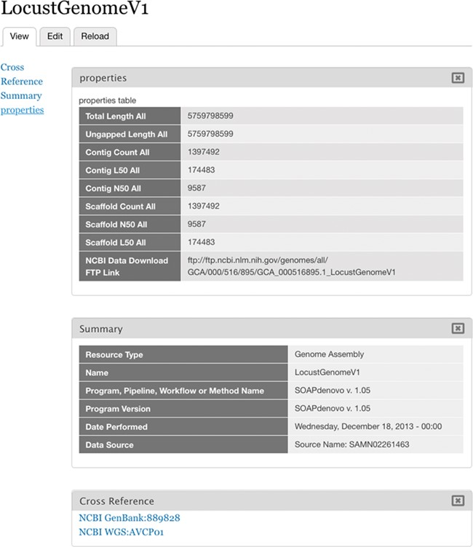
Figure 4 Imported Assembly. Assembly WGS AVCP01 as represented in Chado.
Notes:
Figure 4 Imported Assembly. Assembly WGS AVCP01 as represented in Chado.
Unless provided in the caption above, the following copyright applies to the content of this slide: Published by Oxford University Press 2020.This work is written by US Government employees and is in the public domain in the US.

