Slide 1
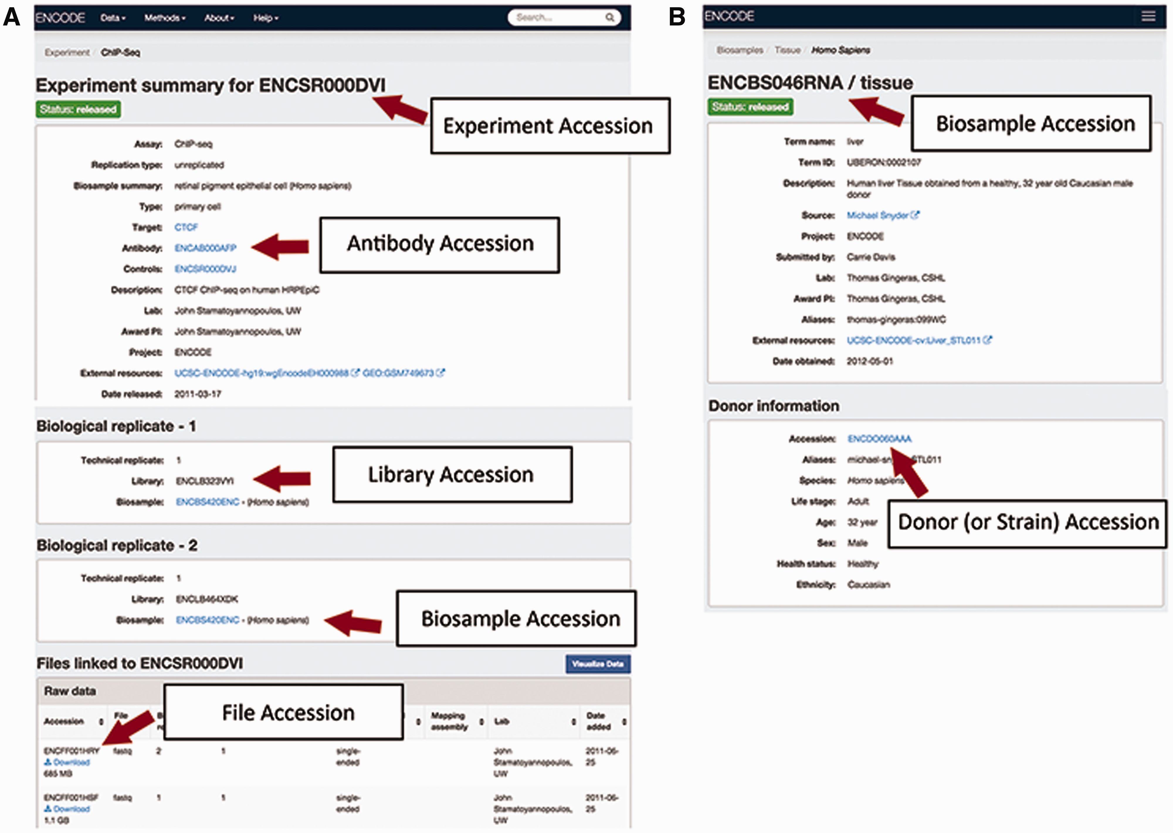
Figure 2 Accessions listed for an experiment on the ENCODE Portal. (A) An experiment page will contain accessions for ...
Notes:
Figure 2 Accessions listed for an experiment on the ENCODE Portal. (A) An experiment page will contain accessions for the experiment referring to the full set of metadata describing how the assay was performed and the data generated by the assay, for the specific antibody lot used in that experiment, for the library that was generated, for the biosample that was used as input to the experiment, and for each data file generated by sequencing. (B) A biosample page will contain accessions for the biosample that was used as well as the unique donor (or strain) that provided the sample.
Unless provided in the caption above, the following copyright applies to the content of this slide: © The Author(s) 2016. Published by Oxford University Press. This is an Open Access article distributed under the terms of the Creative Commons Attribution License ( http://creativecommons.org/licenses/by/4.0/ ), which permits unrestricted reuse, distribution, and reproduction in any medium, provided the original work is properly cited.

