Slide 1
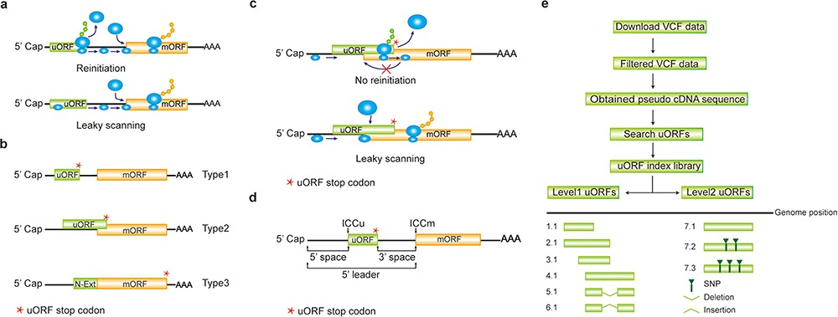
Figure 1 Computation of uORF variation. (a) Reinitiation and leaky scanning models. In the reinitiation model, the 80S ...
Notes:
Figure 1 Computation of uORF variation. (a) Reinitiation and leaky scanning models. In the reinitiation model, the 80S ribosomal subunit will separate after translating the uORF and the 40S subunit remains associated with mRNA, regaining fresh eIF2 ternary complex and other unknown reinitiation factors to translate the mORF. In the leaky scanning model, the uORF initiation codon is bypassed by the scanning complex, which will ignore the uORF and translate the mORF. (b) uORF types. uORFs are divided into Types1–3 with respect to the position of uORF stop codon relative to the mORF. N-Ext, N extension. (c) Type2 uORF-controlled mORF translation is only favored by leaky scanning. Overlap between the Type2 uORF and mORF makes reinitiation of the mORF impossible after translation of uORF. (d) uORF positional information on cDNA. The mORF is flanked by the 5′ leader and 3’ UTR (3′ untranslated region). 5′ and 3′ space are used to describe the distance from Cap to uORF AUG and from uORF stop codon to mORF AUG, respectively. The sequence from −3 to +4 relative to the AUG initiation codon (A as +1) corresponding to the Kozak consensus (A/GCCAUGG) position is termed as initiation codon context (ICC) with ICCu and ICCm for uORF and mORF, respectively. (e) Workflow to identify uORF variants. VCF files are downloaded from public databases and filtered as described in the Method. Pseudo cDNA sequences are generated by replacing all the splicing models with filtered variants. After uORFs identification, their relative positions on the pseudo cDNAs are transferred into absolute positions in the reference genome to create an index library. uORFs are pairwise compared and those uORFs with the same genomic positions and sequences are assigned the same index number to indicate no uORF changes. Otherwise, two leveled uORF identifiers (Level1.Level2) are used to describe the variation. Level1 indicates major differences that cause uORF creation, loss or length changes due to SNPs or INDELs (insertion and deletion). Level2 indicates minor differences that lead to nucleotide and/or amino acid substitution due to SNPs. Continuous index numbers starting with number 1.1 are assigned in the prioritized orders of uORF ATG occurrence in the reference genome, uORF length (shorter), deletion and insertion at Level1, and of SNP number (fewer) at Level2.
Unless provided in the caption above, the following copyright applies to the content of this slide: © The Author(s) 2020. Published by Oxford University Press.This is an Open Access article distributed under the terms of the Creative Commons Attribution License (http://creativecommons.org/licenses/by/4.0/), which permits unrestricted reuse, distribution, and reproduction in any medium, provided the original work is properly cited.

Slide 2
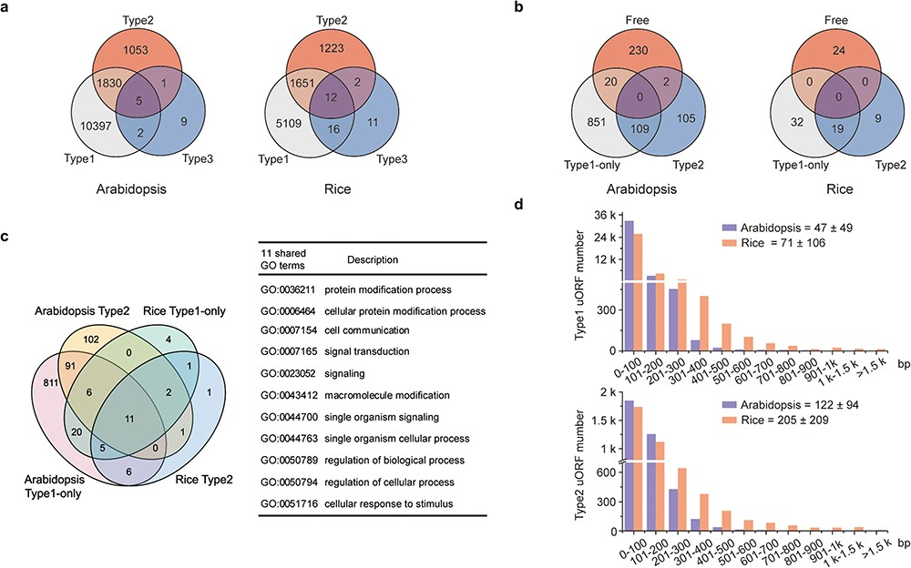
Figure 2 Characterization of uORFs in Arabidopsis and rice. (a) Venn diagram of uORF-containing genes with different ...
Notes:
Figure 2 Characterization of uORFs in Arabidopsis and rice. (a) Venn diagram of uORF-containing genes with different uORF types. (b) Venn diagram of enriched GO terms of uORF-free-, Type1-only- and Type2- uORF-containing genes in Arabidopsis and rice. GO terms of P < 0.05 are used. (c) Venn diagram to show GO terms shared in Arabidopsis and rice uORF-containing genes. 51 out of 57 enriched GO terms of rice uORF-containing genes are also found in Arabidopsis. Eleven GO terms enriched in both Type1-only and Type2 uORF-containing genes of Arabidopsis and rice are detailed in the table. (d) Length distribution of Type1 and Type2 uORFs. Insert number shows Mean ± SD of uORF length (bp). The representative gene models of Arabidopsis reference accession Col-0 and rice reference cultivar Nipponbare are used for analysis.
Unless provided in the caption above, the following copyright applies to the content of this slide: © The Author(s) 2020. Published by Oxford University Press.This is an Open Access article distributed under the terms of the Creative Commons Attribution License (http://creativecommons.org/licenses/by/4.0/), which permits unrestricted reuse, distribution, and reproduction in any medium, provided the original work is properly cited.

Slide 3
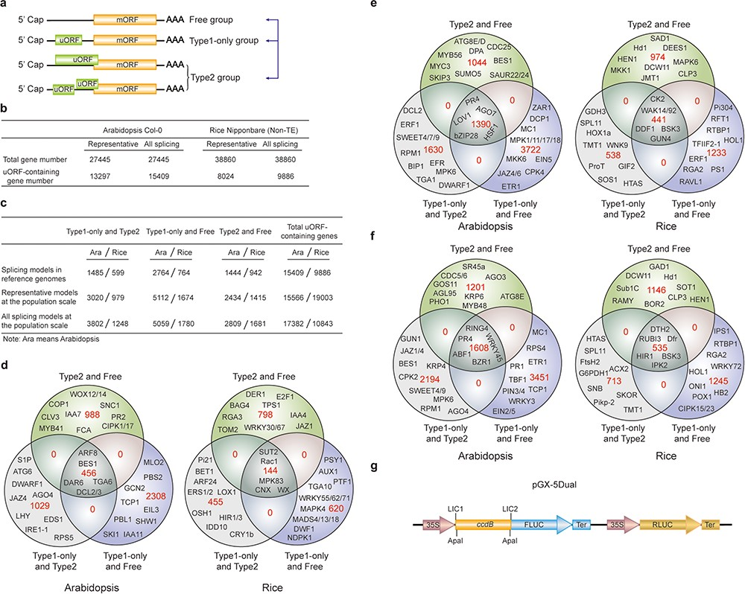
Figure 3 uORF variation. (a) Schematic of altered uORF types analyzed in this study. Three Level1 uORF variants are ...
Notes:
Figure 3 uORF variation. (a) Schematic of altered uORF types analyzed in this study. Three Level1 uORF variants are focused by studying changes between Type1-only and Type2, between Type1-only and uORF-free and between Type2 and uORF-free. Genes with both Type2 and Type1 on the same splicing model are grouped as Type2 in this analysis. (b) Number of uORF-containing genes in Arabidopsis Col-0 and rice Nipponbare. The representative and all splicing gene models are calculated. Non-TE, non-transposon element. (c) Number of three Level1 uORF variants. Analysis is performed among different splicing models of reference genomes (Arabidopsis Col-0 and rice Nipponbare), and among accessions at the population scale using the representative and all splicing gene models. (d) Venn diagram of three Level1 uORF variants within different splicing models of Arabidopsis Col-0 and rice Nipponbare. (e, f) Venn diagram of three Level1 uORF variants of the representative gene models (e) and all splicing gene models (f) at the population level. Example gene names are shown in different regions. (g) Schematic of dual-luciferase vector pGX-5Dual. 5′ leader containing different uORF variants are cloned via LIC method to control the translation of firefly luciferase (FLUC). ApaI is used to linearize the vector. Comparison of the ratio of FLUC activity and mRNA level to the internal control RLUC expressed from the same vector will indicate the effects of uORF variants on mRNA stability and translation efficiency.
Unless provided in the caption above, the following copyright applies to the content of this slide: © The Author(s) 2020. Published by Oxford University Press.This is an Open Access article distributed under the terms of the Creative Commons Attribution License (http://creativecommons.org/licenses/by/4.0/), which permits unrestricted reuse, distribution, and reproduction in any medium, provided the original work is properly cited.

Slide 4
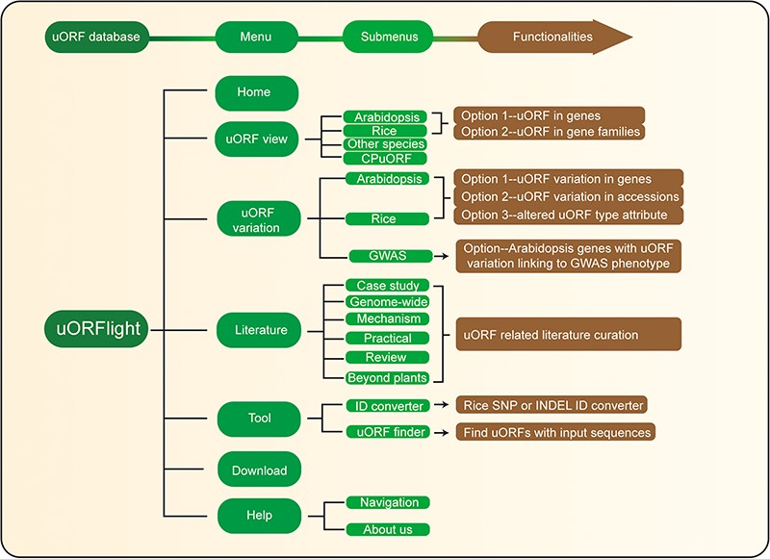
Figure 4 Database structure. Home menu contains the background information of uORFlight database including organisms, ...
Notes:
Figure 4 Database structure. Home menu contains the background information of uORFlight database including organisms, and definition of uORF attributes and variants. uORF view menu has four submenus to browse and search uORF, including in the reference genomes of Arabidopsis Col-0, rice Nipponbare and other species. CPuORF is also included in this menu. In Arabidopsis and rice submenus, Option 1 and Option 2 are provided to individually and bulk retrieve uORF information, respectively. uORF variation menu is used to compare uORF variation among different splicing models in the reference genome (Option 1) or among the selected accessions (Option 2) and to bulk retrieve genes with altered uORF types (Option 3). Literature menu curates plant uORF relevant literature into distinct groups. Tool menu provides ID converter and uORF finder with the former to transform SNP and INDEL variation identity used in different external databases, and with the later to search ATG or non-ATG initiated uORFs in a given cDNA sequence. Help menu contains Navigation submenu to explain the main conclusion on each result page.
Unless provided in the caption above, the following copyright applies to the content of this slide: © The Author(s) 2020. Published by Oxford University Press.This is an Open Access article distributed under the terms of the Creative Commons Attribution License (http://creativecommons.org/licenses/by/4.0/), which permits unrestricted reuse, distribution, and reproduction in any medium, provided the original work is properly cited.

