Slide 1
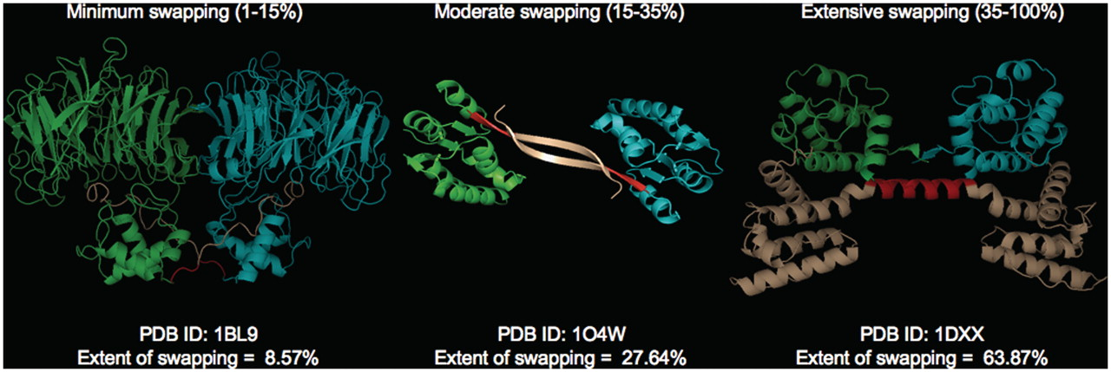
Figure 4. Different classes of ‘ES’ with representative examples (PDB IDs: 1BL9,1O4W and 1DXX). Individual chains are ...
Notes:
Figure 4. Different classes of ‘ES’ with representative examples (PDB IDs: 1BL9,1O4W and 1DXX). Individual chains are colored in cyan and green. Hinge (red) and swapped regions (brown) are mapped in different colors.
Unless provided in the caption above, the following copyright applies to the content of this slide: © The Author(s) 2011. Published by Oxford University Press.This is Open Access article distributed under the terms of the Creative Commons Attribution Non-Commercial License (http://creativecommons.org/licenses/by-nc/2.5), which permits unrestricted non-commercial use, distribution, and reproduction in any medium, provided the original work is properly cited.

