Slide 1
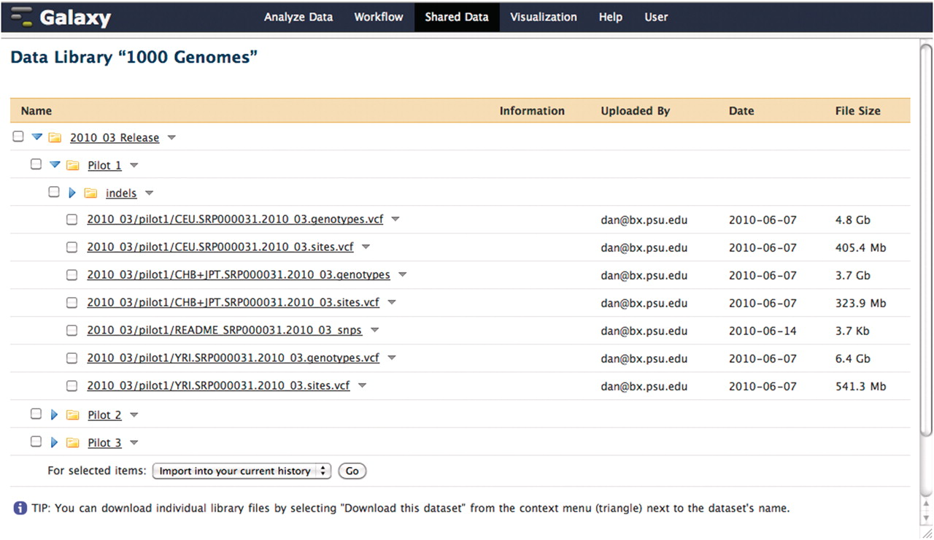
Figure 4. A Galaxy library containing pilot data from the 1000 Genomes project. This data was loaded directly into a ...
Notes:
Figure 4. A Galaxy library containing pilot data from the 1000 Genomes project. This data was loaded directly into a Galaxy data library from the 1000 Genomes project FTP server. When a user imports a data set from a library, the underlying file on disk is not copied. Although each copy of a particular imported data set shares a reference to the same file on disk, the user is free to modify the metadata and attributes of their copy as they see fit.
Unless provided in the caption above, the following copyright applies to the content of this slide: © The Author(s) 2011. Published by Oxford University Press.This is Open Access article distributed under the terms of the Creative Commons Attribution Non-Commercial License (http://creativecommons.org/licenses/by-nc/2.5), which permits unrestricted non-commercial use, distribution, and reproduction in any medium, provided the original work is properly cited.

