Slide 1
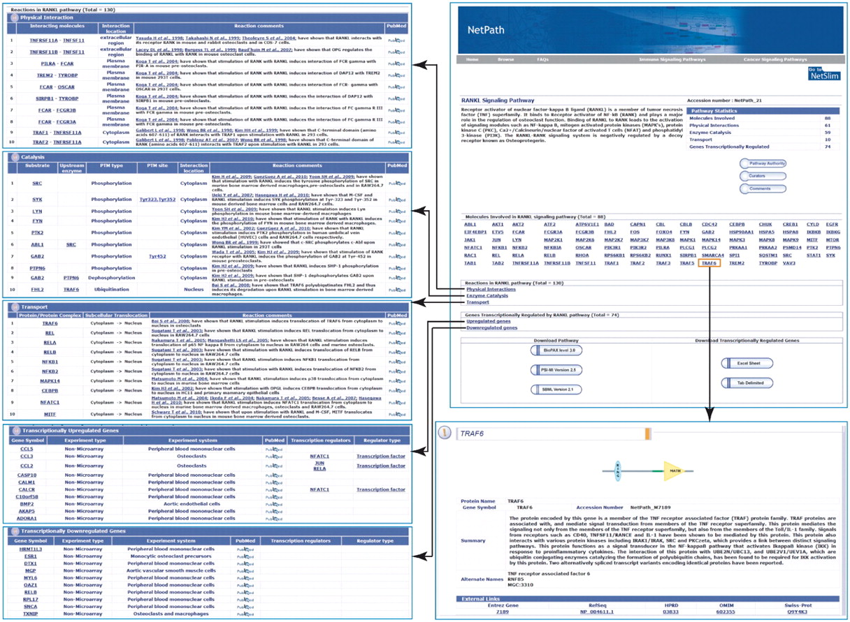
Figure 1. An overview of the RANKL pathway page in NetPath. RANKL pathway page in NetPath hosts the information on the ...
Notes:
Figure 1. An overview of the RANKL pathway page in NetPath. RANKL pathway page in NetPath hosts the information on the number of molecules curated for RANKL pathway, statistics of the total number of molecules, link to RANKL pathway reactions and the list of genes which are differentially upregulated by RANKL/RANK pathway. Every molecule in the pathway page is linked to the corresponding NetPath molecule page which is further linked to Entrez gene, HPRD, OMIM and Swiss-Prot identifiers. The reaction page of the RANKL pathway contains the list of each type of reactions such as physical interactions, enzyme catalysis and transport with a brief description about the reactions with their PTM dependence or interacting regions/domains/motifs whenever it was available in literature. The list of curators and reviewers are provided in the RANKL pathway page with the details of the pathway authority. A comments tab is provided in the pathway page to invite the queries and suggestions from the community so as to update and improve RANKL pathway alike other pathways in NetPath.
Unless provided in the caption above, the following copyright applies to the content of this slide: © The Author(s) 2011. Published by Oxford University Press.This is Open Access article distributed under the terms of the Creative Commons Attribution Non-Commercial License (http://creativecommons.org/licenses/by-nc/2.5), which permits unrestricted non-commercial use, distribution, and reproduction in any medium, provided the original work is properly cited.

