Slide 1
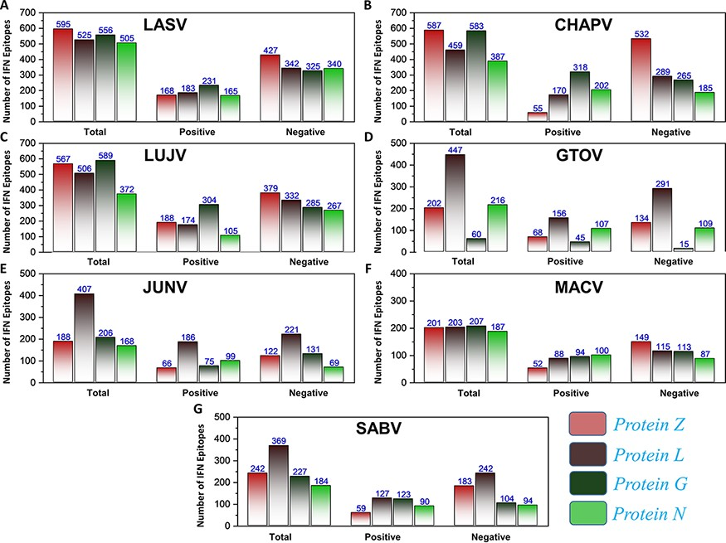
Figure 5. (A–G) Represents the total number of predicted IFN epitopes along with positive and negative IFNs for each ...
Notes:
Figure 5. (A–G) Represents the total number of predicted IFN epitopes along with positive and negative IFNs for each protein of the seven MMVs, respectively.
Unless provided in the caption above, the following copyright applies to the content of this slide: © The Author(s) 2021. Published by Oxford University Press.This is an Open Access article distributed under the terms of the Creative Commons Attribution License (https://creativecommons.org/licenses/by/4.0/), which permits unrestricted reuse, distribution, and reproduction in any medium, provided the original work is properly cited.

Slide 2
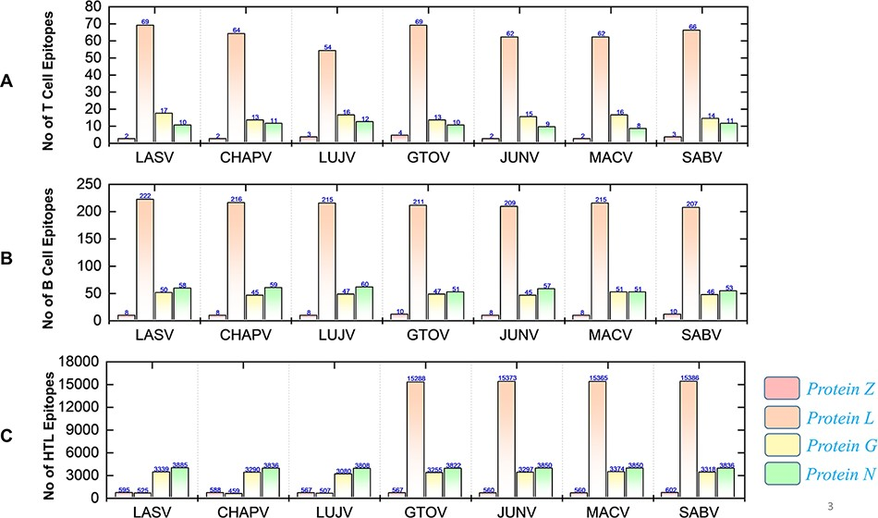
Figure 4. Demonstrates the total identified number of classified immune epitopes for each specific protein; (A) ...
Notes:
Figure 4. Demonstrates the total identified number of classified immune epitopes for each specific protein; (A) represents the number of specified T-cell epitopes, (B) represents the number of B-cell epitopes and (C) represents the number of HTL epitopes predicted for each protein for the seven mammarena species, respectively.
Unless provided in the caption above, the following copyright applies to the content of this slide: © The Author(s) 2021. Published by Oxford University Press.This is an Open Access article distributed under the terms of the Creative Commons Attribution License (https://creativecommons.org/licenses/by/4.0/), which permits unrestricted reuse, distribution, and reproduction in any medium, provided the original work is properly cited.

Slide 3
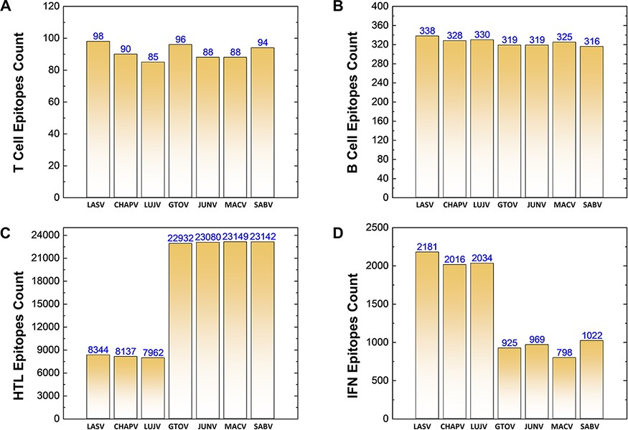
Figure 3. (A–D) Demonstrates the total identified number of predicted immune epitopes for each specific protein; (A) ...
Notes:
Figure 3. (A–D) Demonstrates the total identified number of predicted immune epitopes for each specific protein; (A) represents the total number of T-cell epitopes, (B) represents the total number of B-cell epitopes, (C) represents the total number of HTL epitopes, while (D) represents the total number of IFN epitopes predicted for each protein for the seven mammarena species, respectively.
Unless provided in the caption above, the following copyright applies to the content of this slide: © The Author(s) 2021. Published by Oxford University Press.This is an Open Access article distributed under the terms of the Creative Commons Attribution License (https://creativecommons.org/licenses/by/4.0/), which permits unrestricted reuse, distribution, and reproduction in any medium, provided the original work is properly cited.

Slide 4
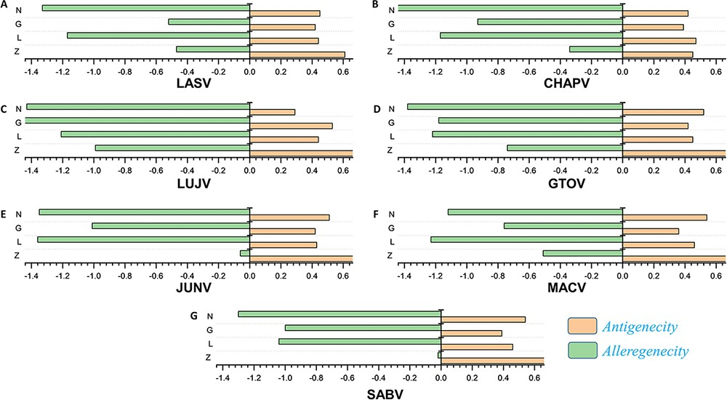
Figure 2. (A–G) Represents the antigenicity and allergenicity scores for whole-protein sequences in the individually ...
Notes:
Figure 2. (A–G) Represents the antigenicity and allergenicity scores for whole-protein sequences in the individually studied mammerenaviruses.
Unless provided in the caption above, the following copyright applies to the content of this slide: © The Author(s) 2021. Published by Oxford University Press.This is an Open Access article distributed under the terms of the Creative Commons Attribution License (https://creativecommons.org/licenses/by/4.0/), which permits unrestricted reuse, distribution, and reproduction in any medium, provided the original work is properly cited.

Slide 5
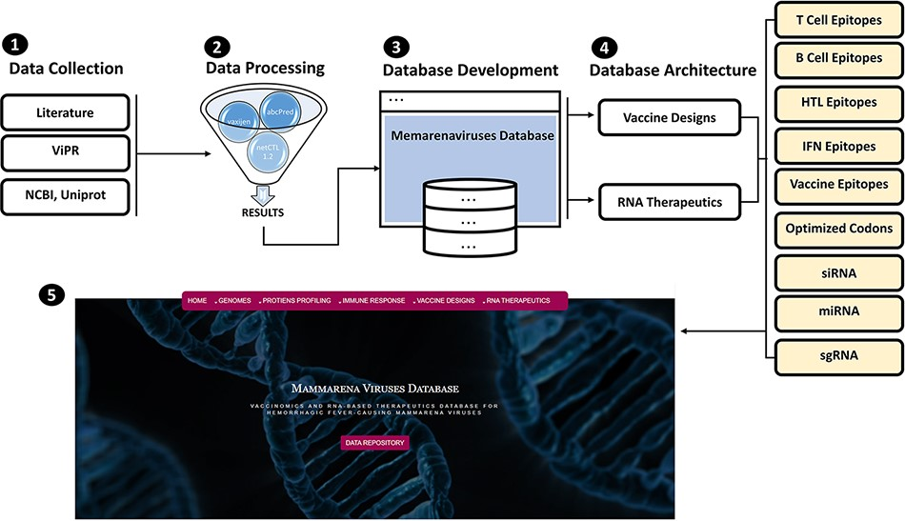
Figure 1. (From 1 to 5) represents the general schematic workflow and different steps followed in the development of ...
Notes:
Figure 1. (From 1 to 5) represents the general schematic workflow and different steps followed in the development of mammarenavirus database.
Unless provided in the caption above, the following copyright applies to the content of this slide: © The Author(s) 2021. Published by Oxford University Press.This is an Open Access article distributed under the terms of the Creative Commons Attribution License (https://creativecommons.org/licenses/by/4.0/), which permits unrestricted reuse, distribution, and reproduction in any medium, provided the original work is properly cited.

Slide 6
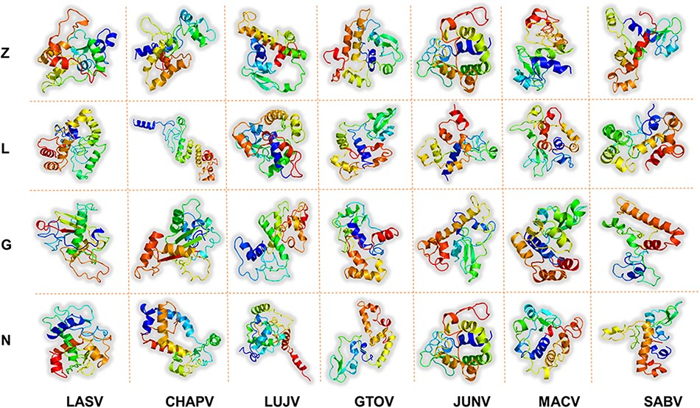
Figure 6. Represents the refined 3D structures of MEV designs for each protein of all the studied mammarenavirus ...
Notes:
Figure 6. Represents the refined 3D structures of MEV designs for each protein of all the studied mammarenavirus species. x-axis includes names of the MMV species, while y-axis shows the vaccine-targeted proteins.
Unless provided in the caption above, the following copyright applies to the content of this slide: © The Author(s) 2021. Published by Oxford University Press.This is an Open Access article distributed under the terms of the Creative Commons Attribution License (https://creativecommons.org/licenses/by/4.0/), which permits unrestricted reuse, distribution, and reproduction in any medium, provided the original work is properly cited.

Slide 7
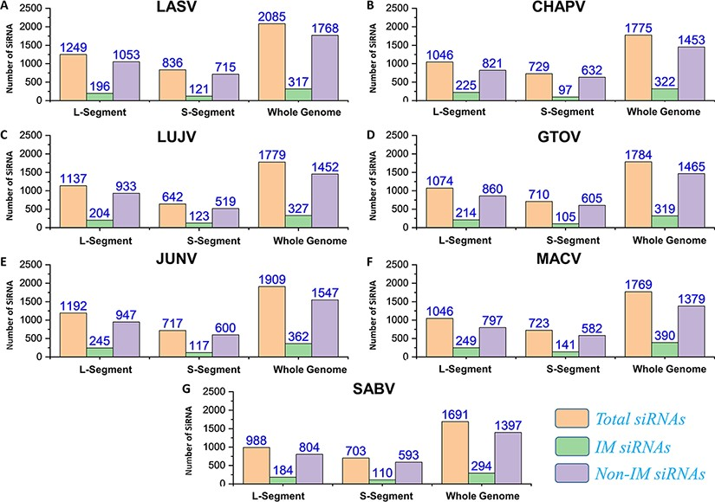
Figure 7. (A–G) Represents number of total SiRNA’s and classified IM/non-IM siRNAs identified for genomic segments L, S ...
Notes:
Figure 7. (A–G) Represents number of total SiRNA’s and classified IM/non-IM siRNAs identified for genomic segments L, S and whole genome of each mammarenavirus.
Unless provided in the caption above, the following copyright applies to the content of this slide: © The Author(s) 2021. Published by Oxford University Press.This is an Open Access article distributed under the terms of the Creative Commons Attribution License (https://creativecommons.org/licenses/by/4.0/), which permits unrestricted reuse, distribution, and reproduction in any medium, provided the original work is properly cited.

Slide 8
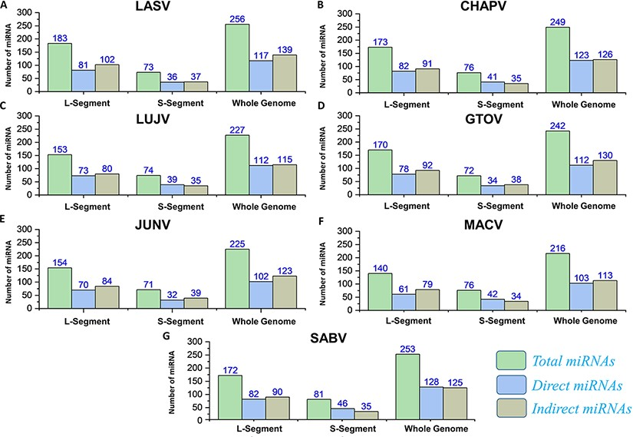
Figure 8. (A–G) Represents the number of total miRNAs and orientation-based classified direct/indirect mature RNAs ...
Notes:
Figure 8. (A–G) Represents the number of total miRNAs and orientation-based classified direct/indirect mature RNAs identified for L, S and whole-genome segments of each mammarenavirus.
Unless provided in the caption above, the following copyright applies to the content of this slide: © The Author(s) 2021. Published by Oxford University Press.This is an Open Access article distributed under the terms of the Creative Commons Attribution License (https://creativecommons.org/licenses/by/4.0/), which permits unrestricted reuse, distribution, and reproduction in any medium, provided the original work is properly cited.

Slide 9
Figure 9. Represents the total number of sgRNAs identified for L, S and whole-genome segments respective to each of the ...
Notes:
Figure 9. Represents the total number of sgRNAs identified for L, S and whole-genome segments respective to each of the seven mammarenavirus.
Unless provided in the caption above, the following copyright applies to the content of this slide: © The Author(s) 2021. Published by Oxford University Press.This is an Open Access article distributed under the terms of the Creative Commons Attribution License (https://creativecommons.org/licenses/by/4.0/), which permits unrestricted reuse, distribution, and reproduction in any medium, provided the original work is properly cited.

