Slide 1
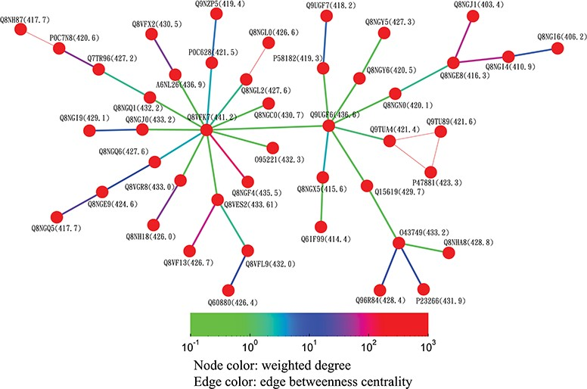
Figure 8 Partial minimum spanning tree of olfactory receptors near the hub sequence Q8VFK7. Nodes are colored based on ...
Notes:
Figure 8 Partial minimum spanning tree of olfactory receptors near the hub sequence Q8VFK7. Nodes are colored based on their closeness centrality values, which are also labeled in parentheses. Edges are colored based on their betweenness centrality values. Thin edges in the graph represent zero-distance sequence pairs.
Unless provided in the caption above, the following copyright applies to the content of this slide: © The Author(s) 2019. Published by Oxford University Press.This is an Open Access article distributed under the terms of the Creative Commons Attribution License (http://creativecommons.org/licenses/by/4.0/), which permits unrestricted reuse, distribution, and reproduction in any medium, provided the original work is properly cited.

