Slide 1
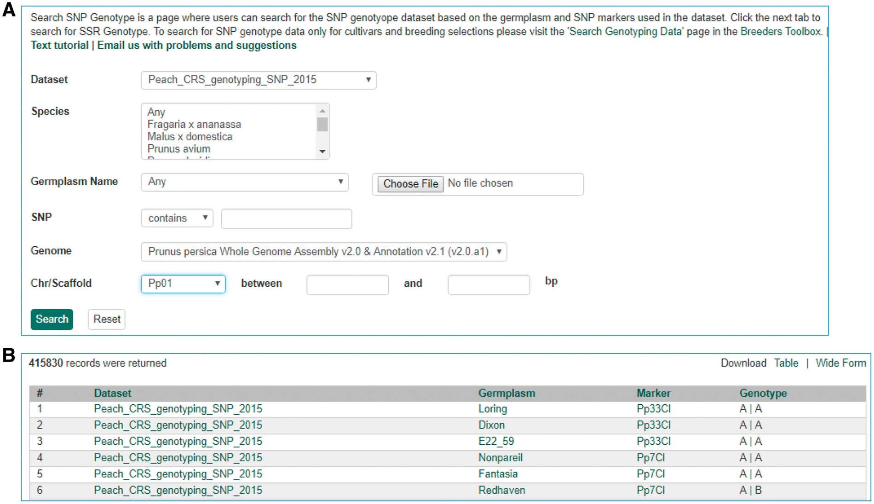
Figure 10. Search page for SNP genotype. (A) Users can search SNP genotype by dataset name, species, germplasm name, SNP ...
Notes:
Figure 10. Search page for SNP genotype. (A) Users can search SNP genotype by dataset name, species, germplasm name, SNP name and/or genome location of the SNP. (B) The returned search results show dataset name, germplasm, marker name and genotype.
Unless provided in the caption above, the following copyright applies to the content of this slide: © The Author(s) 2017. Published by Oxford University Press.This is an Open Access article distributed under the terms of the Creative Commons Attribution License (http://creativecommons.org/licenses/by/4.0/), which permits unrestricted reuse, distribution, and reproduction in any medium, provided the original work is properly cited.

