Slide 1
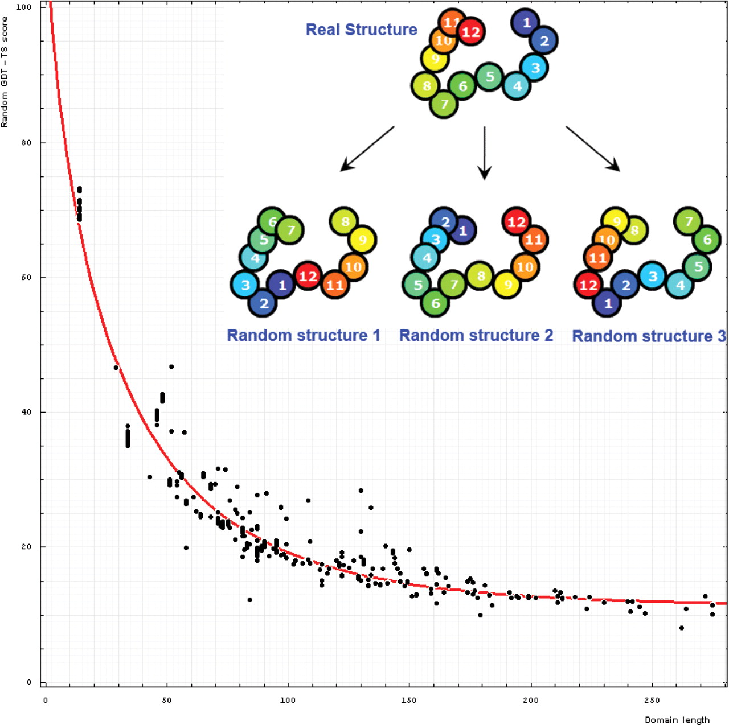
Figure 6. Dependence of GDT-TS (vertical axis) on domain length (horizontal axis). Each point represents a random score ...
Notes:
Figure 6. Dependence of GDT-TS (vertical axis) on domain length (horizontal axis). Each point represents a random score for a domain. All NMR models for each domain are used, and random scores for them appear as vertical streaks giving an idea about random errors of random scores. The red curve is the best-fit of the function mentioned in the text. On the upper right, one example indicates the procedure generating random structures. Random structure 1: permuted and residue 1 is placed at position 6 of the original structure; random structure 2: reverse chain and random structure 3: reverse chain, permuted and residue 1 is placed at position 6 of the reverse chain structure.
Unless provided in the caption above, the following copyright applies to the content of this slide: © 2009 The Author(s).This is Open Access article distributed under the terms of the Creative Commons Attribution Non-Commercial License (http://creativecommons.org/licenses/by-nc/2.0/uk/) which permits unrestricted non-commercial use, distribution, and reproduction in any medium, provided the original work is properly cited.

