Slide 1
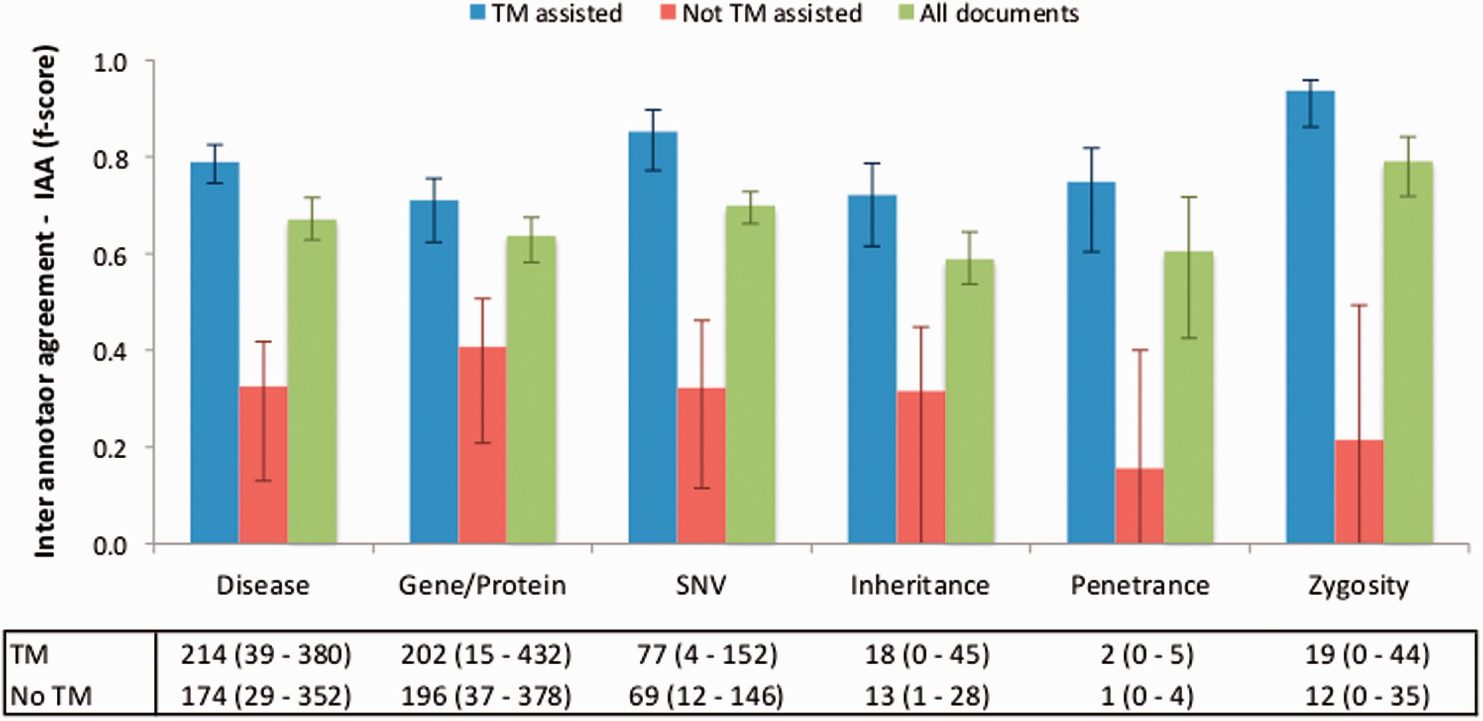
Figure 5. IAA obtained on documents pre-annotated with automated TM services, without pre-annotation, and on all ...
Notes:
Figure 5. IAA obtained on documents pre-annotated with automated TM services, without pre-annotation, and on all documents. The error lines show the minimum and maximum IAA values for all pairs of annotators. The data table shows the average (range) number of annotations for each concept type using TM-assisted vs. not TM-assisted curation.
Unless provided in the caption above, the following copyright applies to the content of this slide: © The Author(s) 2016. Published by Oxford University Press. This is an Open Access article distributed under the terms of the Creative Commons Attribution License ( http://creativecommons.org/licenses/by/4.0/ ), which permits unrestricted reuse, distribution, and reproduction in any medium, provided the original work is properly cited.

