Slide 1
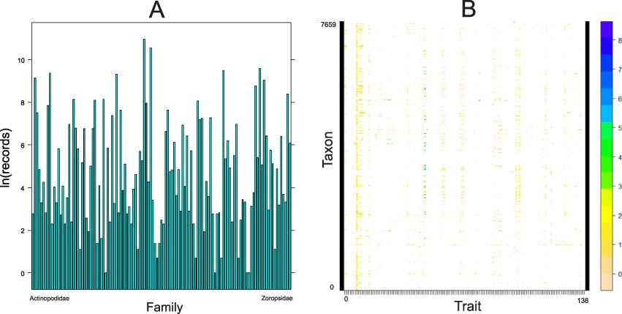
Figure 5. Quantitative content of the database. A. Number of records (logarithmically transformed) for each family ...
Notes:
Figure 5. Quantitative content of the database. A. Number of records (logarithmically transformed) for each family included in the database, arranged alphabetically. B. The taxon by trait matrix representing the completeness. The most complete traits include body length (64% of taxa), followed by cephalothorax length (23%) and cephalothorax width (19%). Dots represent logarithmically transformed number of records per taxon. Taxon includes one of the following: subspecies, species, genus or family.
Unless provided in the caption above, the following copyright applies to the content of this slide: © The Author(s) 2021. Published by Oxford University Press.This is an Open Access article distributed under the terms of the Creative Commons Attribution License (https://creativecommons.org/licenses/by/4.0/), which permits unrestricted reuse, distribution, and reproduction in any medium, provided the original work is properly cited.

