Slide 1
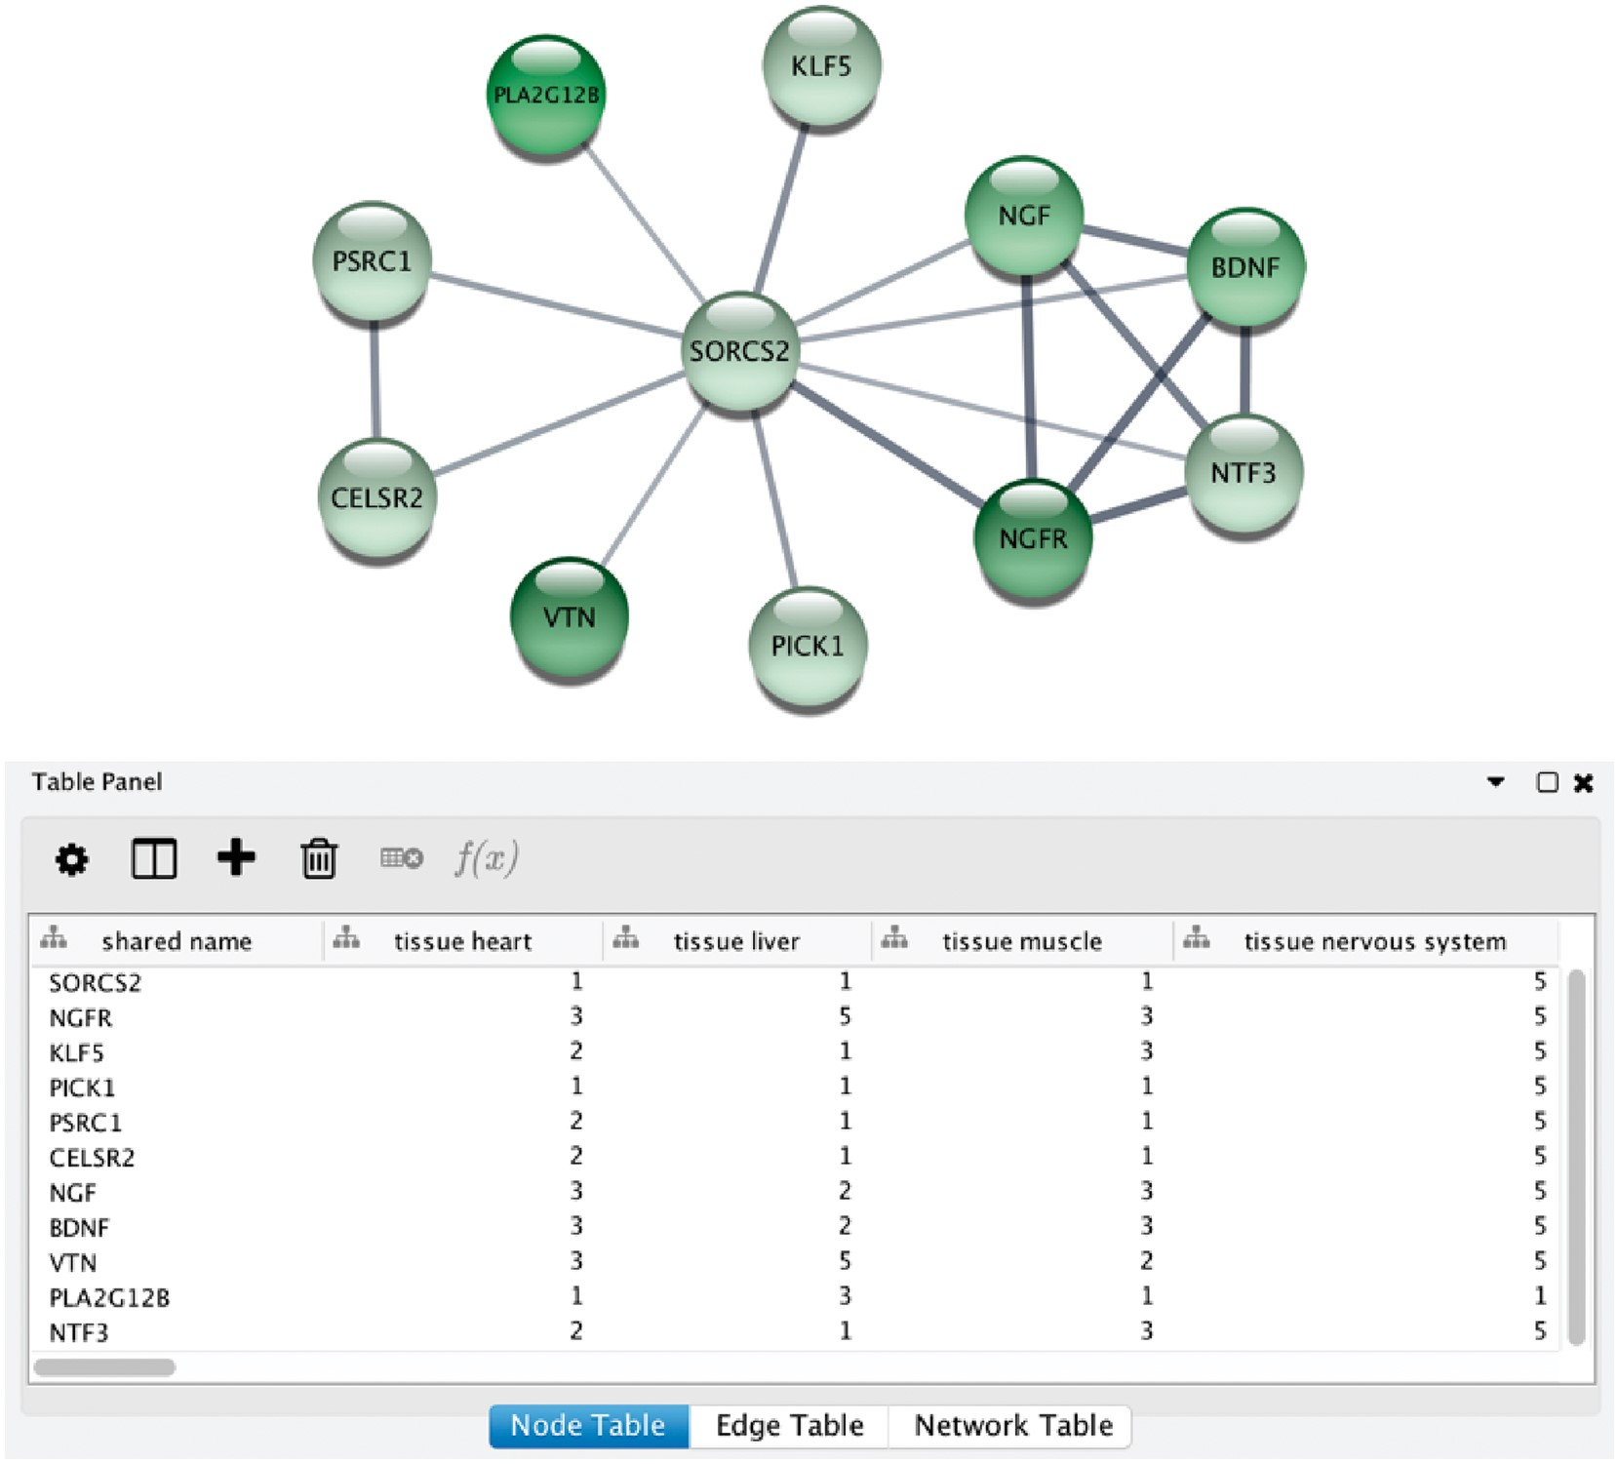
Figure 6. STRING app in Cytoscape with tissue information. (A) The newly developed stringApp for Cytoscape allows users ...
Notes:
Figure 6. STRING app in Cytoscape with tissue information. (A) The newly developed stringApp for Cytoscape allows users to get all the STRING functionality within Cytoscape and allows expression evidence from TISSUES to be visualized onto the network (in this example for liver). (B) The stringApp also shows the evidence score for each of the major tissues in the node attributes table.
Unless provided in the caption above, the following copyright applies to the content of this slide: © The Author(s) 2018. Published by Oxford University Press.This is an Open Access article distributed under the terms of the Creative Commons Attribution License (http://creativecommons.org/licenses/by/4.0/), which permits unrestricted reuse, distribution, and reproduction in any medium, provided the original work is properly cited.

