Slide 1
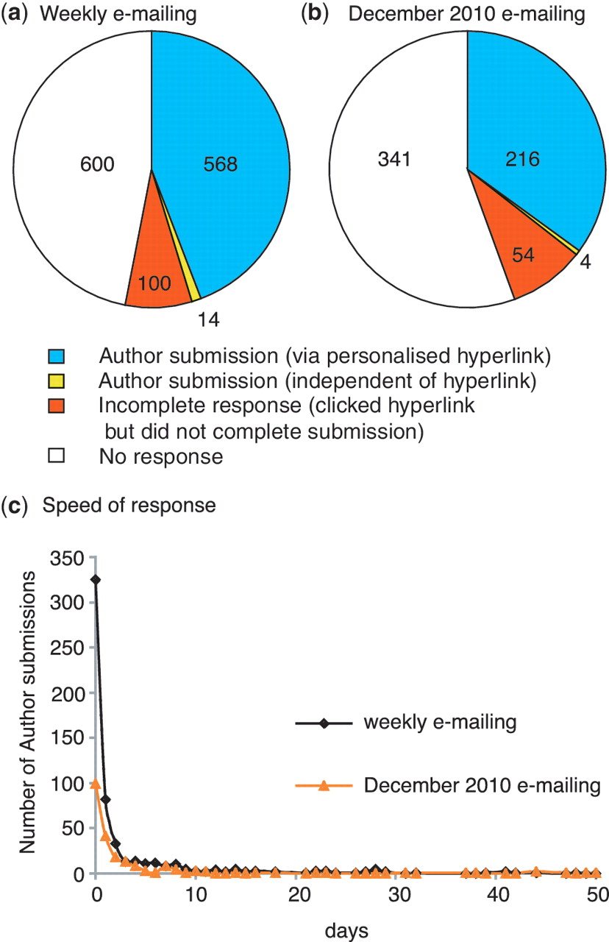
Figure 4. Author response to direct e-mailing. Overall response to (a) weekly e-mailing (corresponding author e-mailed ...
Notes:
Figure 4. Author response to direct e-mailing. Overall response to (a) weekly e-mailing (corresponding author e-mailed <2 weeks after the entry for the published paper appeared in PubMed) and (b) single e-mailing to authors of untriaged papers carried out in December 2010 (in this case a PubMed entry for the published paper had existed for 2–13 months prior to e-mailing the corresponding author). The number of papers in each category is shown. (c) Speed of author response: number of days between author being sent e-mail and completing the author submission.
Unless provided in the caption above, the following copyright applies to the content of this slide: © The Author(s) 2012. Published by Oxford University Press.This is an Open Access article distributed under the terms of the Creative Commons Attribution Non-Commercial License (http://creativecommons.org/licenses/by-nc/3.0), which permits unrestricted non-commercial use, distribution, and reproduction in any medium, provided the original work is properly cited.

