Slide 1
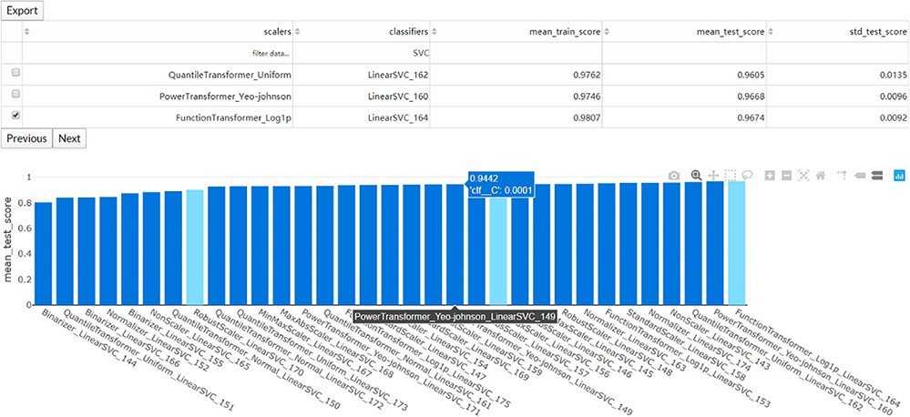
Figure 3 The interaction diagram for the performance of all the candidate models. The users can screen the candidate ...
Notes:
Figure 3 The interaction diagram for the performance of all the candidate models. The users can screen the candidate models by the scalers, classifiers, mean training score, mean test score and standard test score.
Unless provided in the caption above, the following copyright applies to the content of this slide: © The Author(s) 2020. Published by Oxford University Press.This is an Open Access article distributed under the terms of the Creative Commons Attribution License (http://creativecommons.org/licenses/by/4.0/), which permits unrestricted reuse, distribution, and reproduction in any medium, provided the original work is properly cited.

