Slide 1
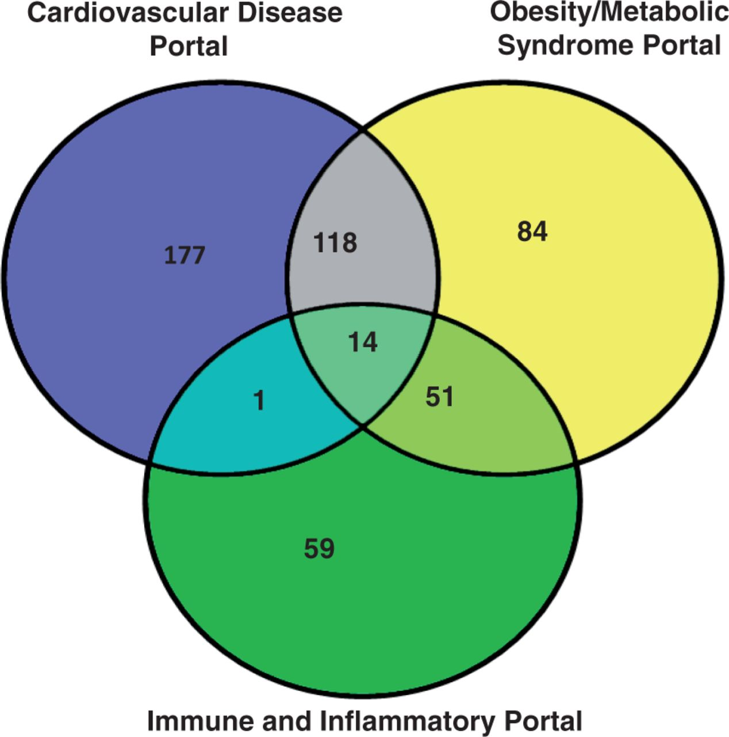
Figure 1. The rat strain distribution among three RGD disease portals. The numbers in each area represent the strain ...
Notes:
Figure 1. The rat strain distribution among three RGD disease portals. The numbers in each area represent the strain count of that section. Strain names are available from the RGD disease portals (http://rgd.mcw.edu/wg/portals).
Unless provided in the caption above, the following copyright applies to the content of this slide: © The Author(s) 2013. Published by Oxford University Press.This is an Open Access article distributed under the terms of the Creative Commons Attribution License (http://creativecommons.org/licenses/by/3.0/), which permits unrestricted reuse, distribution, and reproduction in any medium, provided the original work is properly cited.

