Slide 1
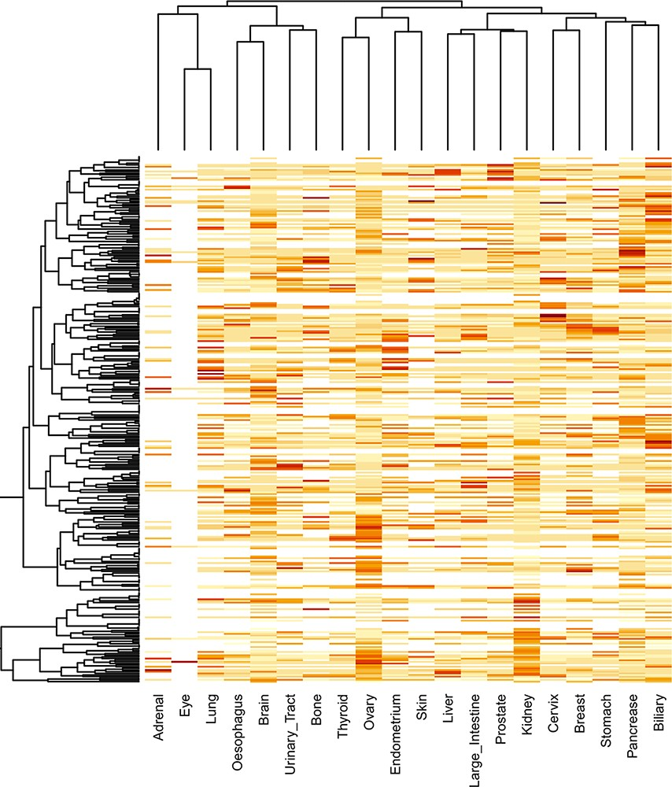
Figure 9. Clustering of significantly mutated domains (SMDs) across different cancer types. The heatmap reveals the ...
Notes:
Figure 9. Clustering of significantly mutated domains (SMDs) across different cancer types. The heatmap reveals the importance of cancer-specific SMDs in various cancers. The sidebars in the same color represent the domain instances belonging to the specific cancer type.
Unless provided in the caption above, the following copyright applies to the content of this slide: © The Author(s) 2021. Published by Oxford University Press.This is an Open Access article distributed under the terms of the Creative Commons Attribution License (https://creativecommons.org/licenses/by/4.0/), which permits unrestricted reuse, distribution, and reproduction in any medium, provided the original work is properly cited.

