Slide 1
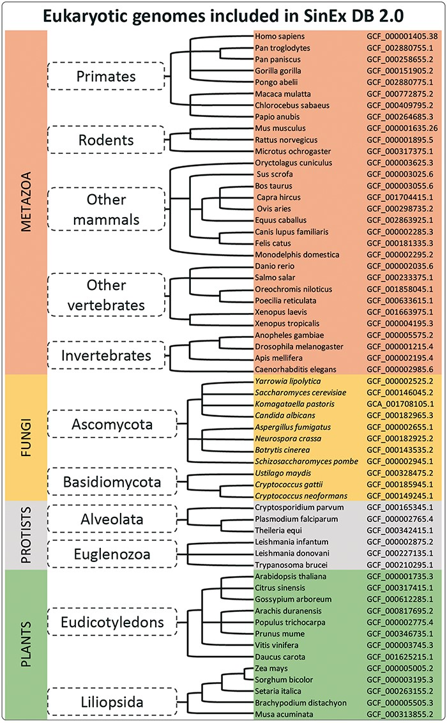
Figure 1. A simplified cladogram of genome assemblies downloaded from NCBI database. The updated SinEx DB 2.0 has ...
Notes:
Figure 1. A simplified cladogram of genome assemblies downloaded from NCBI database. The updated SinEx DB 2.0 has increased the number of genomes interrogated from 10 to 60 and has expanded the phylogenetic representation from only mammals to incorporate other eukaryotes including fungi, protists and terrestrial plants.
Unless provided in the caption above, the following copyright applies to the content of this slide: © The Author(s) 2021. Published by Oxford University Press.This is an Open Access article distributed under the terms of the Creative Commons Attribution License (http://creativecommons.org/licenses/by/4.0/), which permits unrestricted reuse, distribution, and reproduction in any medium, provided the original work is properly cited.

