Slide 1
Figure 1. Screenshot of TparvaDB interface providing access to several online tools.
Notes:
Figure 1. Screenshot of TparvaDB interface providing access to several online tools.
Unless provided in the caption above, the following copyright applies to the content of this slide: © The Author(s) 2011. Published by Oxford University Press.This is Open Access article distributed under the terms of the Creative Commons Attribution Non-Commercial License (http://creativecommons.org/licenses/by-nc/2.5), which permits unrestricted non-commercial use, distribution, and reproduction in any medium, provided the original work is properly cited.

Slide 2
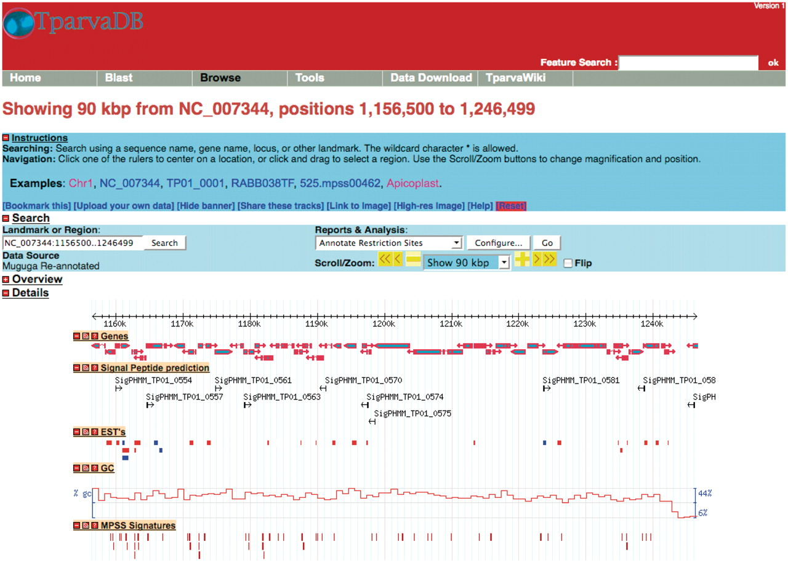
Figure 2. A representative example of the GBrowse interface. Tracks display information on annotated genes, predicted ...
Notes:
Figure 2. A representative example of the GBrowse interface. Tracks display information on annotated genes, predicted signal peptides, mapped ESTs, %GC content and MPSS signatures in a region of Chromosome 1.
Unless provided in the caption above, the following copyright applies to the content of this slide: © The Author(s) 2011. Published by Oxford University Press.This is Open Access article distributed under the terms of the Creative Commons Attribution Non-Commercial License (http://creativecommons.org/licenses/by-nc/2.5), which permits unrestricted non-commercial use, distribution, and reproduction in any medium, provided the original work is properly cited.

Slide 3
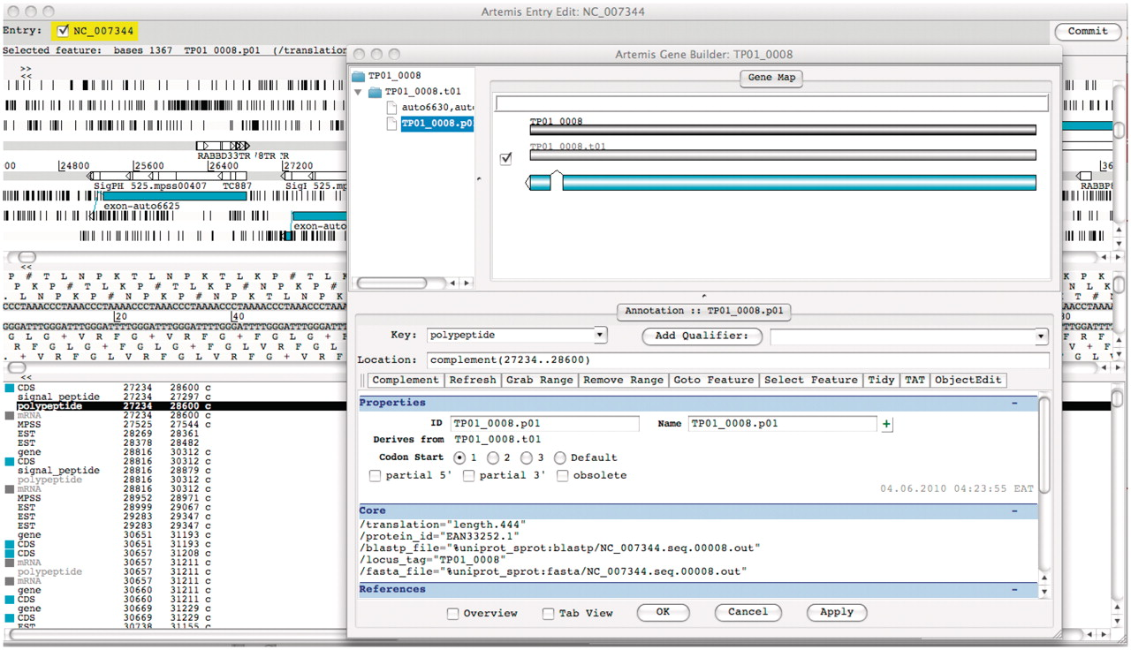
Figure 3. Screenshot of Artemis annotation tool allowing direct access to T. parva genome data in the TparvaDB database ...
Notes:
Figure 3. Screenshot of Artemis annotation tool allowing direct access to T. parva genome data in the TparvaDB database for online annotation. Background image depicts Artemis interface and foreground image depict Gene Builder view.
Unless provided in the caption above, the following copyright applies to the content of this slide: © The Author(s) 2011. Published by Oxford University Press.This is Open Access article distributed under the terms of the Creative Commons Attribution Non-Commercial License (http://creativecommons.org/licenses/by-nc/2.5), which permits unrestricted non-commercial use, distribution, and reproduction in any medium, provided the original work is properly cited.

