Slide 1
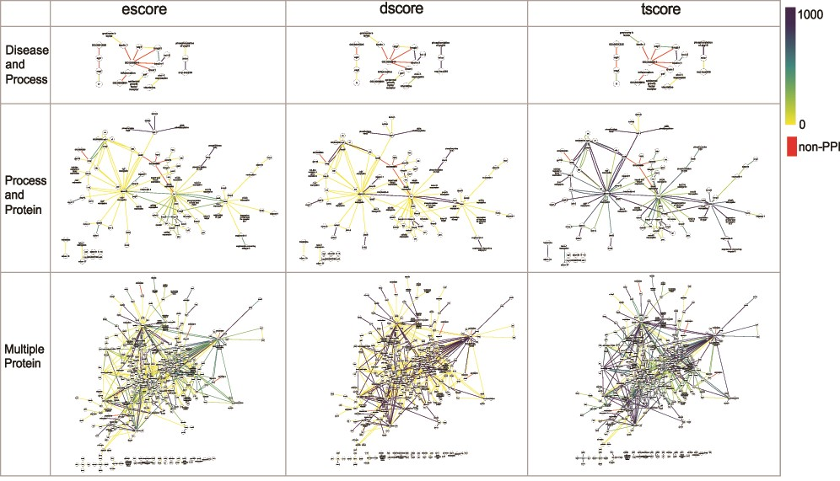
Figure 7 The networks of selected PPI interactions for the Disease and Process set (top row), Process and Protein set ...
Notes:
Figure 7 The networks of selected PPI interactions for the Disease and Process set (top row), Process and Protein set (middle row), and Multiple Protein set (bottom row), where each edge color represents a value of escore (left), dscore (middle) or tscore (right). Each PPI edge is colored by the indicated score type, from the minimum (0) to the maximum score (1000). A red edge indicates a non-PPI.
Unless provided in the caption above, the following copyright applies to the content of this slide: © The Author(s) 2020. Published by Oxford University Press.This is an Open Access article distributed under the terms of the Creative Commons Attribution License (http://creativecommons.org/licenses/by/4.0/), which permits unrestricted reuse, distribution, and reproduction in any medium, provided the original work is properly cited.

