Slide 1
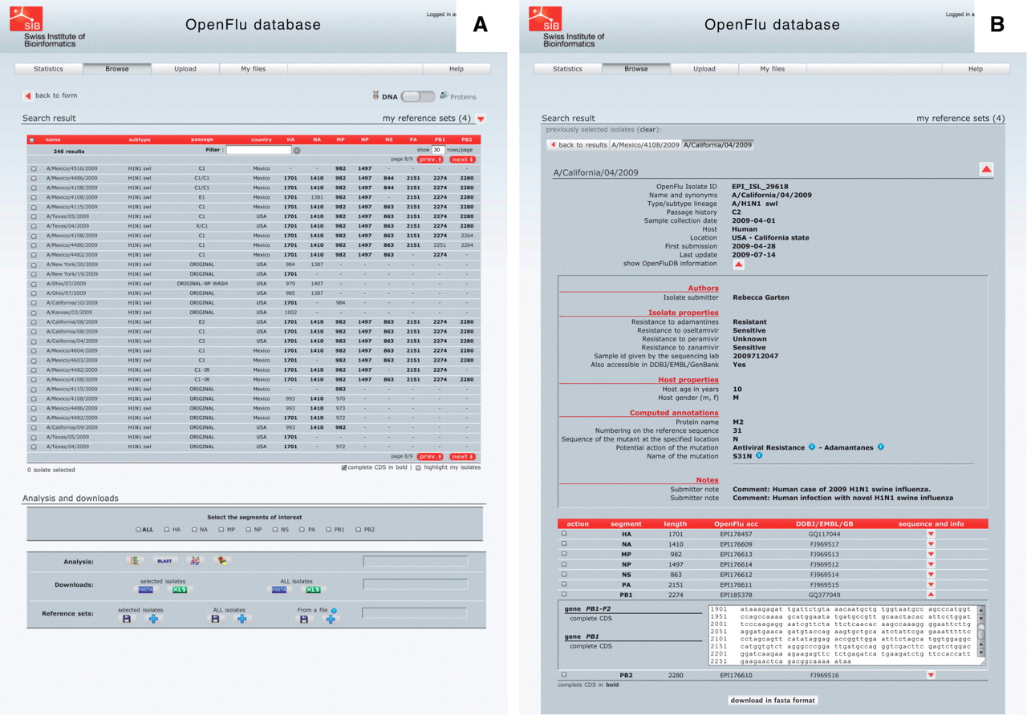
Figure 3. ‘Browse’ results are presented in an isolate-centric view. Columns contain either annotations or sequence ...
Notes:
Figure 3. ‘Browse’ results are presented in an isolate-centric view. Columns contain either annotations or sequence length. Switching between the nucleotide and protein views is done with the top right switch. Complete CDS or proteins can be highlighted in bold. Checkboxes are used to select isolates for further analysis, export or assignment to a reference set. Analysis buttons are from left to right: MUSCLE MSA, BLAST, SSMs and isolate geolocation. Isolate annotations are exported in a Microsoft Excel file and viral nucleotide or protein sequences are exported in a FASTA file.
Unless provided in the caption above, the following copyright applies to the content of this slide: © The Author(s) 2010. Published by Oxford University Press.This is Open Access article distributed under the terms of the Creative Commons Attribution Non-Commercial License (http://creativecommons.org/licenses/by-nc/2.5), which permits unrestricted non-commercial use, distribution, and reproduction in any medium, provided the original work is properly cited.

