Slide 1
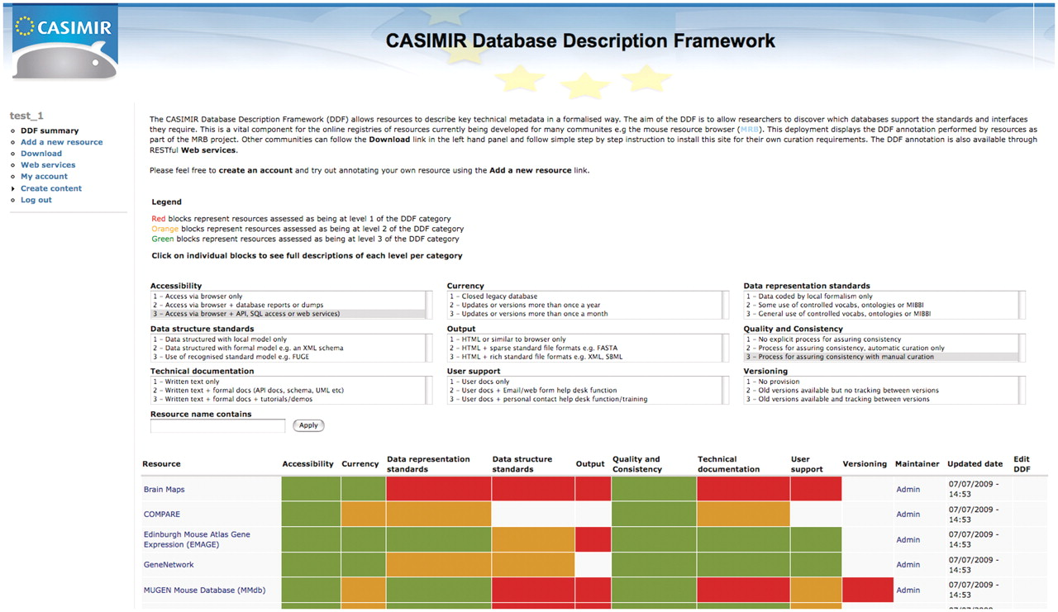
Figure 1. The DDF query and annotation tool. This tool allows any user to browse a set of resources that have been ...
Notes:
Figure 1. The DDF query and annotation tool. This tool allows any user to browse a set of resources that have been annotated using the DDF categories. Searches for resources by DDF category and level are also possible. In addition, resource maintainers can log-in and edit their existing annotations or annotate a new resource using a simple web form. This tool is freely available and easy to install for other communities that wish to create their own registry of resources.
Unless provided in the caption above, the following copyright applies to the content of this slide: © The Author(s) 2010. Published by Oxford University Press.This is Open Access article distributed under the terms of the Creative Commons Attribution Non-Commercial License (http://creativecommons.org/licenses/by-nc/2.5), which permits unrestricted non-commercial use, distribution, and reproduction in any medium, provided the original work is properly cited.

