Slide 1
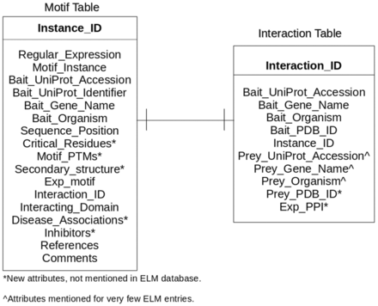
Figure 1. Entity-relationship diagram of LMPID. Asterisk (*) marked attributes present only in LMPID, whereas caret (^) ...
Notes:
Figure 1. Entity-relationship diagram of LMPID. Asterisk (*) marked attributes present only in LMPID, whereas caret (^) marked attributes were substantially enriched as compared with ELM.
Unless provided in the caption above, the following copyright applies to the content of this slide: © The Author(s) 2015. Published by Oxford University Press.This is an Open Access article distributed under the terms of the Creative Commons Attribution License (http://creativecommons.org/licenses/by/4.0/), which permits unrestricted reuse, distribution, and reproduction in any medium, provided the original work is properly cited.

Slide 2
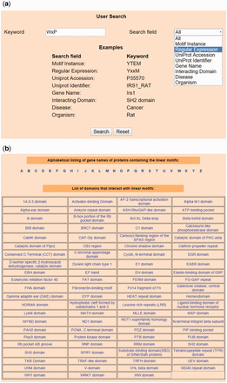
Figure 2. Snapshots of search and browse option of LMPID. ( a ) Search’ page of LMPID showing ‘WxP’ used as a keyword ...
Notes:
Figure 2. Snapshots of search and browse option of LMPID. ( a ) Search’ page of LMPID showing ‘WxP’ used as a keyword to be searched in the ‘Regular Expression’ field. ( b ) ‘Browse’ page of LMPID.
Unless provided in the caption above, the following copyright applies to the content of this slide: © The Author(s) 2015. Published by Oxford University Press.This is an Open Access article distributed under the terms of the Creative Commons Attribution License (http://creativecommons.org/licenses/by/4.0/), which permits unrestricted reuse, distribution, and reproduction in any medium, provided the original work is properly cited.

Slide 3
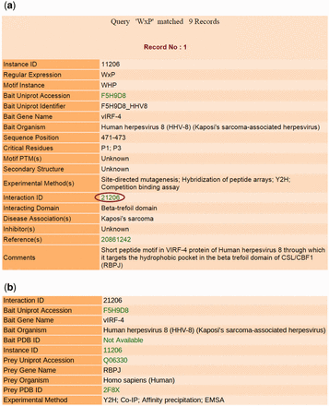
Figure 3. Output results of LMPID. ( a ) The main search result against the query ‘WxP’. ( b ) Page showing the ...
Notes:
Figure 3. Output results of LMPID. ( a ) The main search result against the query ‘WxP’. ( b ) Page showing the details of the interacting bait and prey proteins by clicking on the hyperlink ‘Interaction ID’.
Unless provided in the caption above, the following copyright applies to the content of this slide: © The Author(s) 2015. Published by Oxford University Press.This is an Open Access article distributed under the terms of the Creative Commons Attribution License (http://creativecommons.org/licenses/by/4.0/), which permits unrestricted reuse, distribution, and reproduction in any medium, provided the original work is properly cited.

