Slide 1
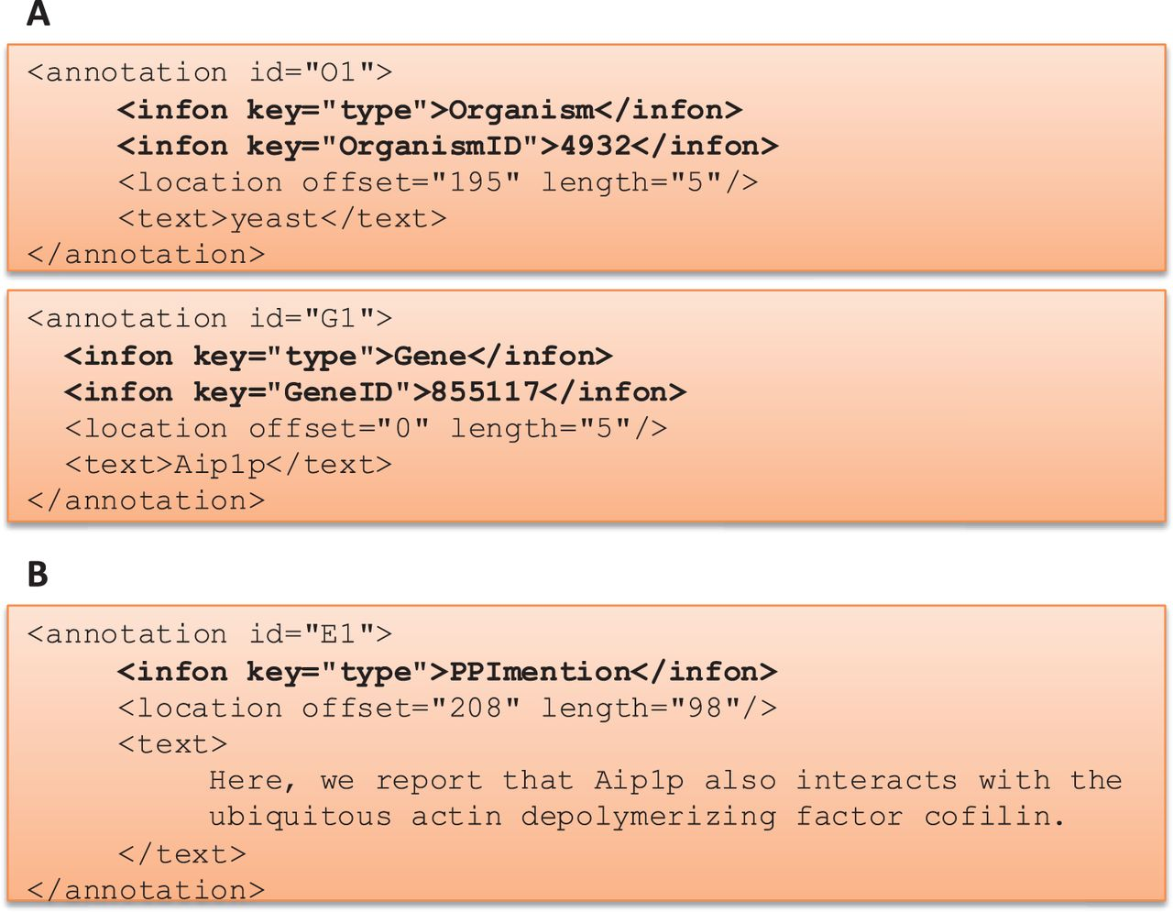
Figure 2. BioC Format for BioCreative V BioC track. (A) BioC format to share annotations for named entity recognition ...
Notes:
Figure 2. BioC Format for BioCreative V BioC track. (A) BioC format to share annotations for named entity recognition tasks: gene/protein and organism mentions and normalization. OrganismID and GeneID are NCBI Taxonomy ID and Entrez Gene ID, respectively. (B) BioC format to share annotations for the molecular interaction tasks: protein–protein interaction mention and evidence (PPImention, PPIevidence) and genetic interaction mention and evidence (GImention, GIevidence).
Unless provided in the caption above, the following copyright applies to the content of this slide: Published by Oxford University Press 2016. This work is written by US Government employees and is in the public domain in the US.

