Slide 1
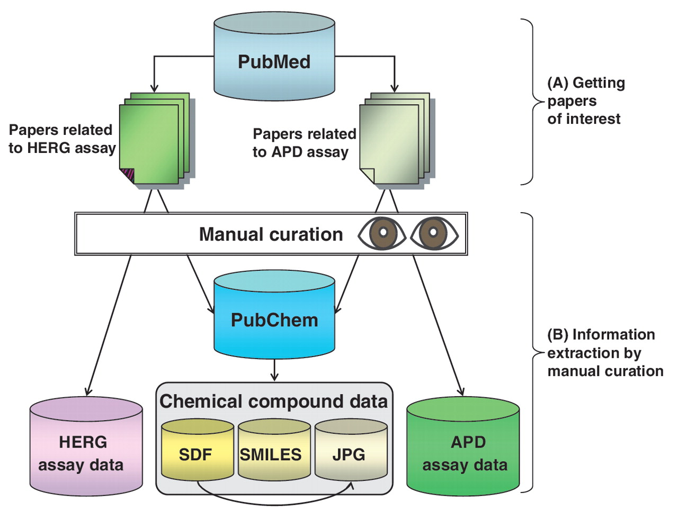
Figure 1. Overall method for hERGAPDbase data collection. (A) Two types of papers related to the hERG assay and the APD ...
Notes:
Figure 1. Overall method for hERGAPDbase data collection. (A) Two types of papers related to the hERG assay and the APD assay found in PubMed. (B) hERG assay data and APD assay data were extracted manually from scientific papers. The structural data of the chemical compounds (SDF; SMILES; and JPEG files) were obtained from PubChem.
Unless provided in the caption above, the following copyright applies to the content of this slide: © The Author(s) 2011. Published by Oxford University Press.This is Open Access article distributed under the terms of the Creative Commons Attribution Non-Commercial License (http://creativecommons.org/licenses/by-nc/2.5), which permits unrestricted non-commercial use, distribution, and reproduction in any medium, provided the original work is properly cited.

