Slide 1
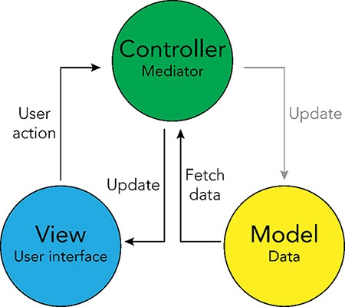
Figure 4. Model-View-Controller (MVC) software design pattern used for the UKB Health Disparities Browser. The ...
Notes:
Figure 4. Model-View-Controller (MVC) software design pattern used for the UKB Health Disparities Browser. The schematic showing the MVC software design pattern used to develop the interactive web server. Parts of the pattern that are not applicable to the current browser are grayed out.
Unless provided in the caption above, the following copyright applies to the content of this slide: Published by Oxford University Press 2023. This work is written by (a) US Government employee(s) and is in the public domain in the US.This work is written by (a) US Government employee(s) and is in the public domain in the US.

