Slide 1
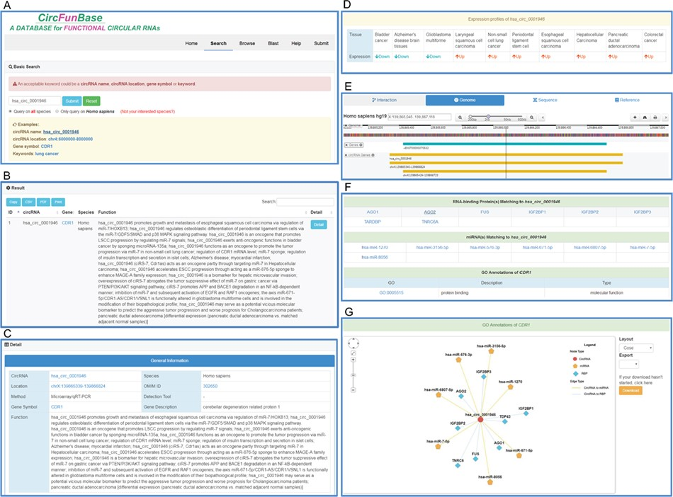
Figure 1 An overview of the user interface of CircFunBase. (A) The search page of CircFunBase. (B) Hsa_circ_0001946 as ...
Notes:
Figure 1 An overview of the user interface of CircFunBase. (A) The search page of CircFunBase. (B) Hsa_circ_0001946 as an example of input and the search result. (C) Detailed information of hsa_circ_0001946. (D) The expression pattern of hsa_circ_0001946. (E) Visualization of the circRNA genome location. (F) CircRNA-associated interactions and GO annotations of parent genes. (G) Visualization of circRNA-associated interactions.
Unless provided in the caption above, the following copyright applies to the content of this slide: © The Author(s) 2019. Published by Oxford University Press.This is an Open Access article distributed under the terms of the Creative Commons Attribution License (http://creativecommons.org/licenses/by/4.0/), which permits unrestricted reuse, distribution, and reproduction in any medium, provided the original work is properly cited.

