Slide 1
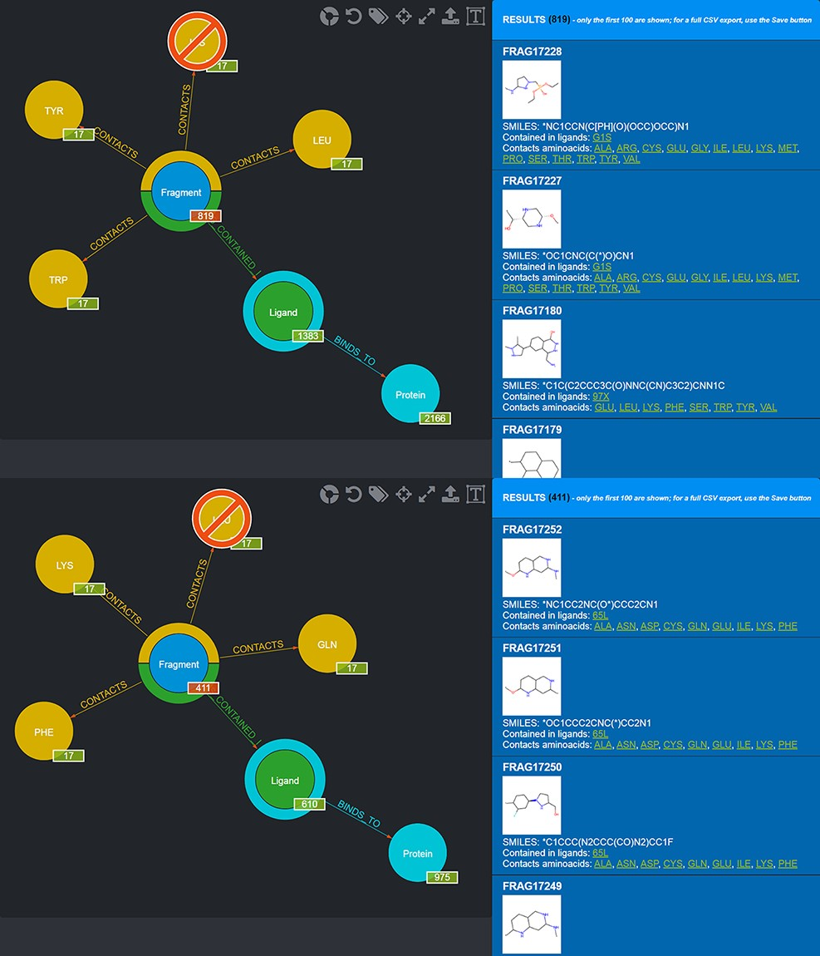
Figure 8. Screenshot of the graphical queries done to extract from the database those fragments observed to contact the ...
Notes:
Figure 8. Screenshot of the graphical queries done to extract from the database those fragments observed to contact the amino acids lining the first (top panel) and the second (bottom panel) subpocket of MELK with, on the right side, a preview of the results of the queries.
Unless provided in the caption above, the following copyright applies to the content of this slide: © The Author(s) 2022. Published by Oxford University Press.This is an Open Access article distributed under the terms of the Creative Commons Attribution-NonCommercial License (https://creativecommons.org/licenses/by-nc/4.0/), which permits non-commercial re-use, distribution, and reproduction in any medium, provided the original work is properly cited. For commercial re-use, please contact journals.permissions@oup.com

