Slide 1
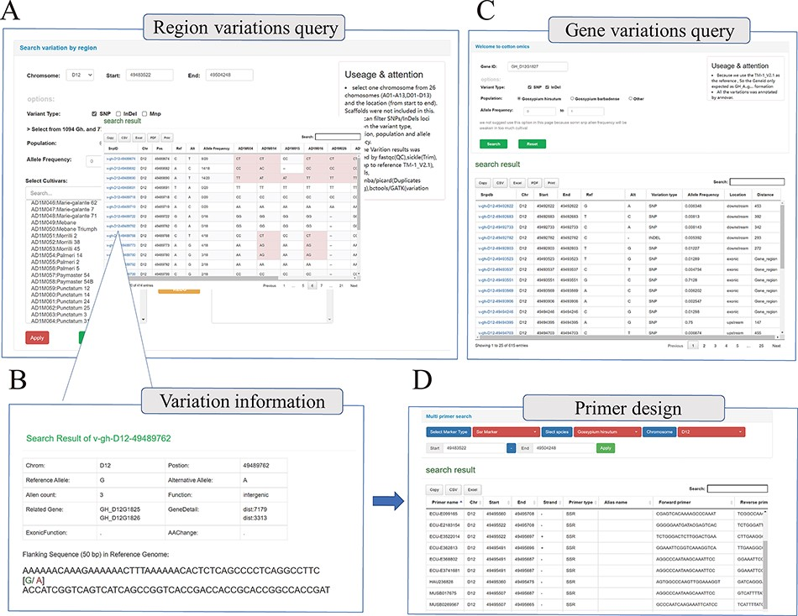
Figure 3. Whole genome-wide variations query interface. (A) Variation information regarding genome region (e.g. ...
Notes:
Figure 3. Whole genome-wide variations query interface. (A) Variation information regarding genome region (e.g. D12:49 483 522–49 504 248) among different cotton samples. (B) Detailed introduction of the mutation site (e.g. v-gh-D12-49 489 762), including location information, related genes, function prediction and flank sequence. (C) Variations query based on gene locus (e.g. GH_D12G1827); this interface will return all the mutation sites related to the gene, including upstream, downstream, UTR, exon, etc. (D) Multi-type primer design interface; users can obtain SSR primers and InDel primers based on locus.
Unless provided in the caption above, the following copyright applies to the content of this slide: © The Author(s) 2022. Published by Oxford University Press.This is an Open Access article distributed under the terms of the Creative Commons Attribution-NonCommercial License (https://creativecommons.org/licenses/by-nc/4.0/), which permits non-commercial re-use, distribution, and reproduction in any medium, provided the original work is properly cited. For commercial re-use, please contact journals.permissions@oup.com

