Slide 1
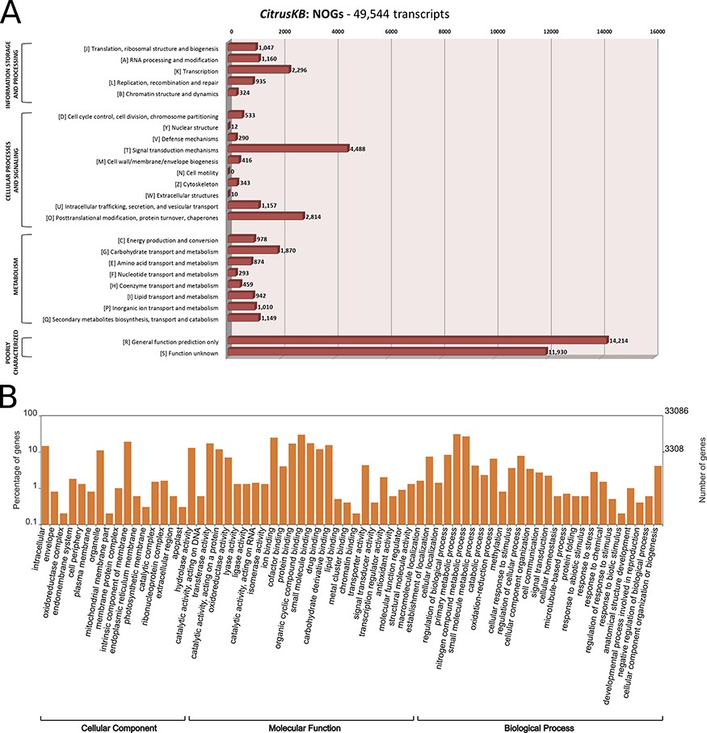
Figure 2. Annotation of Citrus sinensis CitrusKB transcriptome. EggNOG (A) and representative GO terms (B). ...
Notes:
Figure 2. Annotation of Citrus sinensis CitrusKB transcriptome. EggNOG (A) and representative GO terms (B). Functionally annotated orthologous groups are represented in the Y axis of eggNOG annotation. For each annotated group, we have the identification of the functional category of the group (J, A, K, L, B, D, Y, V, T, M, N, Z, W, U, O, C, G, E, F, H, I, P, Q, R, S) followed by its description. The Y axis of GO annotations is presented in log (10) scale. Both, eggNOG and GO terms are fully searchable trough the Gene expression tables.
Unless provided in the caption above, the following copyright applies to the content of this slide: © The Author(s) 2020. Published by Oxford University Press.This is an Open Access article distributed under the terms of the Creative Commons Attribution License (http://creativecommons.org/licenses/by/4.0/), which permits unrestricted reuse, distribution, and reproduction in any medium, provided the original work is properly cited.

Slide 2
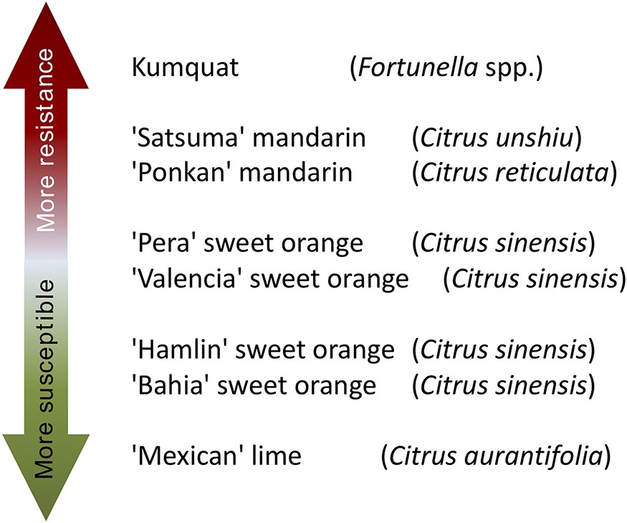
Figure 1. Citrus genotypes resistance and susceptibility scale to citrus canker A. ‘More resistant’ indicates that a ...
Notes:
Figure 1. Citrus genotypes resistance and susceptibility scale to citrus canker A. ‘More resistant’ indicates that a citrus genotype is more resistant to citrus canker disease, as well as ‘More susceptible’ indicates that a citrus genotype is less resistant to citrus canker disease.
Unless provided in the caption above, the following copyright applies to the content of this slide: © The Author(s) 2020. Published by Oxford University Press.This is an Open Access article distributed under the terms of the Creative Commons Attribution License (http://creativecommons.org/licenses/by/4.0/), which permits unrestricted reuse, distribution, and reproduction in any medium, provided the original work is properly cited.

Slide 3
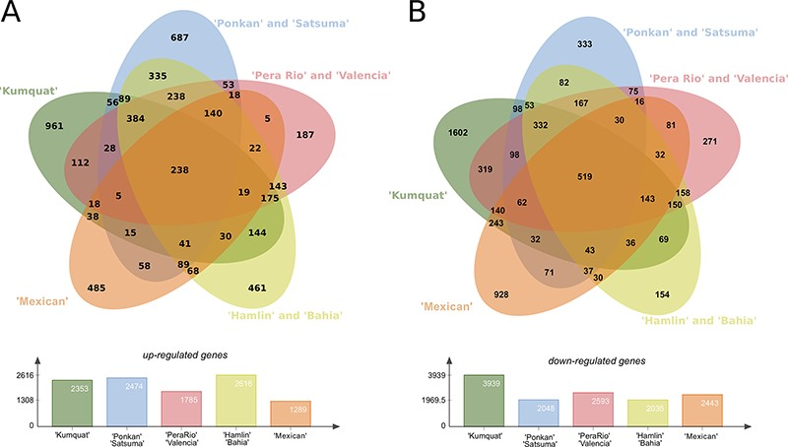
Figure 4. Differentially expressed genes (DEGs) present in the eight citrus genotypes considering the three analysed ...
Notes:
Figure 4. Differentially expressed genes (DEGs) present in the eight citrus genotypes considering the three analysed time stages (24, 48 and 72 h) post X. citri inoculation. (A) Upper panel, Venn diagram with the Up-regulated transcripts; Lower panel, total number of DEGs for each analysed genotype group. (B) Upper panel, venn diagram with the Down-regulated transcripts; Lower panel, total number of DEGs for each analysed genotype group.
Unless provided in the caption above, the following copyright applies to the content of this slide: © The Author(s) 2020. Published by Oxford University Press.This is an Open Access article distributed under the terms of the Creative Commons Attribution License (http://creativecommons.org/licenses/by/4.0/), which permits unrestricted reuse, distribution, and reproduction in any medium, provided the original work is properly cited.

