Slide 1
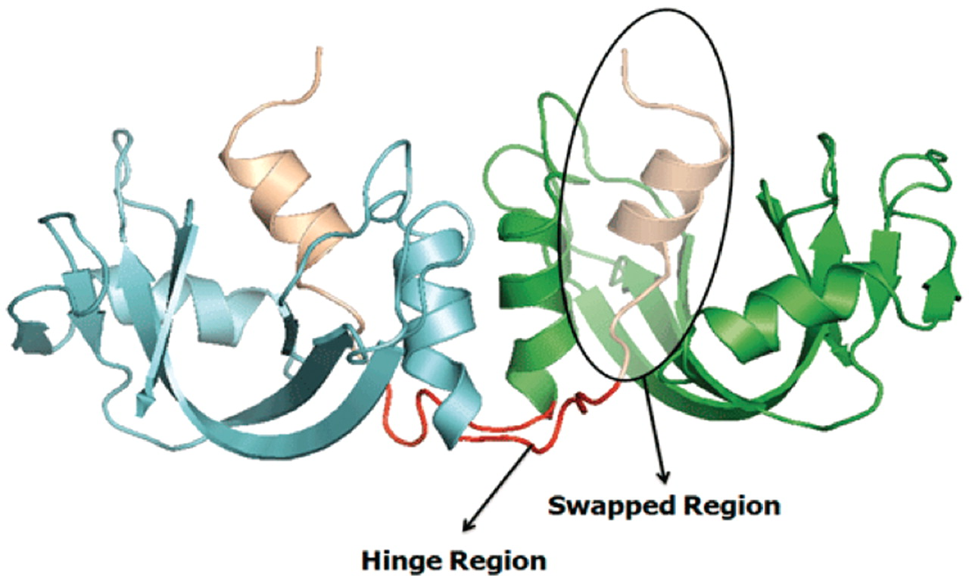
Figure 1. Example of a bona fide domain swapping structure: bovine seminal ribonuclease (PDB ID: 11BG) in 3D domain ...
Notes:
Figure 1. Example of a bona fide domain swapping structure: bovine seminal ribonuclease (PDB ID: 11BG) in 3D domain swap conformation with highlighted hinge and swapped regions. Individual chains are colored in cyan and green. Hinge regions are colored in red and swapped region is colored in coffee brown.
Unless provided in the caption above, the following copyright applies to the content of this slide: © The Author(s) 2011. Published by Oxford University Press.This is Open Access article distributed under the terms of the Creative Commons Attribution Non-Commercial License (http://creativecommons.org/licenses/by-nc/2.5), which permits unrestricted non-commercial use, distribution, and reproduction in any medium, provided the original work is properly cited.

