Slide 1
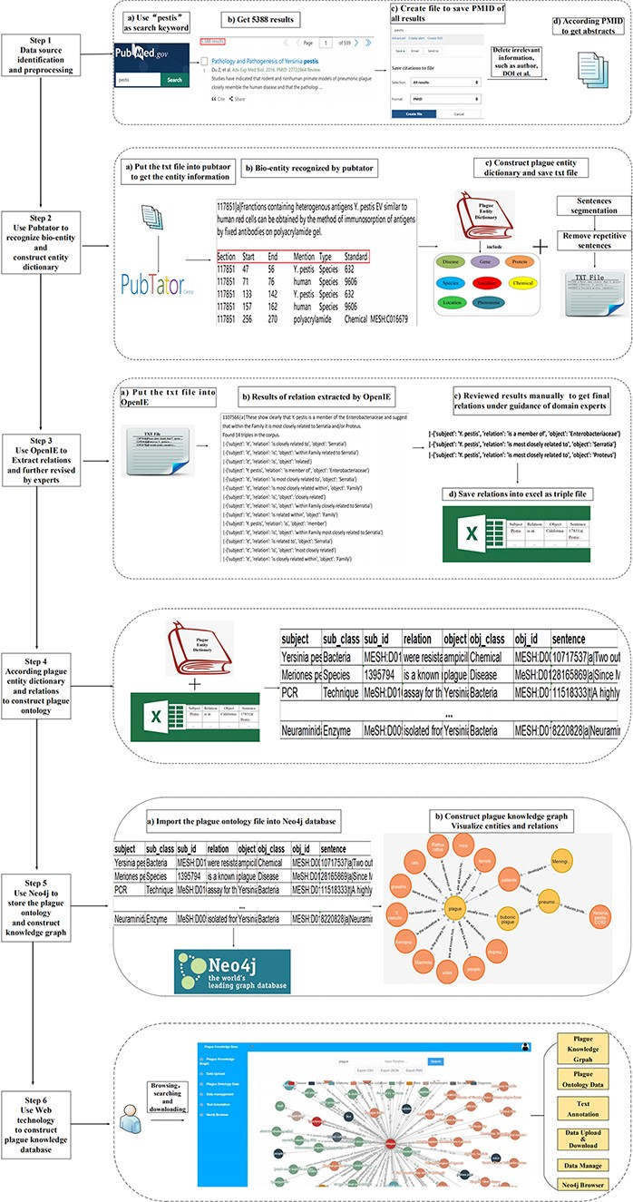
Figure 1. The workflow for constructing plague knowledge database.
Notes:
Figure 1. The workflow for constructing plague knowledge database.
Unless provided in the caption above, the following copyright applies to the content of this slide: © The Author(s) 2022. Published by Oxford University Press.This is an Open Access article distributed under the terms of the Creative Commons Attribution-NonCommercial License (https://creativecommons.org/licenses/by-nc/4.0/), which permits non-commercial re-use, distribution, and reproduction in any medium, provided the original work is properly cited. For commercial re-use, please contact journals.permissions@oup.com

Slide 2
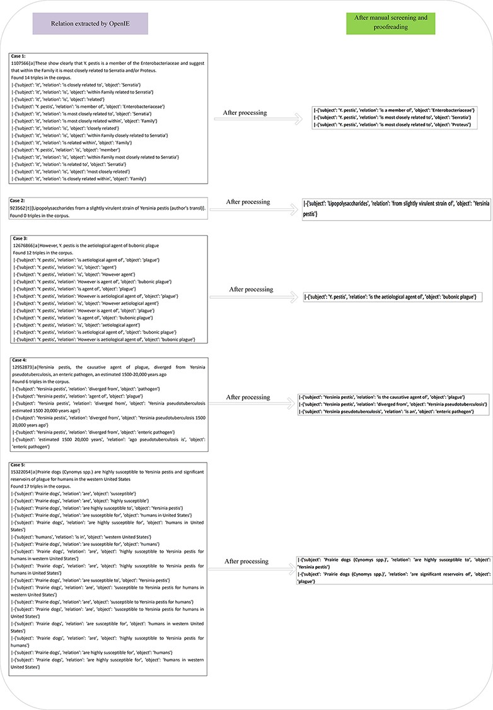
Figure 2. The process of processing triads manually.
Notes:
Figure 2. The process of processing triads manually.
Unless provided in the caption above, the following copyright applies to the content of this slide: © The Author(s) 2022. Published by Oxford University Press.This is an Open Access article distributed under the terms of the Creative Commons Attribution-NonCommercial License (https://creativecommons.org/licenses/by-nc/4.0/), which permits non-commercial re-use, distribution, and reproduction in any medium, provided the original work is properly cited. For commercial re-use, please contact journals.permissions@oup.com

Slide 3
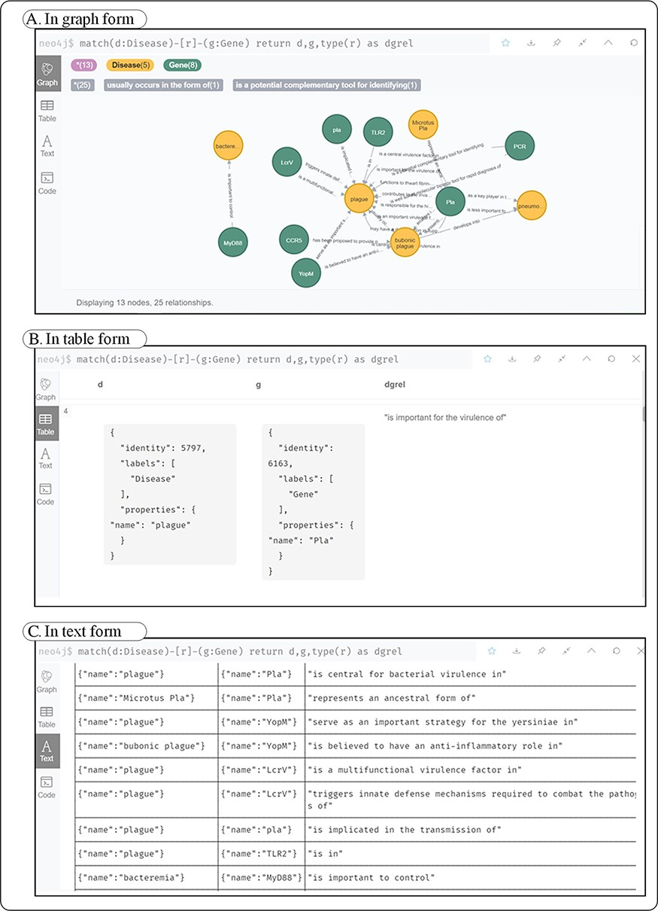
Figure 3. Three forms of disease–gene query results in Neo4j. (A) A kind of form in graph; (B) shows a kind of form in ...
Notes:
Figure 3. Three forms of disease–gene query results in Neo4j. (A) A kind of form in graph; (B) shows a kind of form in table; (C) a kind of form in text.
Unless provided in the caption above, the following copyright applies to the content of this slide: © The Author(s) 2022. Published by Oxford University Press.This is an Open Access article distributed under the terms of the Creative Commons Attribution-NonCommercial License (https://creativecommons.org/licenses/by-nc/4.0/), which permits non-commercial re-use, distribution, and reproduction in any medium, provided the original work is properly cited. For commercial re-use, please contact journals.permissions@oup.com

Slide 4
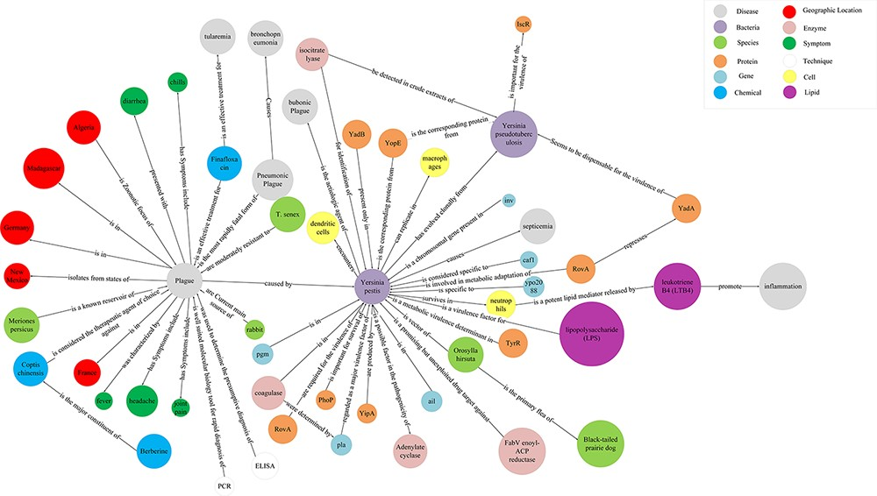
Figure 4. Subgraph of the plague knowledge graph.
Notes:
Figure 4. Subgraph of the plague knowledge graph.
Unless provided in the caption above, the following copyright applies to the content of this slide: © The Author(s) 2022. Published by Oxford University Press.This is an Open Access article distributed under the terms of the Creative Commons Attribution-NonCommercial License (https://creativecommons.org/licenses/by-nc/4.0/), which permits non-commercial re-use, distribution, and reproduction in any medium, provided the original work is properly cited. For commercial re-use, please contact journals.permissions@oup.com

Slide 5
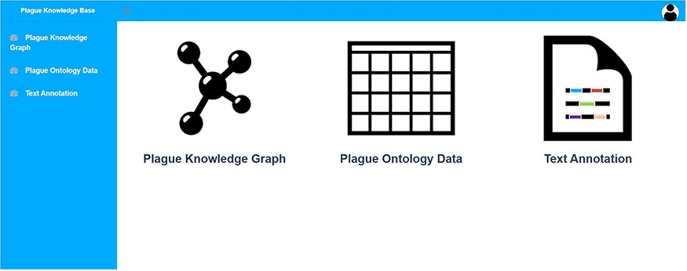
Figure 5. System home page.
Notes:
Figure 5. System home page.
Unless provided in the caption above, the following copyright applies to the content of this slide: © The Author(s) 2022. Published by Oxford University Press.This is an Open Access article distributed under the terms of the Creative Commons Attribution-NonCommercial License (https://creativecommons.org/licenses/by-nc/4.0/), which permits non-commercial re-use, distribution, and reproduction in any medium, provided the original work is properly cited. For commercial re-use, please contact journals.permissions@oup.com

Slide 6
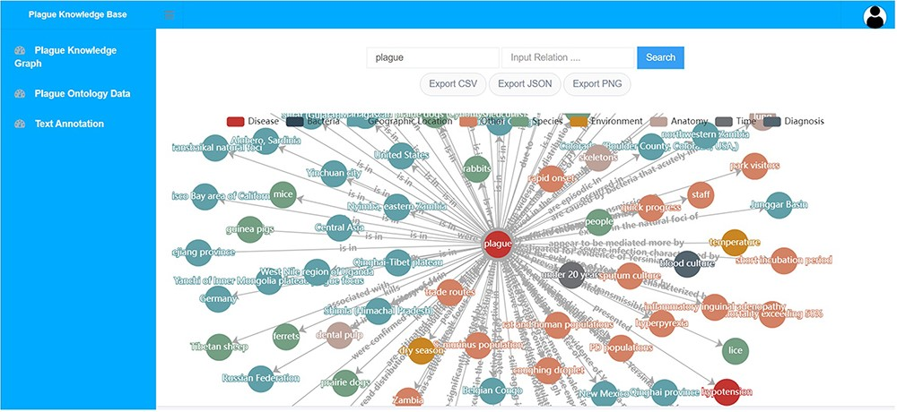
Figure 6. Plague knowledge graph visualization module.
Notes:
Figure 6. Plague knowledge graph visualization module.
Unless provided in the caption above, the following copyright applies to the content of this slide: © The Author(s) 2022. Published by Oxford University Press.This is an Open Access article distributed under the terms of the Creative Commons Attribution-NonCommercial License (https://creativecommons.org/licenses/by-nc/4.0/), which permits non-commercial re-use, distribution, and reproduction in any medium, provided the original work is properly cited. For commercial re-use, please contact journals.permissions@oup.com

Slide 7
Figure 7. Text automatic annotation module.
Notes:
Figure 7. Text automatic annotation module.
Unless provided in the caption above, the following copyright applies to the content of this slide: © The Author(s) 2022. Published by Oxford University Press.This is an Open Access article distributed under the terms of the Creative Commons Attribution-NonCommercial License (https://creativecommons.org/licenses/by-nc/4.0/), which permits non-commercial re-use, distribution, and reproduction in any medium, provided the original work is properly cited. For commercial re-use, please contact journals.permissions@oup.com

Slide 8
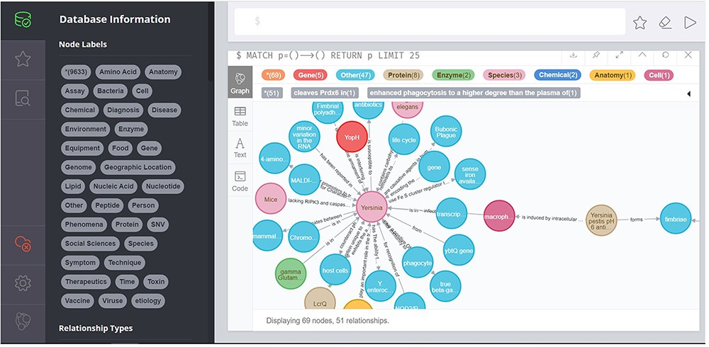
Figure 8. Plague knowledge graph visualization based on the Neo4j module.
Notes:
Figure 8. Plague knowledge graph visualization based on the Neo4j module.
Unless provided in the caption above, the following copyright applies to the content of this slide: © The Author(s) 2022. Published by Oxford University Press.This is an Open Access article distributed under the terms of the Creative Commons Attribution-NonCommercial License (https://creativecommons.org/licenses/by-nc/4.0/), which permits non-commercial re-use, distribution, and reproduction in any medium, provided the original work is properly cited. For commercial re-use, please contact journals.permissions@oup.com

Slide 9
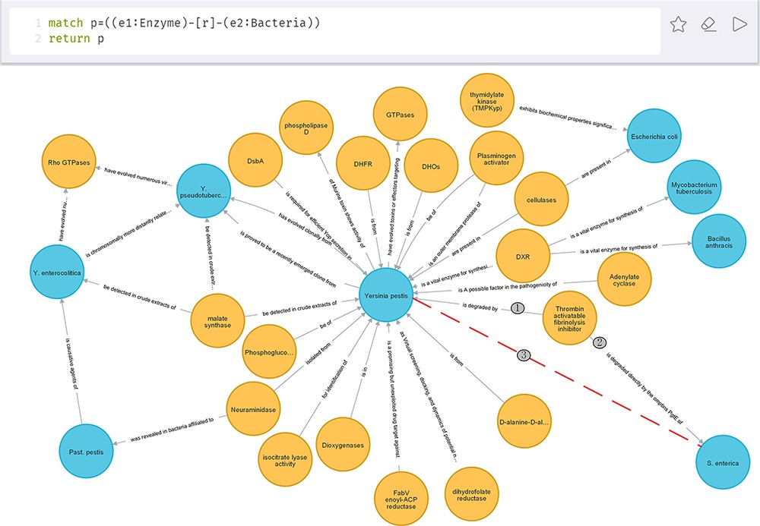
Figure 9. Relations between enzyme and bacteria.
Notes:
Figure 9. Relations between enzyme and bacteria.
Unless provided in the caption above, the following copyright applies to the content of this slide: © The Author(s) 2022. Published by Oxford University Press.This is an Open Access article distributed under the terms of the Creative Commons Attribution-NonCommercial License (https://creativecommons.org/licenses/by-nc/4.0/), which permits non-commercial re-use, distribution, and reproduction in any medium, provided the original work is properly cited. For commercial re-use, please contact journals.permissions@oup.com

Slide 10
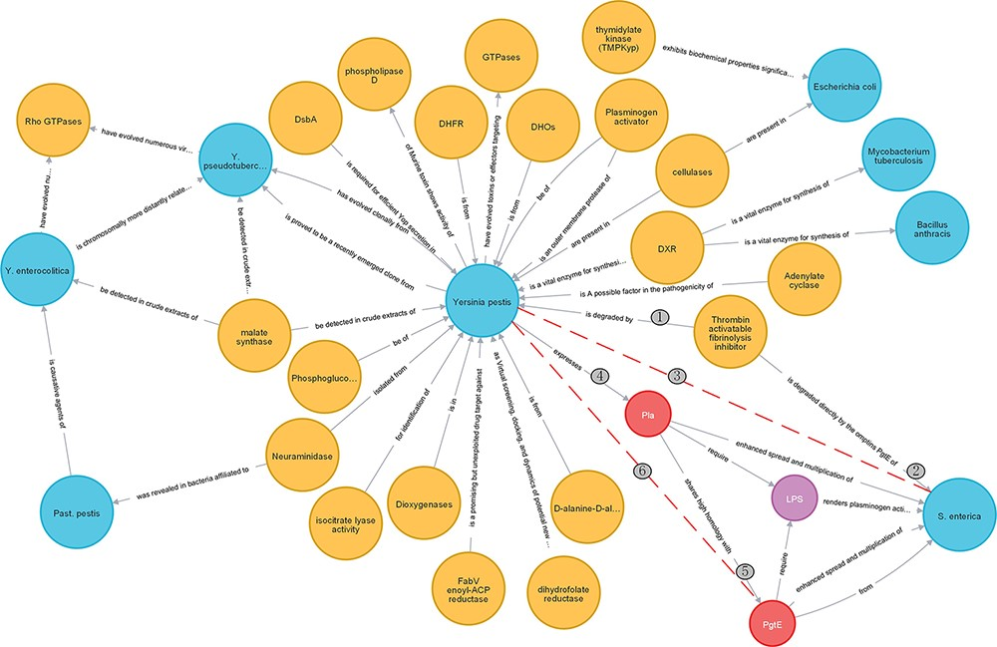
Figure 10. Extended relations.
Notes:
Figure 10. Extended relations.
Unless provided in the caption above, the following copyright applies to the content of this slide: © The Author(s) 2022. Published by Oxford University Press.This is an Open Access article distributed under the terms of the Creative Commons Attribution-NonCommercial License (https://creativecommons.org/licenses/by-nc/4.0/), which permits non-commercial re-use, distribution, and reproduction in any medium, provided the original work is properly cited. For commercial re-use, please contact journals.permissions@oup.com

Slide 11
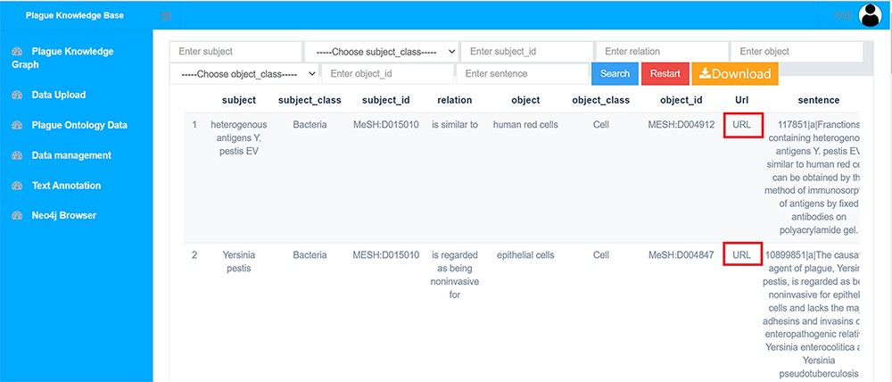
Figure 11. Plague knowledge in list format.
Notes:
Figure 11. Plague knowledge in list format.
Unless provided in the caption above, the following copyright applies to the content of this slide: © The Author(s) 2022. Published by Oxford University Press.This is an Open Access article distributed under the terms of the Creative Commons Attribution-NonCommercial License (https://creativecommons.org/licenses/by-nc/4.0/), which permits non-commercial re-use, distribution, and reproduction in any medium, provided the original work is properly cited. For commercial re-use, please contact journals.permissions@oup.com

